Slide 1
2026 WAC Summit Erwin Resin Solutions Presentation
Jake Gardner

Slide 2
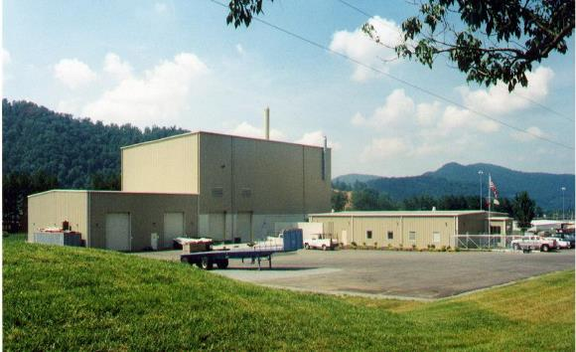
EnergySolutions’ Waste Acceptance and Customer Portal Overview
Facility Overview – Erwin ResinSolutions
Erwin ResinSolutions safely and compliantly operates under a Radioactive Material License issued by the Tennessee Department of Environment and Conservation (TDEC) Department of Radiological Health (TDRH) (license initially issued in 1996).

Slide 3
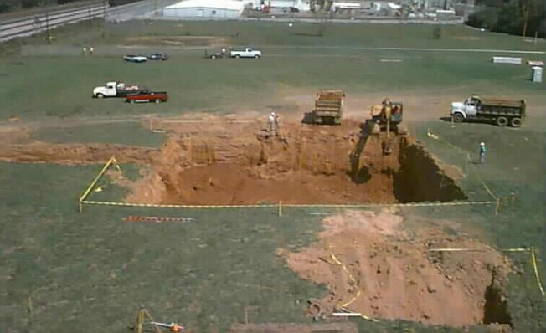
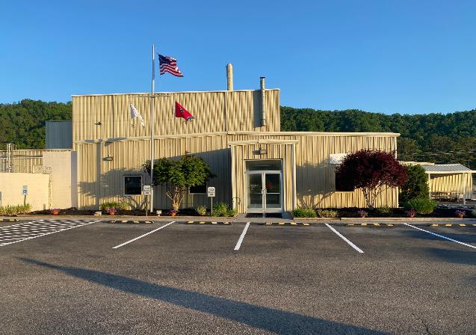
EnergySolutions’ Waste Acceptance and Customer Portal Overview
Facility Overview – Erwin ResinSolutions
Commissioned in 1996, building completed in summer of 1999 and put into full production early 2000.
  Over 26 years operation
  >600,000 ft3 resins processed
  >230,000 Ci processed
  Excellent volume reduction
    5:1 to 12:1 for Ion Exchange resin
  Designed annual processing capacity 38,000 ft3

Slide 4
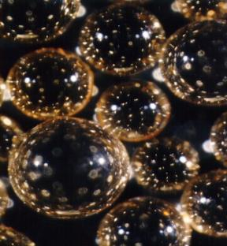
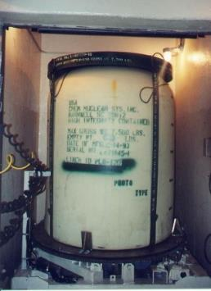
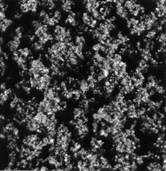

EnergySolutions’ Waste Acceptance and Customer Portal Overview
Process Overview – Erwin ResinSolutions
Steam Reforming Process
Organic Resin
Pyrolyzed Resin
Reformed Resin
Heat
Mineral Former
Heat
Oxygen from Superheated Steam
Polystyrene Beads
Organics
Metals
Water
Salts
Fixed Carbon
Salts
Metal Oxides, Spinels, and Aluminates
Metal Oxides, Spinels,
and Aluminates
Salts
Residual Fixed Carbon

Slide 5

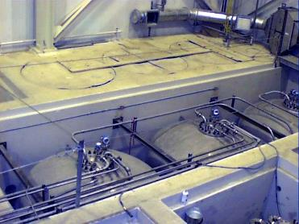
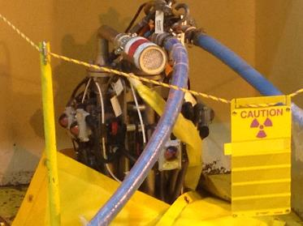
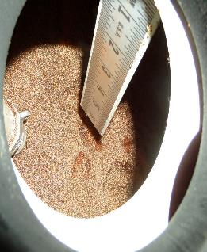
EnergySolutions’ Waste Acceptance and Customer Portal Overview
Process Overview – Erwin ResinSolutions
Resin Consolidation, Mixing & Dewatering Process
SEDS System: Transfer and Dewater
Mechanical Mixing in Storage Tanks
Organic Resin
Resin for Burial
Polystyrene Beads
Organics
Metals
Water
Salts
Ensures homogenous mix
regardless if
Steam Reforming
process is used
Removes Water
Polystyrene Beads
Organics
Metals
Salts

Slide 6
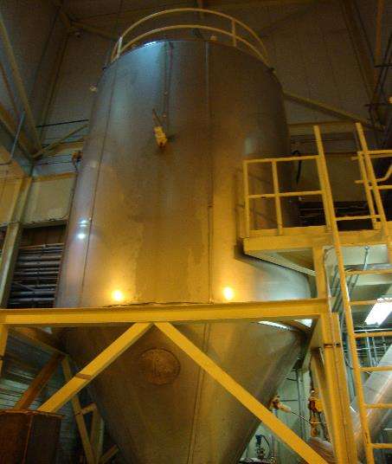
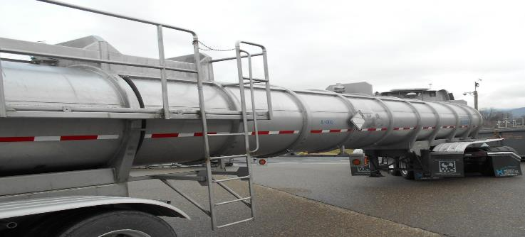
EnergySolutions’ Waste Acceptance and Customer Portal Overview
Process Overview – Erwin ResinSolutions
Liquid Waste Processing
Spray drying system efficiently evaporates liquids and collects solids for disposal
>25,000 ft3 processed
Appropriate for established waste streams such as salt water
Inappropriate for wastes with high concentrations of active organic materials (Steam Reforming would be a more appropriate processing method)

Slide 7
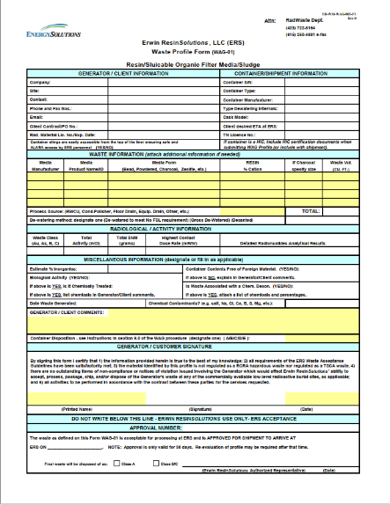
EnergySolutions’ Waste Acceptance Criteria and Customer Portal Overview
ERS Waste Acceptance Process
Prior to Shipping:
Must have a valid Contract with EnergySolutions for waste processing at ERS
Tennessee License for Delivery (Issued by TN Rad Health Department)
Waste Profile Form (Signed / Approved by ERS, valid for 30 days)

Slide 8
EnergySolutions’ Waste Acceptance Criteria and Customer Portal Overview
ERS Waste Acceptance Process
Prior to Shipping (continued):
A “Return of Waste” agreement must be in place to ensure any processed or unprocessed waste may be returned if necessary
Non-Southeast Compact Generators must have Interregional Access Agreement signatory
Generator must inform ERS of any NOV’s or contractual issues that could impact ERS’s ability to process, package or dispose of waste.

Slide 9
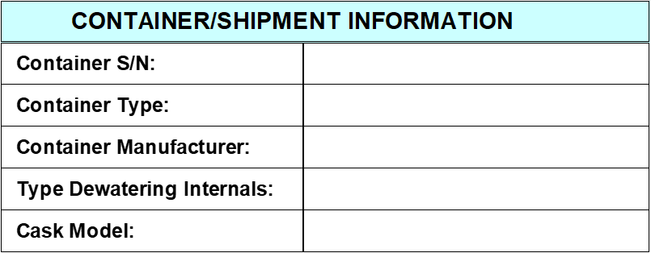
EnergySolutions’ Waste Acceptance Criteria and Customer Portal Overview
ERS Waste Acceptance Process
Waste Profile Form
Submitted a minimum of 48 hours ahead of proposed shipping date (please provide to ERS as early as possible, as it makes the approval process easier)
Characterization Data must be submitted as well (also the earlier the better)
The form is self explanatory, but these are key data points
  RML, TNLFD, Container Type (ES-210, EL-210, Carbon Steel, Stainless Steel, Poly)
  Block “Type Dewatering Internals”
  *Due to the difficulty of removing resins from containers with FEDX internals, sheet filters and sludge internals, containers with these types of internals will only be accepted on a case-by-case basis. *
  Container Disposition: Be sure to complete this with corresponding letter
    A-refurb/ return, B- inspect / return, C- disposal (ERS discretion), D- THOR liner, E-other

Slide 10
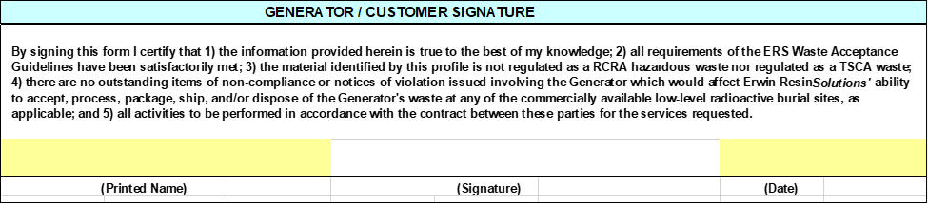
EnergySolutions’ Waste Acceptance Criteria and Customer Portal Overview
ERS Waste Acceptance Process
Waste Profile Form (continued)
Must be signed by the Generator when submitting
Approval Number: ERS issued unique number for each shipment. This must be reflected on the NRC Form 540 in the “Shipment ID” block
Signed by ERS and an approved shipment arrival date will be assigned.
Any delays in shipping (weather, mechanical issues, etc.) must be communicated immediately to ERS logistics personnel
This form is valid for 30 days after it is approved, any extensions will need to be re-approved by ERS.

Slide 11
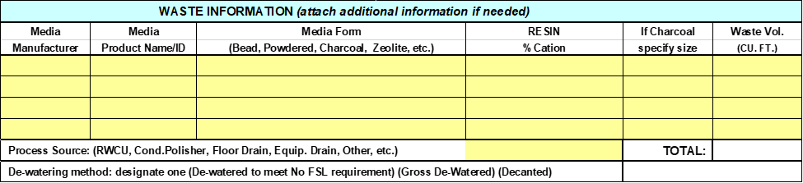
EnergySolutions’ Waste Acceptance Criteria and Customer Portal Overview
ERS Waste Acceptance Process
General Waste Guidelines
ALARA
Waste Information

Slide 12
EnergySolutions’ Waste Acceptance Criteria and Customer Portal Overview
ERS Waste Acceptance Process
General Waste Guidelines
ERS WAG- available online at EnergySolution’s Customer Portal
Waste that exceeds the WAG limits may approved on a case-by-case basis
Waste Types Processed at ERS- Resins, Aqueous Liquids, Oils and Sludge
All waste approvals are based upon ERS storage capacity and RML conditions being met

Slide 13
EnergySolutions’ Waste Acceptance Criteria and Customer Portal Overview
ERS Waste Acceptance Process
General Waste Information

Slide 14
EnergySolutions’ Waste Acceptance Criteria and Customer Portal Overview
ERS Waste Acceptance Process
Radiation / Contamination Levels
Contact Dose Rates : Unshielded waste container
  < 100 R/hr Resin / Filter Media
  < 10 R/hr (all others)
Removable External Contamination:
  < 1,000 dpm beta- gamma/ 100 cm2
  < 20 dpm alpha/ 100 cm2

Slide 15
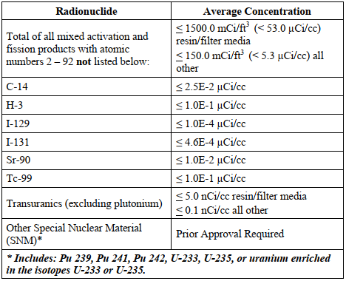
EnergySolutions’ Waste Acceptance Criteria and Customer Portal Overview
ERS Waste Acceptance Process
Radionuclide Guidelines: **The radionuclide concentration per package shall not exceed the following group or individual guidelines without specific written approval.**
**All SNM requires specific approval**

Slide 16
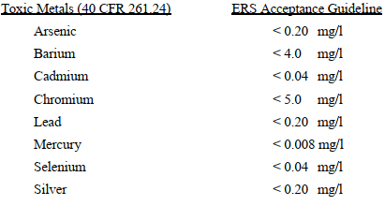
EnergySolutions’ Waste Acceptance Criteria and Customer Portal Overview
ERS Waste Acceptance Process
RCRA / TSCA Analysis
ERS is not permitted for RCRA / TSCA regulated materials
Generators are responsible for testing waste to ensure that it is not RCRA / TSCA regulated
Toxicity Characteristic Leaching Procedure (TCLP) WAG limits

Slide 17
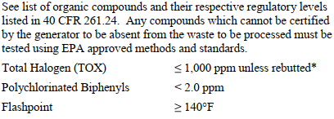
EnergySolutions’ Waste Acceptance Criteria and Customer Portal Overview
ERS Waste Acceptance Process
        RCRA / TSCA Analysis (continued)
ORGANICS:
Waste may contain up to 4000 ppm (TOX), if appropriate mixing has occurred and can be demonstrated.

Slide 18
EnergySolutions’ Waste Acceptance Criteria and Customer Portal Overview
ERS Waste Acceptance
Packaging Requirements
All packaging must be in metal (Carbon or Stainless Steel) or plastic containers. All packaging must be compatible with waste contents and meet applicable DOT regulations.
All containers not provided by ERS must have prior arrangements for disposition of empty packages.

Slide 19
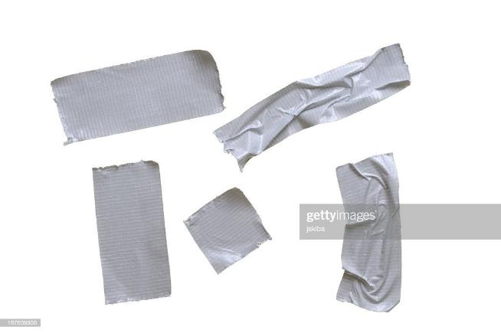
EnergySolutions’ Waste Acceptance Criteria and Customer Portal Overview
ERS Waste Acceptance
Foreign Material Clause
All packages must be free of foreign material (duct tape, ppe, plastics, tie wraps, etc.) that could inhibit sluicing of material
  Any packages that are suspected or known to have foreign materials must have ERS approval prior to shipping, case by case evaluation.

Slide 20
EnergySolutions’ Waste Acceptance Criteria and Customer Portal Overview
ERS Waste Acceptance
Non-Conforming Waste
Any waste that is found to be non-conforming will be dispositioned as required by applicable regulations or returned to the Generator (at Generator’s expense).

Slide 21
EnergySolutions’ Waste Acceptance Criteria and Customer Portal Overview
ERS Waste Acceptance
Resin / Sluiceable Filter Media Requirements
Processing can be performed on a wide variety of organic waste media including bead resin, powdered resin, activated carbon (charcoal), and other powdered filter media. Waste media must meet the following specific guidelines for processing unless written approval is provided by ERS. No exceptions will be granted for hazardous waste.
Inorganics (i.e. dirt, metal oxides, etc.) ≤ 5 wt%
Soluble inorganics < 1%
Particle Size < 5/32”
Aqueous Liquids Content ≤3 inches above waste surface
Non-hazardous by RCRA/TSCA Guidelines (section 6.3 of the WAC)

Slide 22
EnergySolutions’ Waste Acceptance Criteria and Customer Portal Overview
ERS Waste Acceptance
Aqueous Liquids Requirements
pH Range: 5-9
Solids Content: < 10% volume
Oil Content: < 10% volume
Particle Size: < 5/32”
Chelating Agents: < 20% volume
Non-hazardous by RCRA/TSCA Guidelines (section 6.3 of the WAC)

Slide 23
EnergySolutions’ Waste Acceptance Criteria and Customer Portal Overview
ERS Waste Acceptance
Contaminated Oil Requirements
Viscosity: <40 weight (<100ssu)
Solids Content: < 10% volume
Oil Content: < 10% volume
Particle Size: < 5/32”
Aqueous Liquids Content: < 20% volume
Non-hazardous by RCRA/TSCA Guidelines (section 6.3 of the WAC)

Slide 24
EnergySolutions’ Waste Acceptance Criteria and Customer Portal Overview
ERS Waste Acceptance
Sludge Requirements
  Must be < WAG Limits for Metals & Organics
  No Listed Waste
  No RCRA / TSCA regulated material

Slide 25
EnergySolutions’ Waste Acceptance Criteria and Customer Portal Overview
ERS Waste Acceptance
Generator Certification Statements:
Aqueous Liquids
pH – can be based off process knowledge or lab analysis (must certify that the liquids do not exhibit hazardous waste characteristics, and meets the ERS WAG)
Must identify specific pH for the waste
Oils
Must certify that the waste does not contain listed or characteristic codes.
Process Knowledge or Lab analysis may be used

Slide 26
EnergySolutions’ Waste Acceptance Criteria and Customer Portal Overview
Q&A
QUESTIONS???

