Slide 1
2026 WAC Summit
Clive Facility WAC Training
Tim Orton
Jake Gardner

Slide 2
EnergySolutions’ Waste Acceptance Criteria and Customer Portal Overview
Technical Services Contact Information
Tim Orton Director of Technical Services 801-649-2144
torton@energysolutions.com 801-209-7251 (cell)
Jake Gardner VP of Technical Services 865-220-1207
jhgardner@energysolutions.com 801-836-1555 (cell)
Veronica Pitts Technical Services Customer Specialist 801-649-2139
vpitts@energysolutions.com 801-573-1707 (cell)

Slide 3

EnergySolutions’ Waste Acceptance Criteria and Customer Portal Overview
Clive Permits and Licenses
All current Permits, Licenses, WAC, etc. can be accessed from our company website: www.energysolutions.com

Slide 4
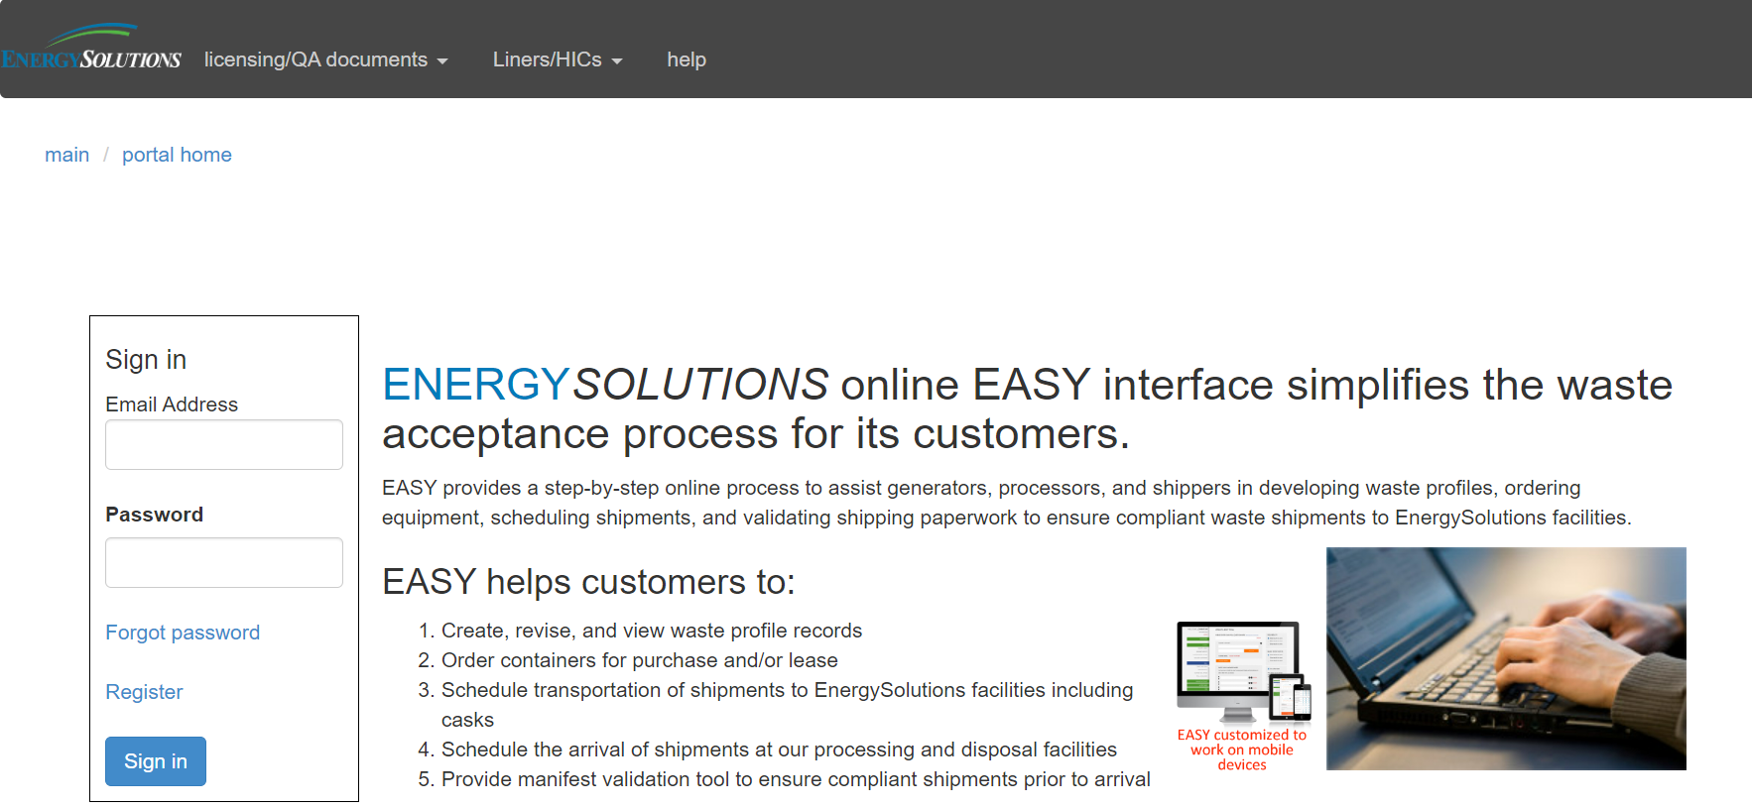
EnergySolutions’ Waste Acceptance Criteria and Customer Portal Overview
Clive Permits and Licenses
All current Permits, Licenses, WAC, etc. can be accessed from our company website: www.energysolutions.com

Slide 5
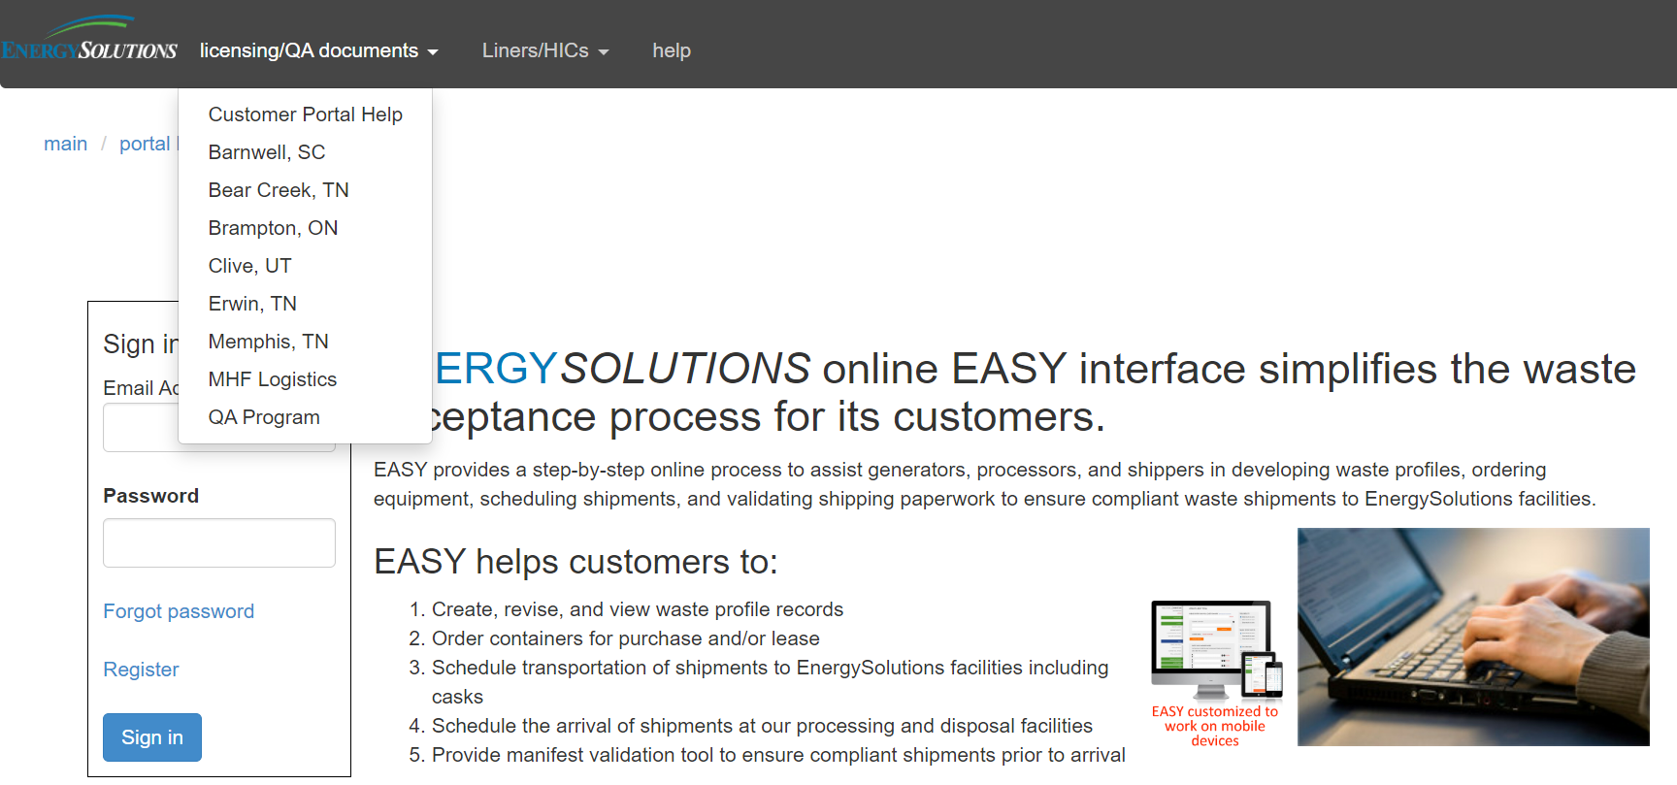
EnergySolutions’ Waste Acceptance Criteria and Customer Portal Overview
Clive Permits and Licenses
All current Permits, Licenses, WAC, etc. can be accessed from our company website: www.energysolutions.com

Slide 6
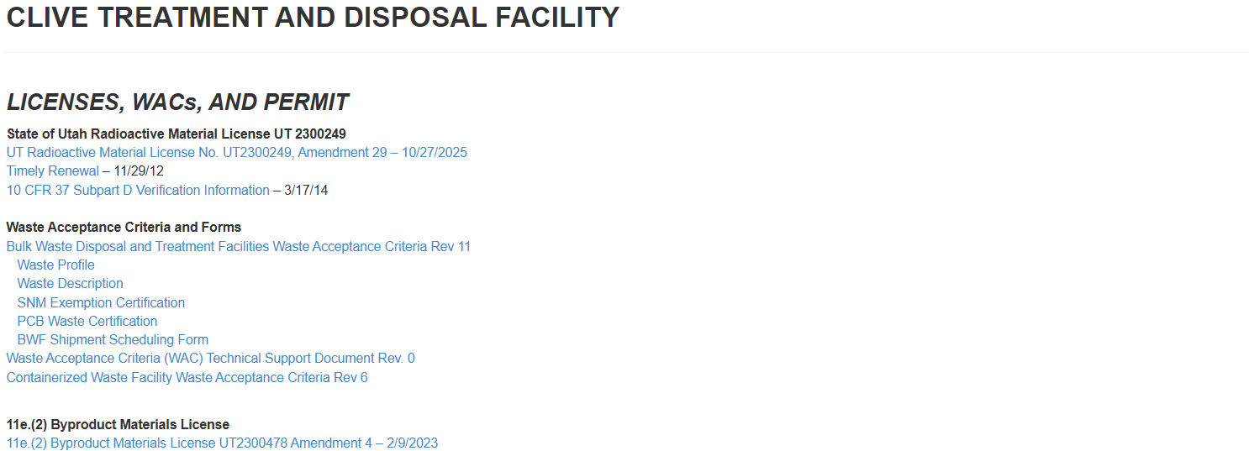
EnergySolutions’ Waste Acceptance Criteria and Customer Portal Overview
Clive Permits and Licenses
All current Permits, Licenses, WAC, etc. can be accessed from our company website: www.energysolutions.com

Slide 7
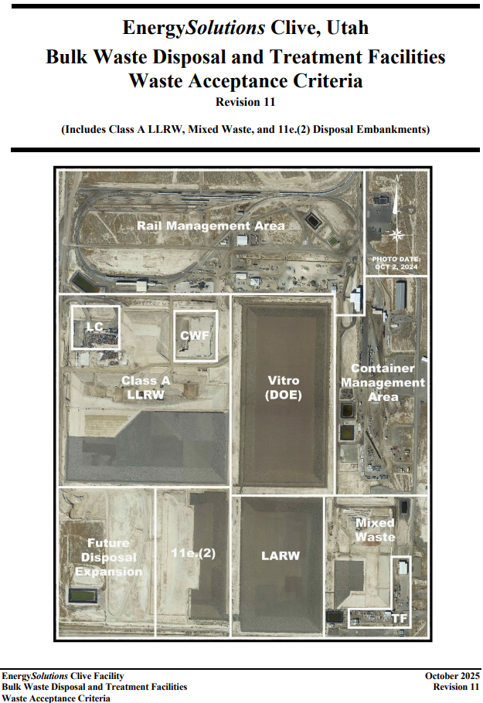
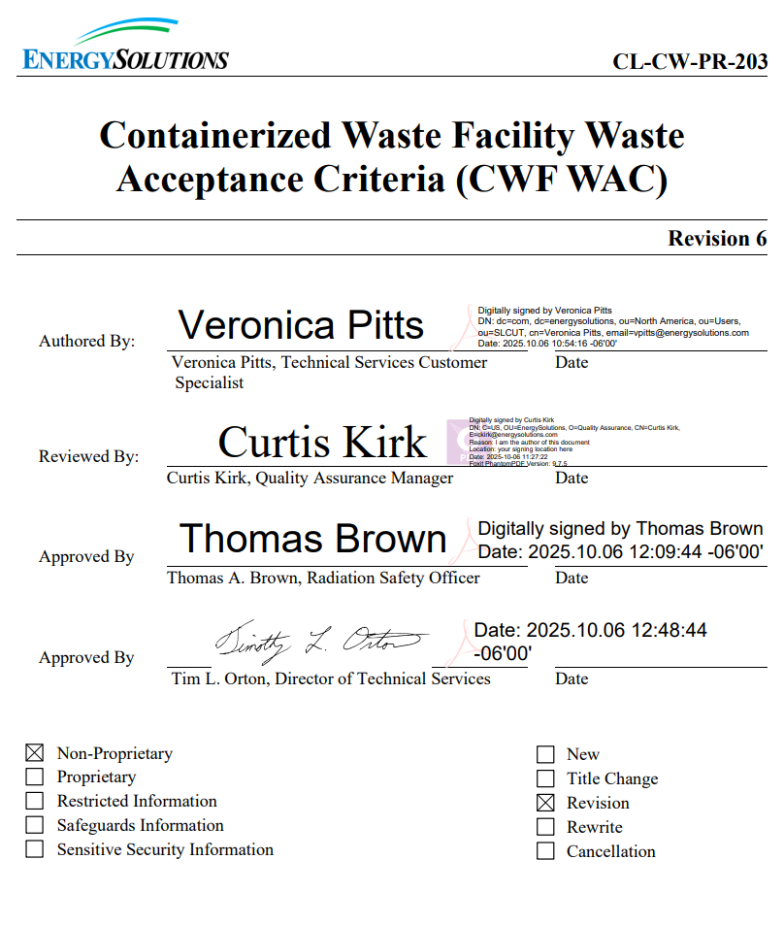
EnergySolutions’ Waste Acceptance Criteria and Customer Portal Overview
Clive Waste Acceptance Criteria

Slide 8
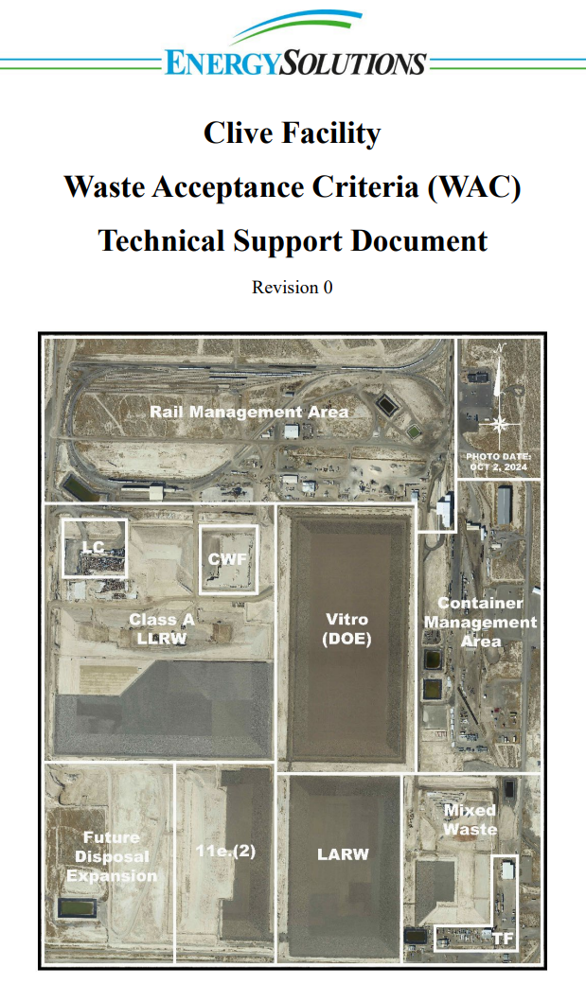
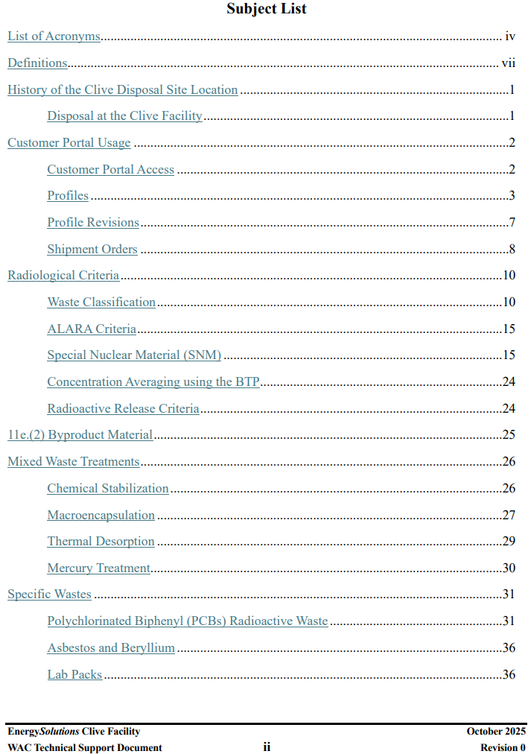
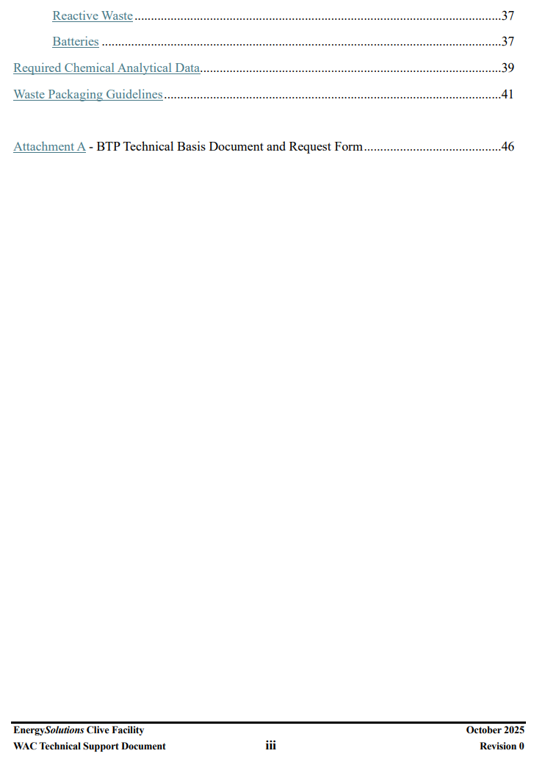
EnergySolutions’ Waste Acceptance Criteria and Customer Portal Overview
Clive WAC Technical Support Document

Slide 9



EnergySolutions’ Waste Acceptance Criteria and Customer Portal Overview
Q&A
Take a look
Let us know if these work
We are always looking for Feedback

Slide 10
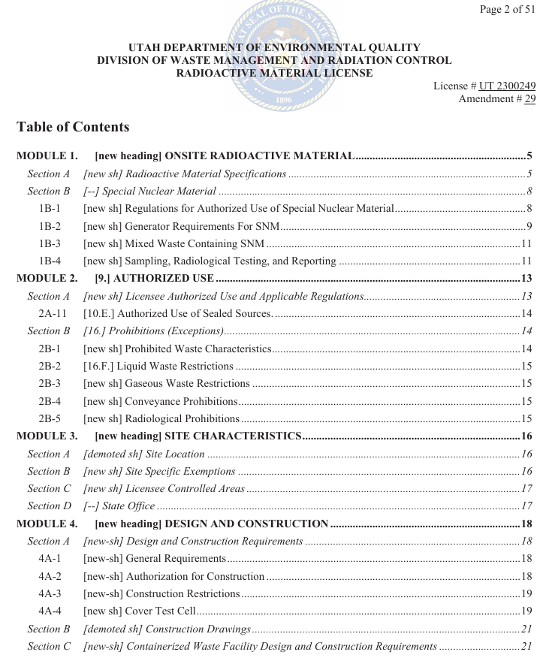
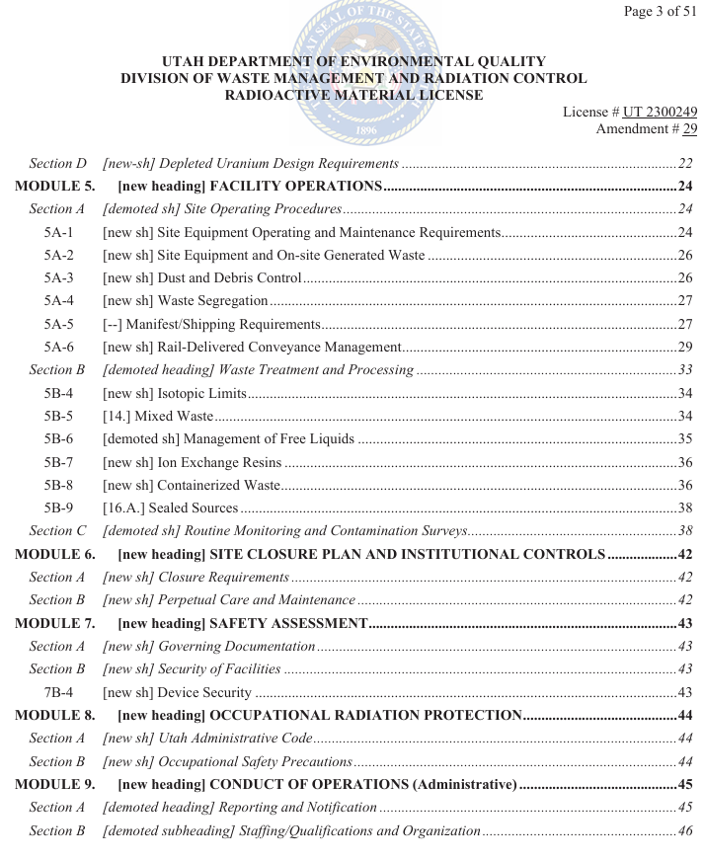
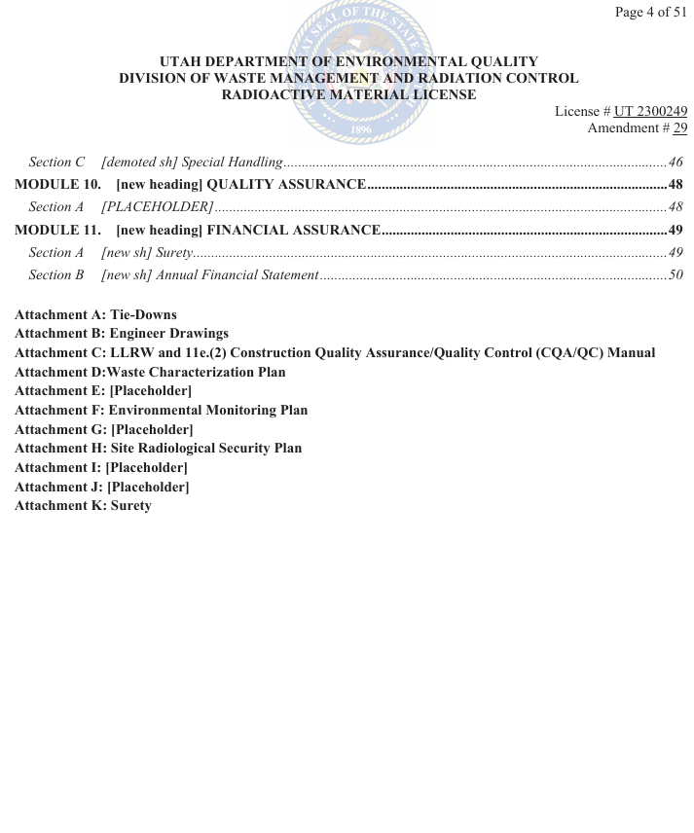
EnergySolutions’ Waste Acceptance Criteria and Customer Portal Overview
Reformatted RML
Amendment 29 – October 27, 2025
  Restructured similar to a Part B Permit
    Modules and Attachments

Slide 11
EnergySolutions’ Waste Acceptance Criteria and Customer Portal Overview
Training Plan
Today: Presentations describing Clive Waste Criteria (WAC)
  Primarily Bulk Waste Facility (BWF)
  Touch on Customer Portal Profiling and Shipping
Future Small Online In-Depth Teams Trainings
  Customer Portal Profiling
  Customer Portal Shipping
  Containerized Waste Facility (CWF)
  Analysis of High Dose Samples (GEL)
  Other? Suggestions?
Specific Customer Trainings
  Teams / Onsite

