Slide 1
2026 WAC Summit
Donnie Brackett

Slide 2
Bear Creak Operations
Waste Acceptance Guidelines (WAG)

Slide 3
The WAG is a tool
that provides information
to safely package material
for shipment for processing
while practicing ALARA.

Slide 4
Derivation of the WAG values
Impact on
Effluents
BASIC WAG VALUES
High
Waste Class
Low
Health Physics controls
GTCC --------- C ---------- B --------- A
Simple
Difficult
Low
Other considerations:
Packaging & Transport
Licensing Bases
Non-radiological permitting
ALARA Constraints
High
Safety & Env
Impacts
Notes:
Asphalt replacement plan – options for use of GIC processing. Amendment includes provisions for on-site disposition of no-detect asphalt (fill). Also includes standard sampling options.
Alternative Controls for High Radiation Areas (pending) - request based upon USNRC Reg Guide 8.38 NPP controls. Seeks relaxed requirements for securing areas with dose rates > 100 mR/h, but < 1000 mR/h. Additional info being presented to DRH
Name change amendment was submitted after very protracted effort to obtain proper verification of insurance from Corporate.
RSG C-6, Personnel Monitoring (approved). Permitted changes to monitoring program, including use of WBC as primary bioassay tools, and deletion of routine internal monitoring of NRWs.
Gallaher Road License extension request (approved). Required due to slower than expected progress in reapplication work.
License for Delivery was rec’d on time, but was also much delayed due to inability to obtain required insurance documentation.

Slide 5
Major Components Of WAG
Shipping, Packaging, and Documentation Requirements
Notification Requirements
License Requirements
Out of WAG Parameters
Process/Material Specific Requirements
Material Specific Packaging Requirements

Slide 6
Shipping, Packaging, and Documentation Requirements
Shipment of waste to EnergySolutions’ Bear Creek require
  Compliance with the WAG 501 Rev.15
  Approval to Ship Out of WAG Material (if applicable)
  Valid contract mechanism
  A completed Shipment Summary Form (WAG-501-F11)
  A valid Category 2 Tennessee Radioactive Waste License-for-Delivery
  Uniform Low-Level Radioactive Waste Manifest (540/541 forms)

Slide 7
Shipment Summary Form

Slide 8
Shipment Summary Form

Slide 9
Shipment Summary Form - Shipment Information

Slide 10
Shipment Summary Form - Material Identification

Slide 11
Shipment Summary Form - Notification Requirements
Approvals From Bear Creek Must be Received Prior to Releasing Shipment That Contains Out of WAG Material. Written Approval must be received for the following Out of WAG Items:

Slide 12
Shipment Summary Form – Special Instructions

Slide 13
Shipment Summary Form – Sign Off Page

Slide 14

Stored/Residual Energy
The Energy Wheel is a simple method that reminds us of the energy sources that may be present and helps focus our attention to spot the energy sources.

Slide 15


Slide 16
License Requirements – Quantity of Concern

Slide 17
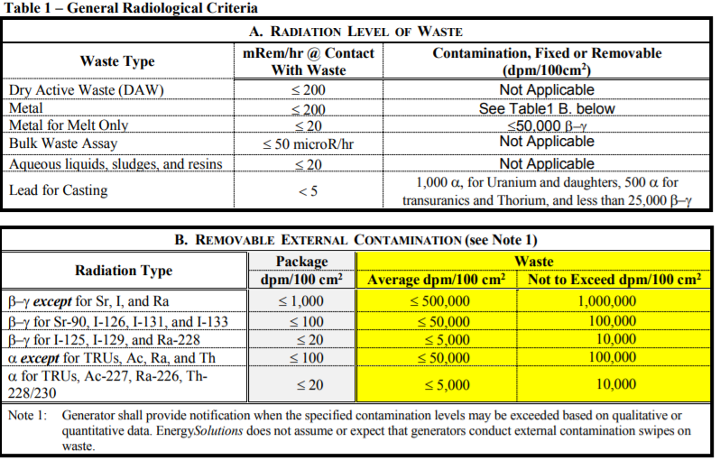
Process Specific Radiological Criteria

Slide 18
Process Specific Radiological Criteria
C. Radionuclide Concentration (Note 2)
Radionuclide concentration per package (e.g., drum or inner-pack box) shall not exceed the following group or individual limits.
Radionuclides | Limiting Values
Total, all radionuclides with >5-yr half-lives except H-3, C-14 and Tc-99 | ≤ 0.3 μCi/cm³
Total, H-3 and C-14 | ≤ 0.03 μCi/cm3
I-125 | ≤ 1 mCi/package
Other mixed fission and activation products, Z <84 | ≤ 25 mCi/ft3
Tc-99 | ≤ 100 μCi/ft3
Be | Special approval required
Th-232 | ≤ 5 mCi/ft3 or 100 lb. Th/ft3 waste
U-238 as metal or oxide | ≤ 15 mCi/ft3 or 100 lb. U/ft3 waste
Depleted Uranium contaminated materials | ≤ 18 nCi/g
α for TRUs, Ac, Ra and Th for processing (unless otherwise listed) | ≤ 0.1 nCi/g and less than 1% of activity
α for TRUs, Ac, Ra and Th for trans-shipment (unless otherwise listed) | ≤ 10 nCi/g
Special Nuclear Material (Pu, U-233 and uranium enriched in U-233 or U-235) | ≤ 0.49 g
Source Material (Th, U(NAT) and U(DEP) | ≤ 0.49 kg
Note 1: Sr-90 and I-129 must be < 2% of the total β–γ activity Note 2: Disposal sites may have more restrictive concentration limits

Slide 19
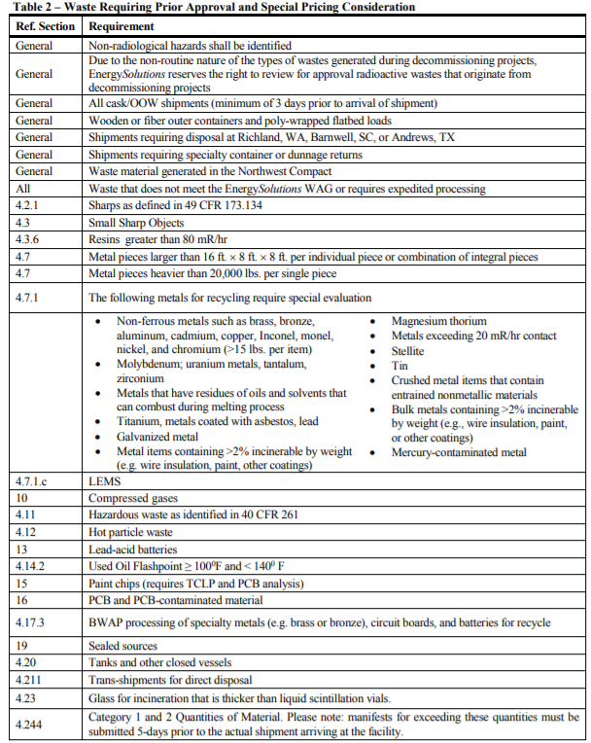
Out Of WAG Parameters
Material requiring pre-approval can be found in Table 2. of the WAG. Examples of material requiring
pre-approval are as follows:

Slide 20
WAG-501 Section 4.4 Aqueous Liquids, Sludges, and Resins
Descriptor (Note 1) | Processing Operations
 | Incineration | Waste Water Evaporator |  | Liquid Evap System | Drum Oven
pH | 5 to 9 | >2 and <12.5 |  | >2 and <12.5 | >2 and <12.5
Solids Content by Volume excluding settled sludge | <1.0% | <1% |  | <1.0% | <1.0%
Oil Content by Volume | <1.0% | No visual sheen |  | <1.0% | <1.0%
Chelating Agent by Volume | <1.0% | <1.0% |  | <1.0% | <1.0%
Flash Point ⁰F | >140 | >250 |  | >200 (Note 2) | >200 (Note 2)
Oil (mg/L) | N/A | N/A |  | N/A | N/A
Gross Beta-Gamma (µCi/ml) | N/A | <1.0E-3 |  | <1.0E-3 | N/A
Gross Alpha (µCi/ml) | N/A | <1.0E-5 |  | <1.0E-6 | N/A
Beryllium (mg/L) | <0.02 | <0.02 |  | <0.02 | <0.02
Note 1: Chemical agents present in the waste stream shall be identified.
Note 2: Actual Flash Point result needed to determine proper processing plan.

Slide 21
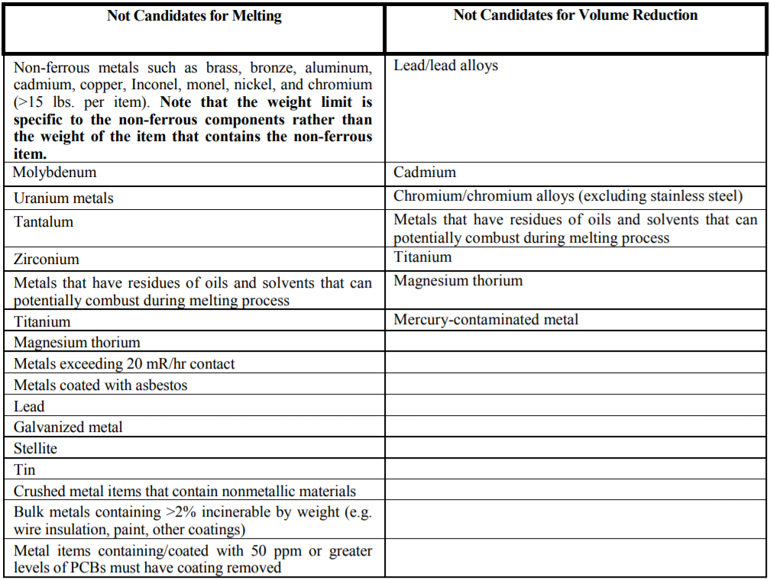
Metal Unacceptable for Processing

Slide 22
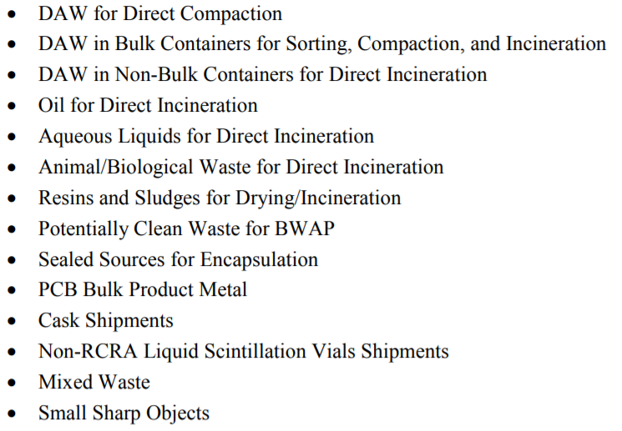
Material Specific Packaging Requirements
WAG Provides Packaging Instructions for:

Slide 23
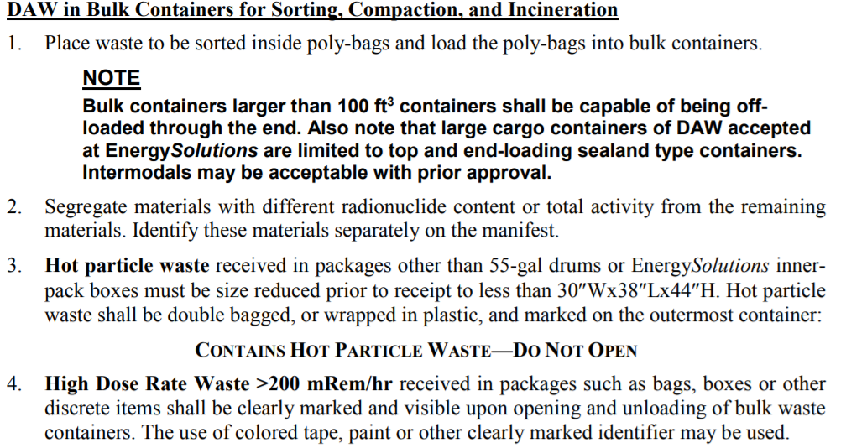
Examples Material Specific Packaging Requirements

Slide 24
If it’s not in the WAG we are likely able to accept the waste, but need prior review for approvals to ensure efficiency and ALARA

Slide 25

WAG Distribution
  The WAG is available through the Customer Portal at our web page at http://www.energysolutions.com.

Slide 26
EnergySolutions Commercial Processing Contact Information
Contact your Account Executive or
Donnie Brackett
email: dbrackett@energysolutions.com
voice: 865.220-1526
mobile: 865.803-7646

Slide 27
Questions?

Slide 28
International Radioactive Material Acceptance Criteria

Slide 29
International Radioactive Material Acceptance Criteria
WAG-502 International Radioactive Material Acceptance Guidelines
WAG-503 International Radioactive Metals Acceptance Guidelines

Slide 30
International Radioactive Material Acceptance Criteria
IMPORT/EXPORT CONSIDERATIONS
If you wish to export radioactive material, you will need to comply with the exporting country’s regulations.
Since EnergySolutions can not dispose of any international radioactive material (processed or unprocessed), ES will not be required to obtain an import permit.
However, if any radioactive material (processed or unprocessed) is to be returned to the customer, ES will have to obtain an export permit.

Slide 31
International Radioactive Material Acceptance Criteria
RESIDUAL WASTE
NRC Definition - Residual waste means low-level radioactive waste resulting from processing or decontamination activities that cannot be easily separated into distinct batches attributable to specific waste generators. This waste is attributable to the processor or decontamination facility, as applicable.
  Metal Melt – All slag from cutting and sizing metal, melting of the metal, PPE, floor sweepings, metal waste from grinding of blocks are considered secondary waste and are the responsibility of ES and are not returned to the customer.

Slide 32
International Radioactive Material Acceptance Criteria
SECONDARY WASTE (continued)
  DAW Incineration – Hearth ash is returned to the customer. All other waste (secondary chamber ash, baghouse filters, PPE, etc.) are considered secondary waste and are the responsibility of ES and are not returned to the customer.
  Oil Incineration – this is injected into the secondary chamber and any ash from ash is considered secondary waste and are the responsibility of ES and are not returned to the customer.

Slide 33
International Radioactive Material Acceptance Criteria
SECONDARY WASTE (continued)
  Liquid Processing – Liquids to be evaporated or incinerated are pumped into a feed tank that contains multiple customer liquids. Once liquid is pumped into the feed tank it loses its customer identity and is considered ES waste. Any residual solids or ash is considered as ES secondary waste and not returned to the customer.
  Compaction – Compacted material is returned to the customer. All other waste (PPE, sump liquids/sludges, etc.) are considered secondary waste and are the responsibility of ES and are not returned to the customer.

Slide 34
International Radioactive Material Acceptance Criteria
Any waste defined below is prohibited from import without authorization of the US Environmental Protection Agency (USEPA) and the exporting country’s appropriate regulatory authority.
  Hazardous as defined in 40 CFR 261
  Off-specification used oil as defined in 40 CFR 279

Slide 35
International Radioactive Material Acceptance Criteria

Slide 36
International Radioactive Material Acceptance Criteria

Slide 37
International Radioactive Material Acceptance Criteria
Metal Criteria
A. Radiation and Contamination Level of Metal for Recycle
Metal Type | Contact Dose Rate with Metal | Removable Contamination (Bq/cm²)¹
Metal for Recycling through Melting | ≤ 200 µSv/hr | ≤8 β–γ ≤1 α
Lead for Casting | ≤ 50 µSv/hr | 0.1 α for Uranium and daughters, 0.08 α for transuranics and Thorium, and less than 4 β–γ
B. Radionuclide Concentration
Radionuclide concentration per package shall not exceed the following limits without prior evaluation and approval.
Metals for Recycle | Limiting Values
All Nuclides | ≤ 5000 Bq/gm
Co-60 | ≤ 40 Bq/gm
Cs-137 | ≤ 5000 Bq/gm
Ni-63 | ≤ 5000 Bq/gm
C-14 | ≤ 1000 Bq/gm
H-3 | ≤ 1000 Bq/gm
Sr-90 | ≤ 35 Bq/gm
Pu-241 | ≤ 800 Bq/gm
Total Transuranics (sum of Am-241, Pu-238. Pu-239. Cm-243. Cm-244) | ≤ 20 Bq/gm
Special Nuclear Material | ≤ 0.49 grams
Source Material | ≤ 0.49 kgs

Slide 38
International Radioactive Material Acceptance Criteria
Other Radioactive Material Criteria
Other Waste Streams | Limiting Values
Total, all radionuclides with >5-yr half-lives except H-3 and C-14 | ≤ 11 kBq/cc
Total, H-3 and C-14 | ≤ 5 kBq/cc
I-125 | ≤ 3700 kBq/package
Other mixed fission and activation products, Z <84 | ≤ 200 kBq /cc
Tc-99 | ≤0.13 kBq/cc
Th-232 | ≤40 kBq/m3 or 1e-5 gm Th/cc of waste
U-238 as metal or oxide | ≤20 kBq/cc or 1.6E-3 g U/cc of waste
Depleted Uranium or Natural Uranium as metal or oxide | ≤ 120 kBq / m3 or 6e-6 gm U/cc of waste
Alpha for TRUs, Ac, Ra-226 and Th for processing. Packages shall be clearly marked for identification. | ≤ 3.7 Bq/g and less than 1% of activity
No shipment shall equal or exceed 10 CFR 110, Appendix P Category 2 quantities of radionuclides (Sum of Fractions Applies)
Special Nuclear Material | ≤ 0.49 grams
Source Material | ≤ 0.49 kgs

Slide 39
International Radioactive Material Acceptance Criteria
Contact
Colin R. Austin
President, International Group
EnergySolutions
Cell: +1 706 830 4959 caustin@energysolutions.com

Slide 40
International Radioactive Material Acceptance Criteria
Questions?

