Slide 1
2026 WAC Summit
Clive Facility WAC Training
Tim Orton
Jake Gardner

Slide 2
EnergySolutions’ Waste Acceptance Criteria and Customer Portal Overview
Technical Services Contact Information
Tim Orton Director of Technical Services 801-649-2144
torton@energysolutions.com 801-209-7251 (cell)
Jake Gardner VP of Technical Services 865-220-1207
jhgardner@energysolutions.com 801-836-1555 (cell)
Veronica Pitts Technical Services Customer Specialist 801-649-2139
vpitts@energysolutions.com 801-573-1707 (cell)

Slide 3

EnergySolutions’ Waste Acceptance Criteria and Customer Portal Overview
Other Clive WAC Requirements
Classification Limit = Class A by Utah Administrative Code (UAC) R313-15-1009
  Ra-226 ≤ 10,000 pCi/g
Depleted Uranium Limit: ≤ 18,000 pCi/g (U-Dep) - Moratorium
Chelating Agents Limit: < 0.1% at LLRW; 21% at MW (at time of disposal)
Gaseous wastes are prohibited unless at an absolute pressure ≤ 1.5 atmospheres at 20 ◦C
Compact Requirements:
  Export approval required for waste from the Rocky Mountain, Southwestern, or Texas compacts
  Export approval required for NORM/NARM and Mixed Waste from the Rocky Mountain Compact
  LLRW cannot be received from the Northwest Compact – without Compact approval
  Approvals not required for DOE, NORM/NARM (except Rocky Mountain), or MW (except Rocky Mountain)
Required Labels:
  “Class A Unstable” or “Class AU” (Minimum 0.5 inch lettering, in contrasting color)

Slide 4
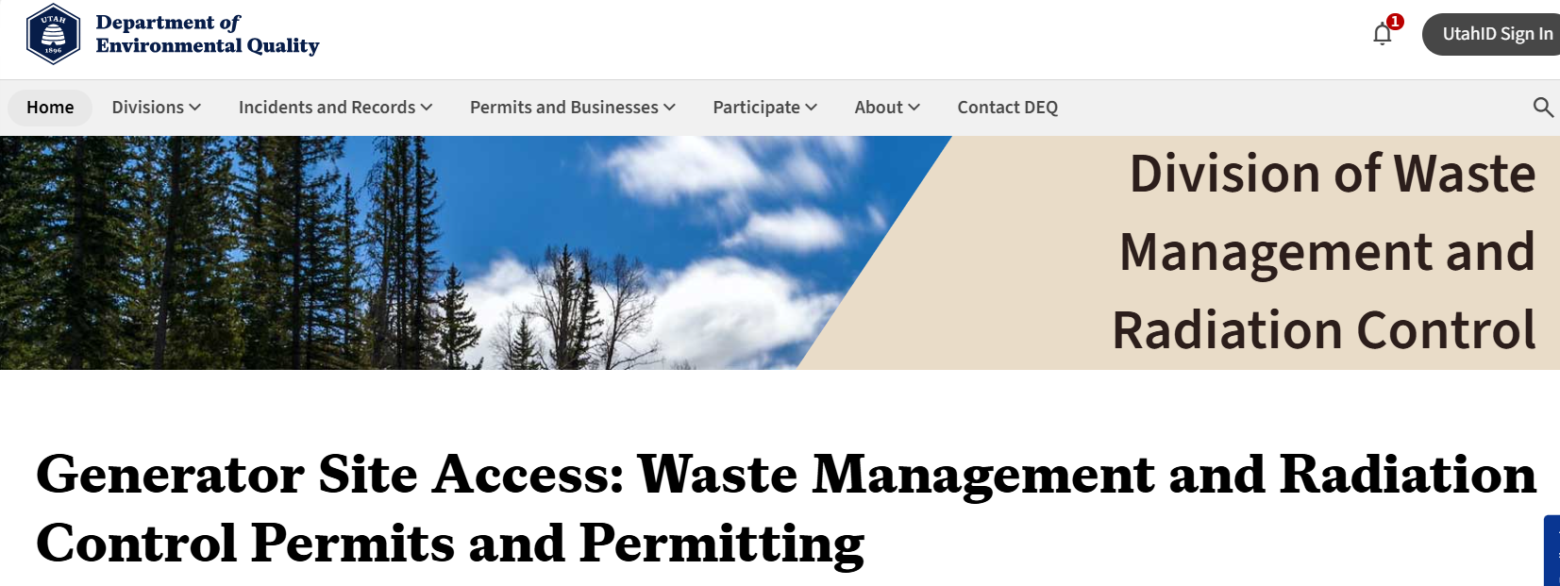
EnergySolutions’ Waste Acceptance Criteria and Customer Portal Overview
Other Clive WAC Requirements
Generator Site Access Permit (GSAP)
State of Utah program to allow generators to ship waste to Clive for disposal (R313-26)
Valid GSAP required for waste acceptance at Clive

Slide 5
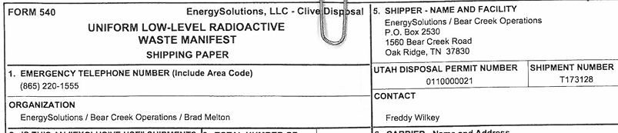
EnergySolutions’ Waste Acceptance Criteria and Customer Portal Overview
Other Clive WAC Requirements
Generator Site Access Permit (GSAP)
A GSAP is issued from the State of Utah to Generators and is required to be renewed annually.
  Link to State website in Section 5.1 of BWF WAC
  Instructions for applying and renewing on that site
Please forward new/revised GSAP Approvals to Technical Services
All shipments to Clive must have a valid GSAP on the manifest.
Do not ship with an expired GSAP!
Contact Technical Services if you need assistance

Slide 6
EnergySolutions’ Waste Acceptance Criteria and Customer Portal Overview
Other Clive WAC Requirements
Generator Site Access Permit (GSAP)
GSAP gives Utah DWMRC Authority to cite and fine
If a shipping incident occurs:
  First = Fact Finding
    Expect a call from a Utah regulator
    Compliance Advisory Letter
      Not an official fine or citation (most of the time)
      Opportunity to provide details on responses and Corrective Actions
      May state potential assessments
        NOV
        GSAP Points
        Fine
  Final Decision Letter
    Based on Response, Severity, Frequency

Slide 7


EnergySolutions’ Waste Acceptance Criteria and Customer Portal Overview
Other Clive WAC Requirements
Generator Site Access Permit (GSAP)
Program currently being updated
  Getting away from the points system
  Relying more heavily on Compliance Advisory information
  All stakeholders will be informed and trained when released
  Stay tuned . . .

Slide 8
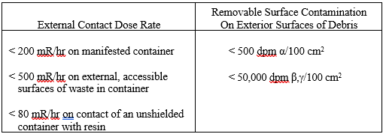
EnergySolutions’ Waste Acceptance Criteria and Customer Portal Overview
Other Clive WAC Requirements
Clive WAC BWF ALARA criteria
Note the accessible surfaces of waste – Clive dumps out
ALARA Exemption process that allows receipt of waste exceeding ALARA criteria
Contact Technical Services or generate a SWSA

Slide 9
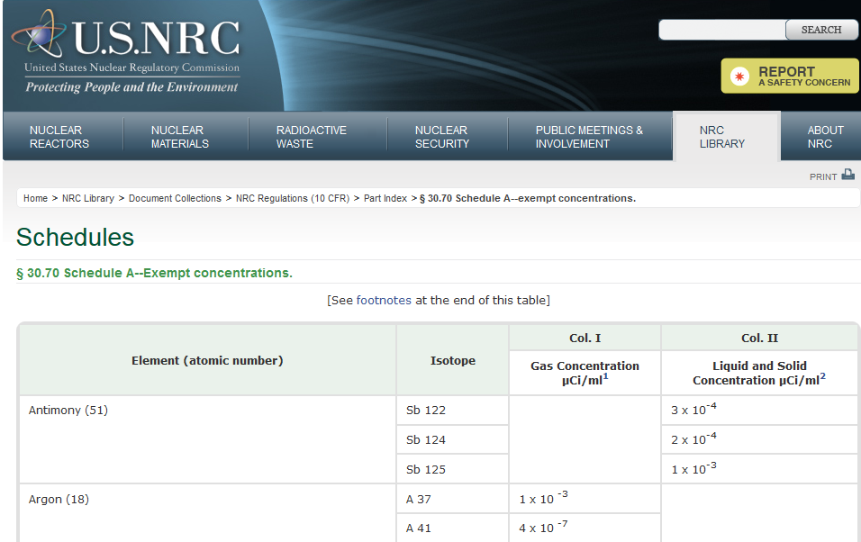
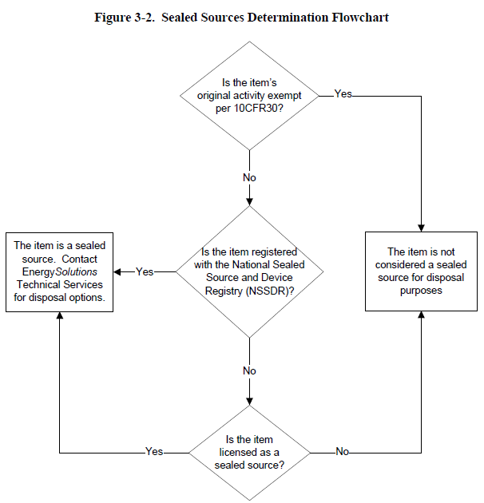
EnergySolutions’ Waste Acceptance Criteria and Customer Portal Overview
Other Clive WAC Requirements
Sealed sources
UAC R313-12 "Sealed source" means radioactive material that is permanently bonded or fixed in a capsule or matrix designed to prevent release and dispersal of the radioactive material under the most severe conditions which are likely to be encountered in normal use and handling.
Exempt & Unlicensed Sealed Sources
  Direct dispose in BWF
Non-exempt Sealed Sources
  Allowed in CWF if Class A
  Allowed, with Director approval, in CWF if Class A via the NRC CA BTP
  Allowed, with Director approval in BWF if Class A
    Prior approval will be required.

Slide 10
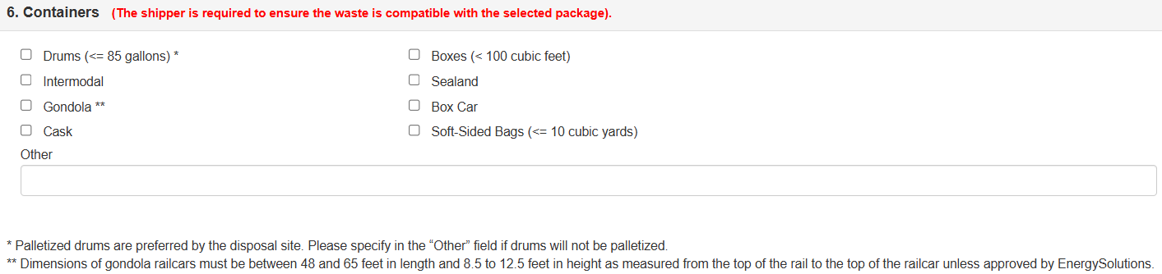
EnergySolutions’ Waste Acceptance Criteria and Customer Portal Overview
Other Clive WAC Requirements
Are any types of waste packages not acceptable for receipt at Clive?
In almost all cases, if a package is compliant for shipping, Clive can receive it.
We highly discourage the use of supersacks or drums without them placed on pallets for transport (Safety Issue)
End Dumps are discouraged but may be approved prior to shipping
Ask if you have questions on a package outside of those listed in the profile
  Unusual containers (e.g., 10’ or 40’ Sealands/IMS; No Isolocks; etc.)
  Clive may not have the equipment to manage
  Contact Technical Services ASAP

Slide 11
EnergySolutions’ Waste Acceptance Criteria and Customer Portal Overview
Other Clive WAC Requirements
Can Clive receive multiple profiles / shipments on the same 540/541?
Clive has a waste tracking system that allows only one shipment per 540/541 manifest.
Multiple shipments will need to be on multiple manifests.
Can a profile have PCB’s added to it?
If a profile has been approved and shipments have been made to Clive, then PCB’s cannot be added.
If the profile is unused and can be revised, then it can most likely have PCB’s added – contact Technical Services.

Slide 12
EnergySolutions’ Waste Acceptance Criteria and Customer Portal Overview
Other Clive WAC Requirements
Large/Heavy Items?
If an item weighs over 20,000 lbs. it is considered a Large Component at Clive
Not all items will require Large Component Disposal and can be managed at the BWF. Shield Blocks, accelerator magnets, etc. may be managed as OS Debris, prior approval is required to ship these.
  Remember, Large Components must be free of external contamination
Mixed Waste – Best to know as soon as possible – months in advance
Contact Technical Services for assistance.

Slide 13
EnergySolutions’ Waste Acceptance Criteria and Customer Portal Overview
Other Clive WAC Requirements
Biological wastes?
Condition 2B-1.4 of the RML states that “Waste containing untreated biological, pathogenic or infectious material including radiologically contaminated laboratory research animals is prohibited.”
Clive may accept these wastes if the generator confirms it has been treated. In many cases, this can be as simple as adding a small quantity of lime to the waste.
Reactive wastes?
Acceptance is predicated upon approval by our treatment staff and compliance manager. They look at both the reactivity and the quantity of the waste.
We must have a proven means of deactivation.
State approval may be required.
We are prohibited from receiving quantities of pyrophoric waste.
Packaging . . .

Slide 14
EnergySolutions’ Waste Acceptance Criteria and Customer Portal Overview
Lessons Learned / Good Information
CWF Liner >200 R/hr on contact requires state approval – extra time
Resins 500 mR/hr on contact max in BWF
  Best if all resin were CWF
UHWM Legible – EPA Rejecting/Sending Back – Pushing for e-Manifest
S&R Requests
  Limit orders to six shipments if possible
  Try to keep orders with more than four shipments away from Friday or Monday arrival at Clive
Multiple containers on same profile that require different treatment should be manifested separately
  Liquid drum for VTD and Debris Box for Macro under a PCB waste management profile
  D009 Elemental Mercury / D008 & D009 Sludge under a stabilization/amalgamation profile

Slide 15
EnergySolutions’ Waste Acceptance Criteria and Customer Portal Overview
Lessons Learned / Good Information
CWF / BWF – If shipping waste to both CWF and BWF on same conveyance (prior approval is required)
  Commingled shipments are not encouraged (but may be necessary, be sure to contact ES prior to scheduling to discuss loading of packages)
Class A Unstable Markings- Legible from ground level (State Inspectors to see with ease)
Take photos of all shipments at time of departure - (documentation saves careers)
Casks scheduled early (Clive will limit # of casks per day, schedule early to ensure you get approved)
  Placeholder information is acceptable, but must be updated
Maintain updated POC’s in Customer portal (Manifest Receipt emails, COD’s, Signed UHWM’s, etc)
Bulk Container Returns- be sure to notify ES if you require a specific release type and where the container is to be returned to, do not assume ES knows.
BTP (CA) Shipments require approval and may need ES BTP Committee review ( please submit documents early for review)

Slide 16
EnergySolutions’ Waste Acceptance Criteria and Customer Portal Overview
Q&A
QUESTIONS???

