Slide 1
2026 WAC Summit
Hittman Transport Services, Inc.
Matthew Parker
James Carrillo

Slide 2
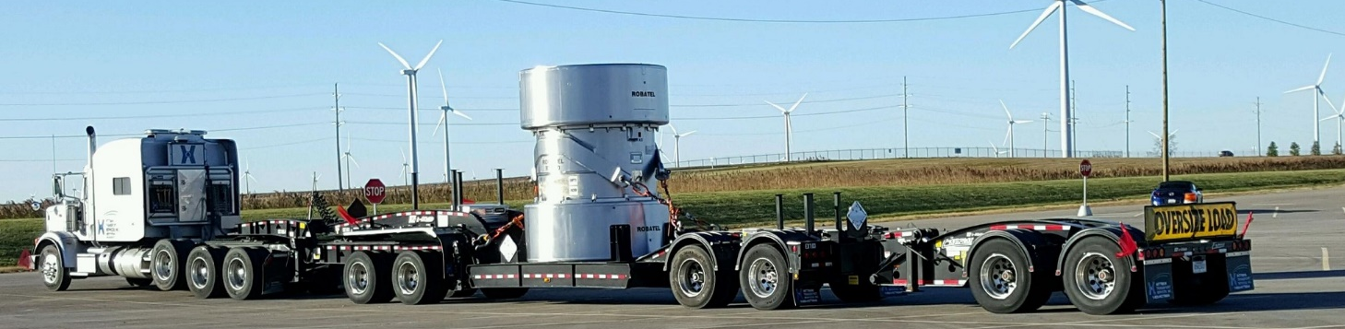
https://vimeo.com/user86243618/review/818954348/4e8453d6e6

Slide 3

Hittman Transport Services, Inc
A full-service logistics company with fully trained drivers and project management oversight for any shipment via road, rail, or water
DOT Type A and NRC Type B Cask shipments
Radioactive material & waste, mixed waste, and hazardous material & waste shipments
Tier 1 Department of Energy Qualified MCEP carrier
New Fuel & Tooling Transport
Highway route control quantity shipments
Category 1/Category 2 shipments
DOE “Q and L” cleared drivers
Specialized transport of OS/OW

Slide 4
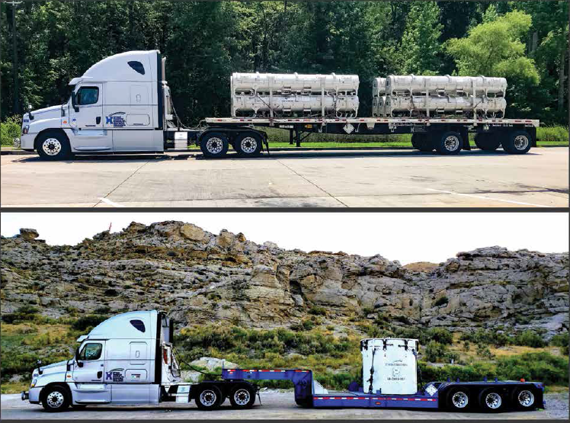
AVAILABLE EQUIPMENT
85 Over-the-road conventional tractors
Flatbed trailers with integral locking devices (ISO)
Closed vans equipped with e-rail load locks
Single drop, double drop, and cask trailers
Open top vans
Shielded van
Pan vans
Curtain Trailers
65-ton multi-axle lowboy
80-ton multi-axle lowboy
Tankers
Specialty trailer types can be leased

Slide 5
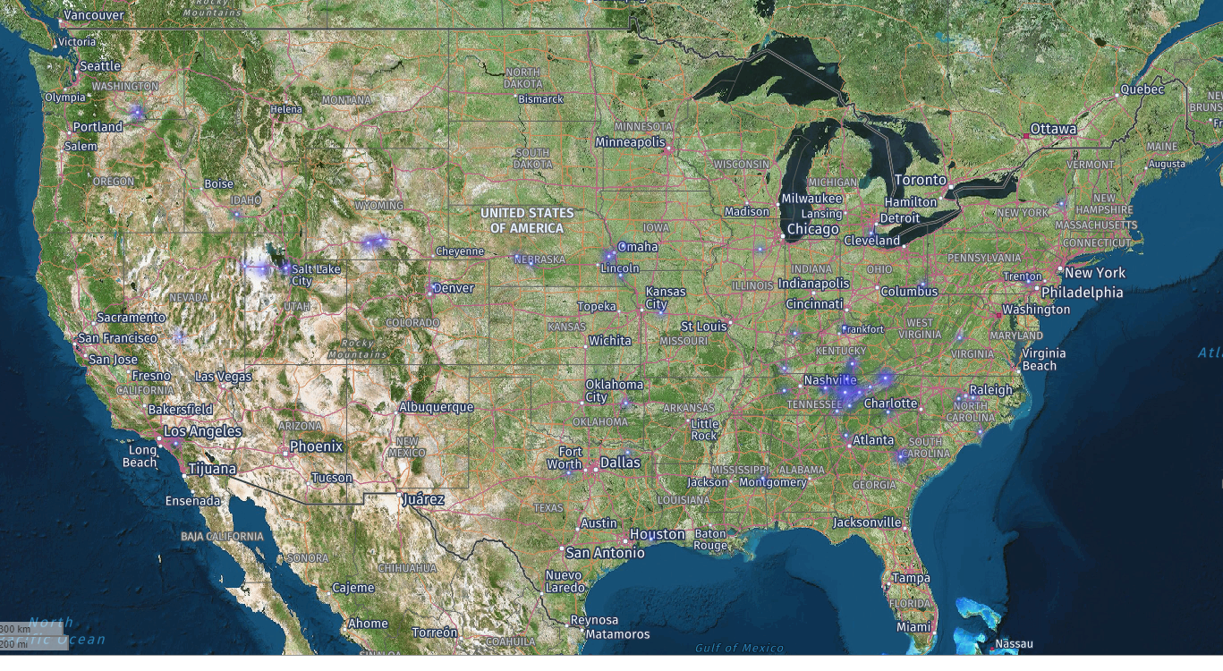
Hittman Transport Services, Inc.
HTS provides three types of compliant transport as described below.
Secure Transport – Normal, Everyday Shipments
Real-time Tracking
All employees go through a comprehensive background check prior to employment
Safeguards Information Modified Handling (SGI-M)
Intermediate level of protection
Access to information is need-to-know only
Continuous surveillance Driver call-in every four hours
Safeguards Information – Classified shipments
Enhanced level of protection – 24/7 surveillance
Category 1/Category 2, Highway Route Control
Security clearance needed to access shipment information
Continuous surveillance by communication center

Slide 6
Barnwell Complex Security Overview
Experienced & Certified Team
The Barnwell Complex security team consists of six South Carolina Law Enforcement Division (SLED)-certified officers, collectively offering over 35 years of experience.
All officers have been formally designated Trustworthy & Reliable by a Reviewing Official.
Each team member holds CPR and First Aid certifications, reinforcing their readiness to respond to a range of emergencies.
Like specialized hospital departments, the team's compact structure and low personnel turnover contribute to reduced miscommunication and operational errors.
Training Credentials
Officers have completed foundational and advanced training through SLED:
  Primary Basic Certification
  Primary Plus Certification
Technology & Communication
The security team leverages QTRAC satellite tracking across the Hittman fleet for real-time location awareness.
Equipped with multiple independent communication systems, the team ensures continuous contact with drivers and monitored shipments.

Slide 7
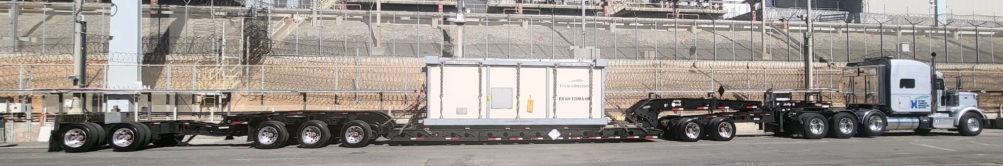
Specialized transport of OS/OW
Dedicated permit specialist for permitting large and oversized loads through states and counties
Team dedicated to outfitting specialty trailers with needed securement
Experienced drivers that can advise and perform walk downs on loading areas

Slide 8
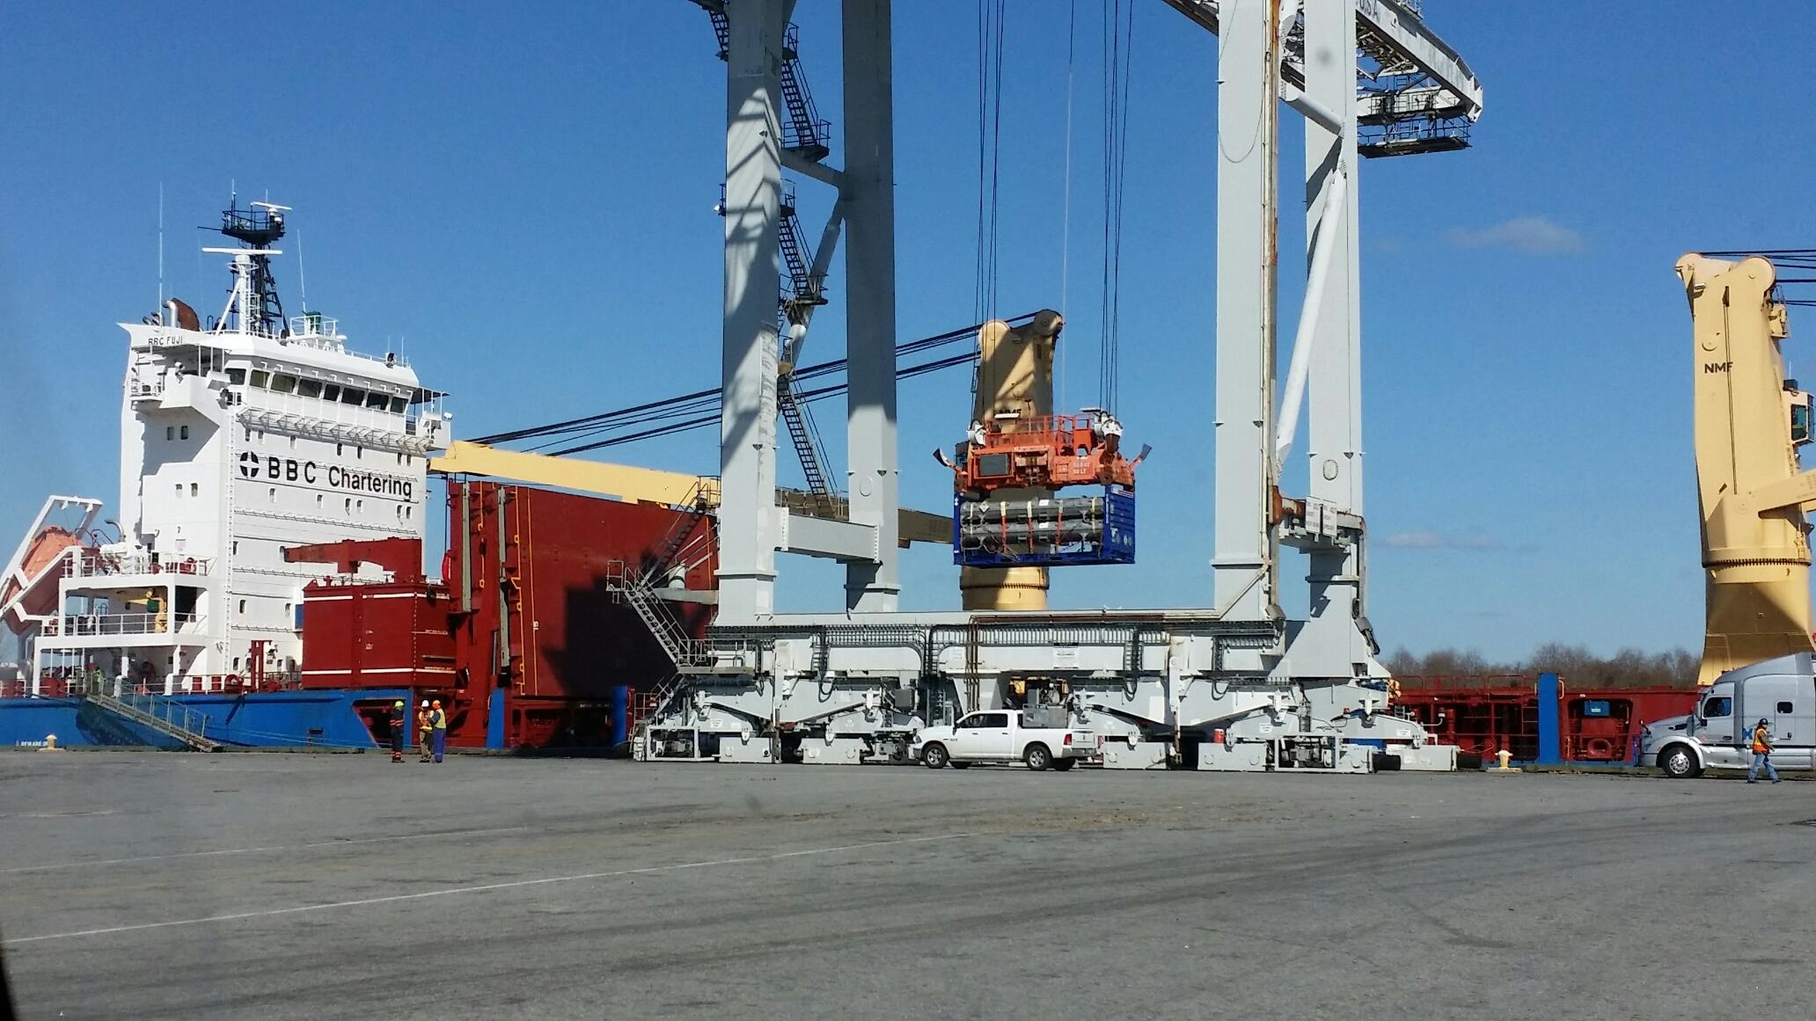
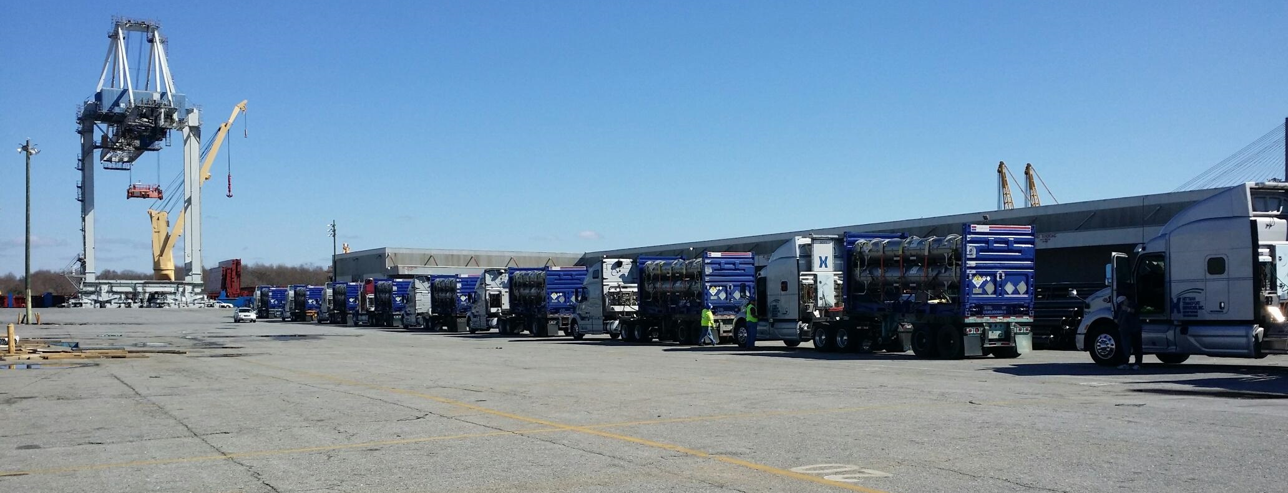
Experienced International Transportation from a number of key ports in the US and Canada
Qualifying member of C-TPAT a voluntary government-business initiative that builds cooperative relationships that strengthen and improve overall international supply chain and U.S. border security.
95% of the Hittman drivers have TWIC credentials for easy access to ports.
Trucks are outfitted with RFID transponders

Slide 9

CONTACTS:
Permits, order questions, and/or scheduling
bco_dispatch@energysolutions.com
(emails all day to day operations personnel)
Matthew Parker - Operations Director
Phone: (865)-220-5817
Email: mdparker@energysolutions.com
Tammy Summers – Compliance Manager
Phone: (865) 220-1385
Email: tssummers@energysolutions.com
For scheduling and/or portal confirmations please contact:
Tyler Terry– Transportation Specialist
Phone: (865) 220-5830
Email: tjterry@energysolutions.com

Slide 10
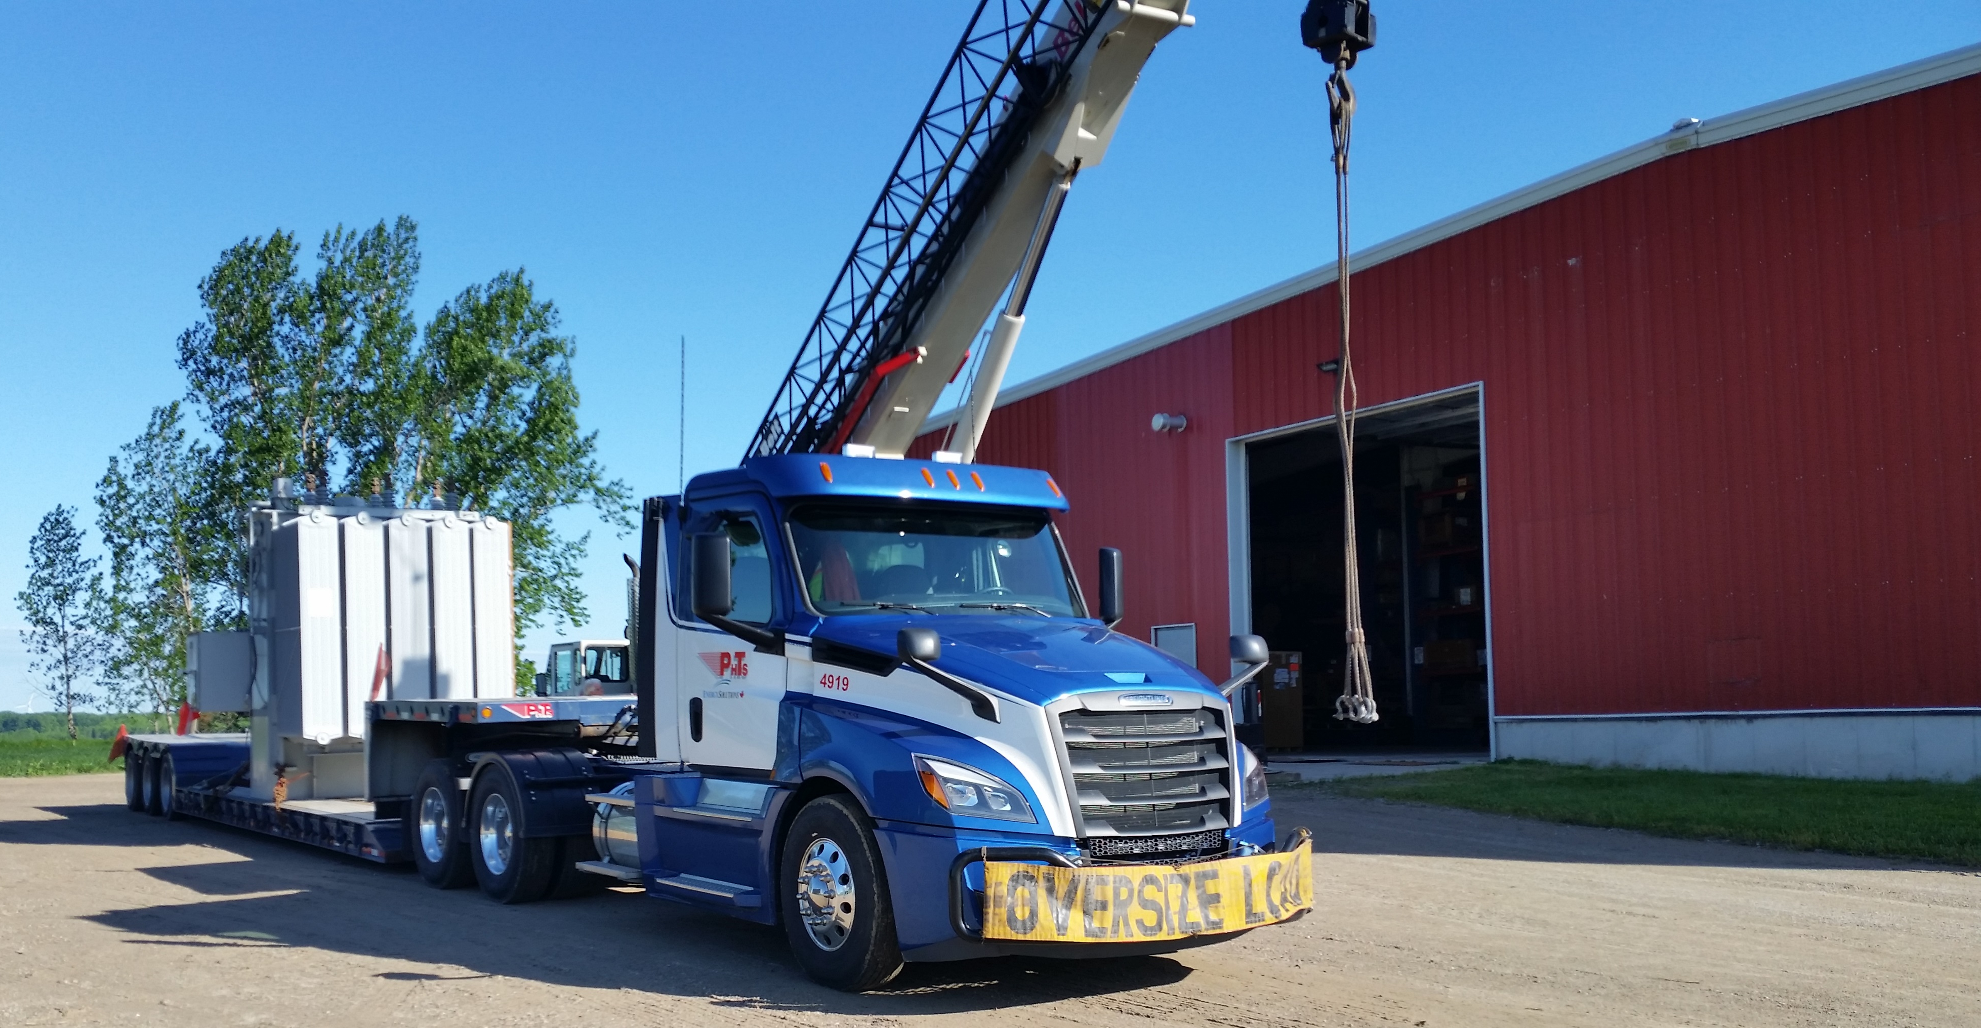

Qualified carrier of and Class 7 radioactive materials with twenty-four years of experience transporting radioactive waste, radioactive material, mixed waste, and hazardous material shipments.
Project management oversite for any shipment with dedicated customer service.
Detailed tracking and monitoring of cargo in transit, online real time tracking and administrative self-service functions.
Ability to handle secure and confidential documents.
Short and long haul transportation to all provinces in Canada and support dedicated runs.
Ability to transport oversize, overweight and contaminated large components.

Slide 11
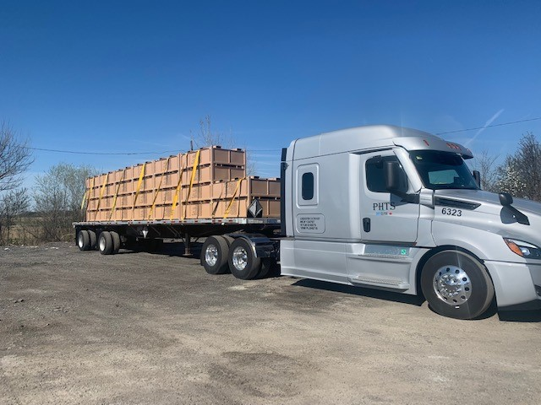
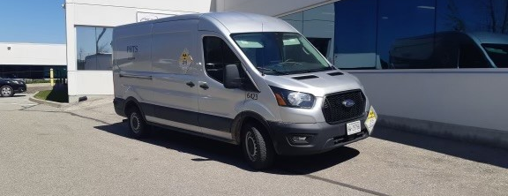
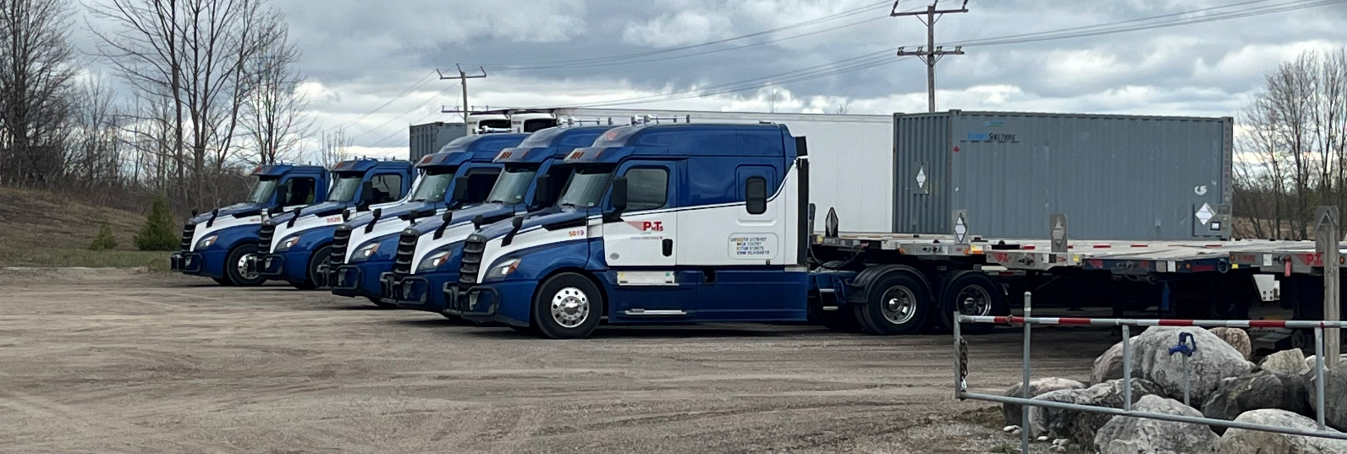
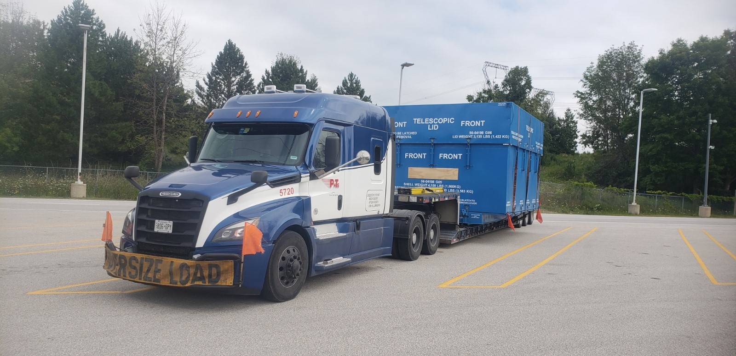
PHTS equipment is state of the art and includes the following:
Tractors equipped with two-way communication and tracking devices.
More than 20 commercial vehicles including Straight trucks with lift gates (including 2 heated box) and Sprinter vans.
Two And Three axle flatbed trailers.
Two, three, and five axle flatbed trailers with integral locking devices (ISO).
Closed vans equipped with vertical and horizontal e-track
Three axle single drop trailer with integral locking devices (ISO).
Roll-Tite trailers (including 1 heated trailer).
Two and three axle chassis trailers.
Single and double drop trailers.
55-ton three axle float Trailer.
Two Reefer Controlled Vans

Slide 12
CONTACTS:
Permits, order questions, and/or scheduling
phtsdispatch@energysolutions.com
(emails all day to day operations personnel)
Tania Angel-Jackson – Terminal Manager
Phone: (519)-363-3765
Email: tangeljackson@energysolutions.com

Slide 13
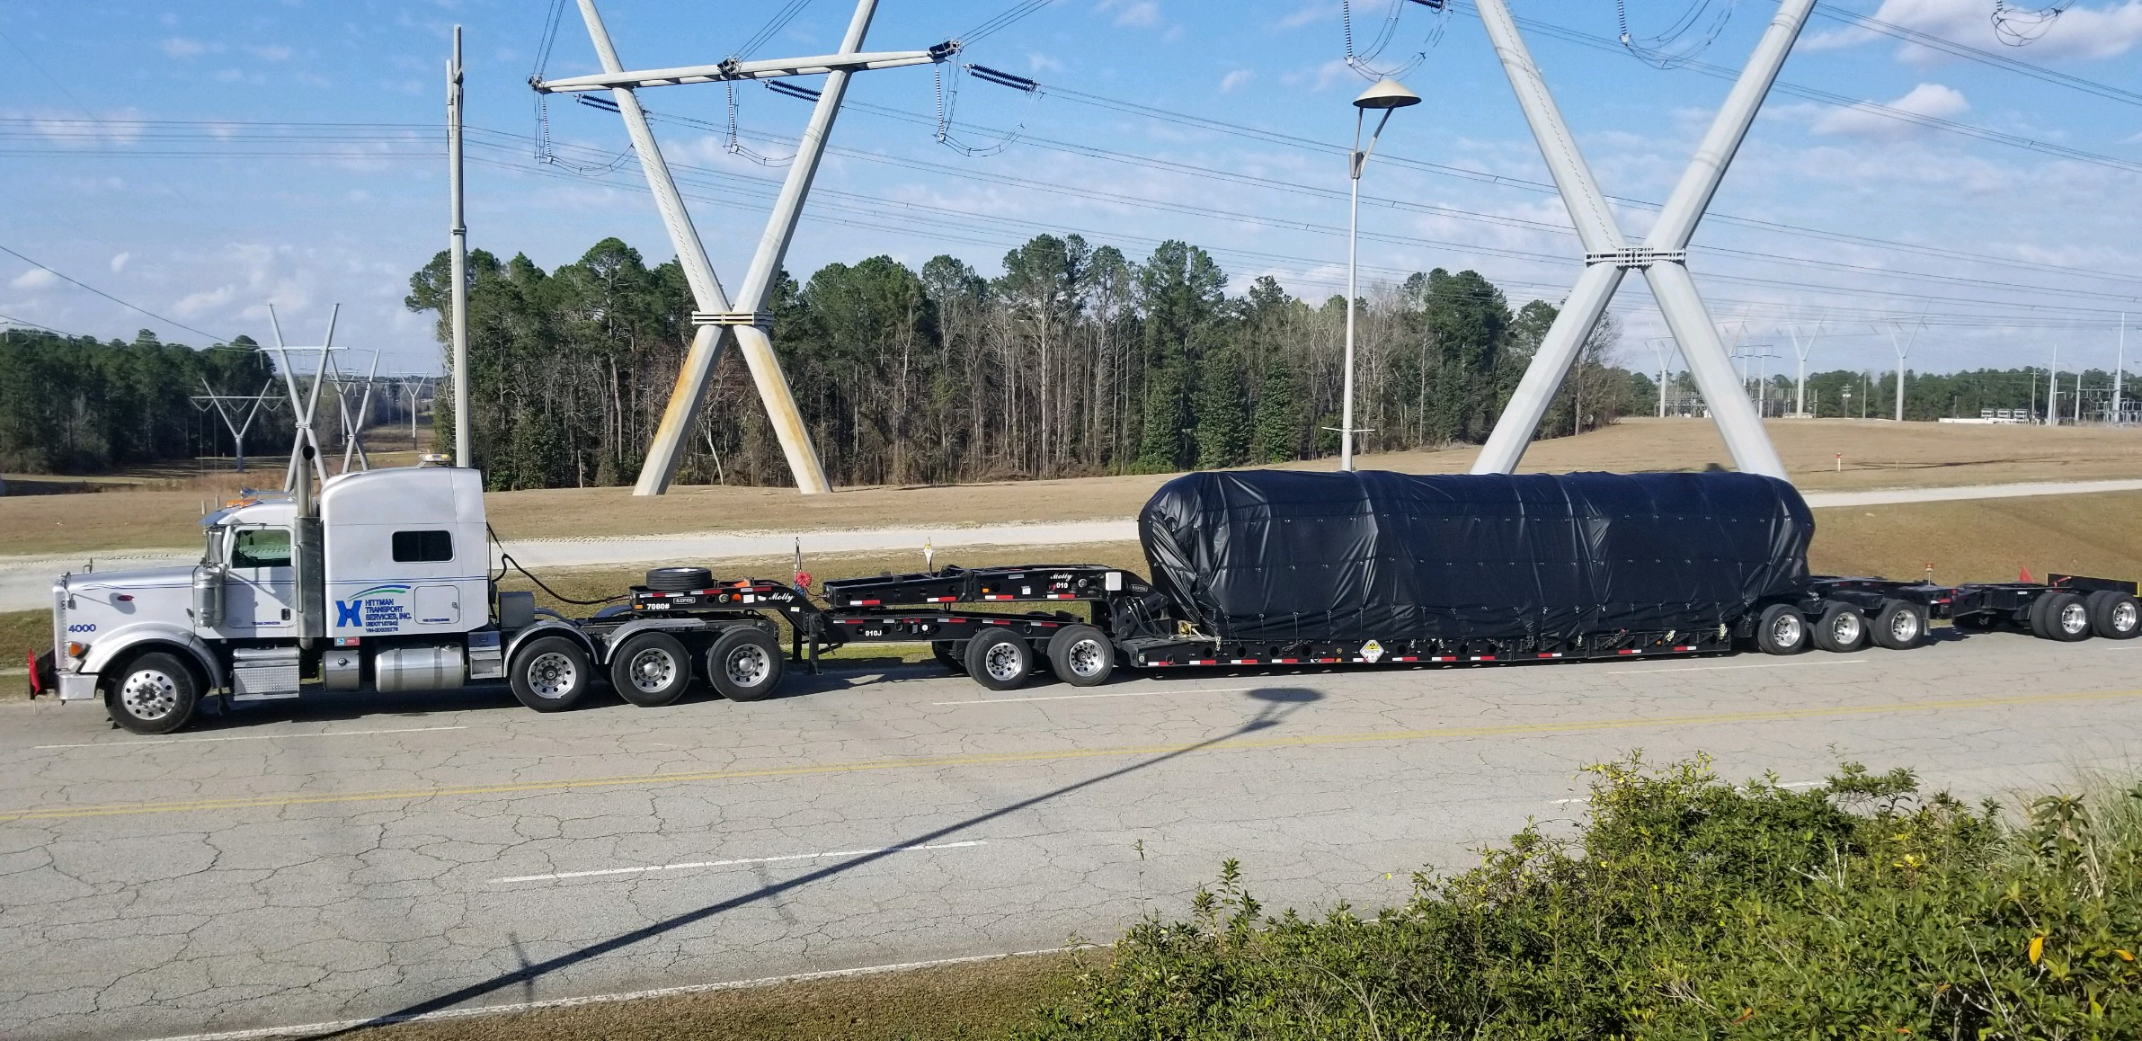
Questions?

