Slide 1
Barnwell Disposal Facility
Barnwell, South Carolina

Slide 2
Barnwell Disposal Location
Less than 50 miles from Augusta, GA
and ~70 miles from Columbia, SC

Slide 3
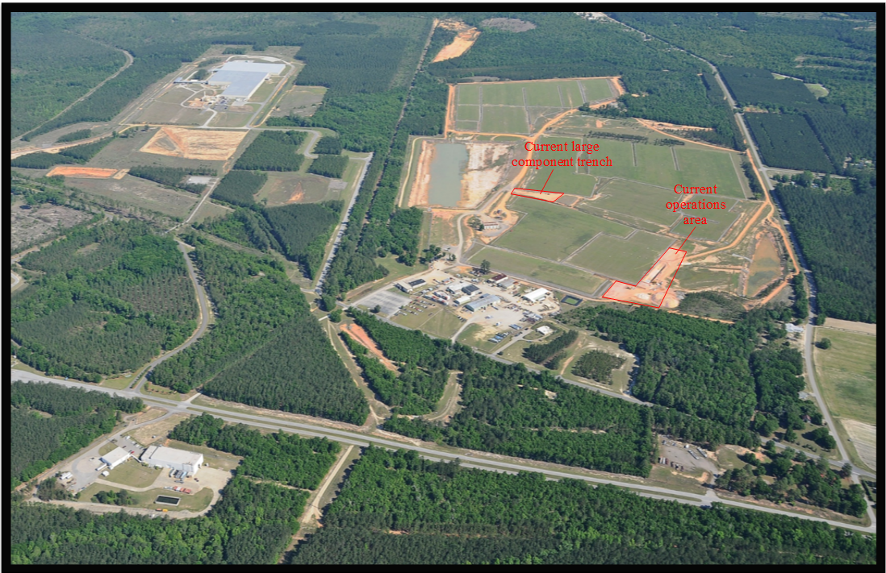
Barnwell Disposal Facility
235 acres licensed for disposal
123 acres in closed condition
11 acres available for potential disposal
96 acres for other uses
28.4 million cubic feet buried since 1971
14.4 million curies buried
~3.1 million curies remaining (decay correction)
192 groundwater monitoring wells

Slide 4
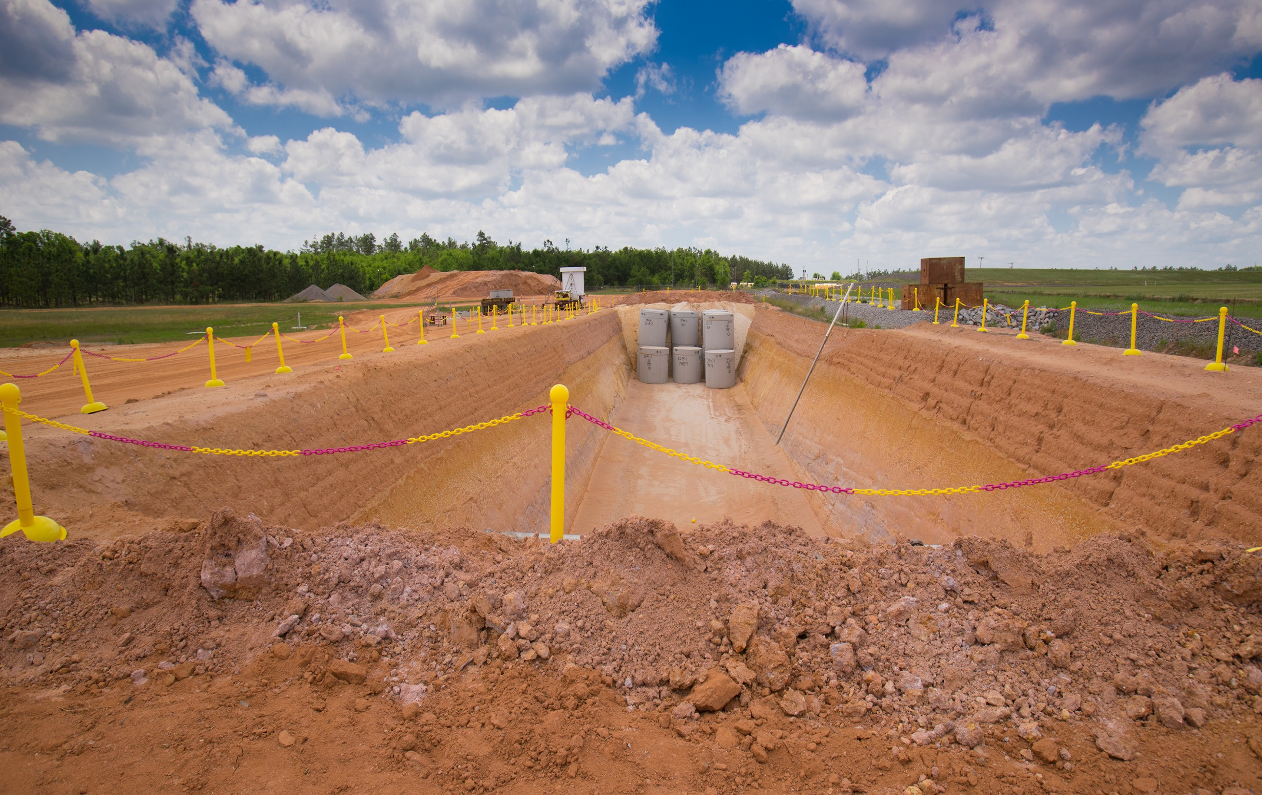
Barnwell Overview
Barnwell Disposal Facility (BDF) accepts Atlantic Compact Waste Only.
  Atlantic Compact Members are South Carolina, Connecticut, and New Jersey
Barnwell accepts radioactive waste for disposal using procedure S20-AD-010, Barnwell Waste Management Facility Site Disposal Criteria

Slide 5
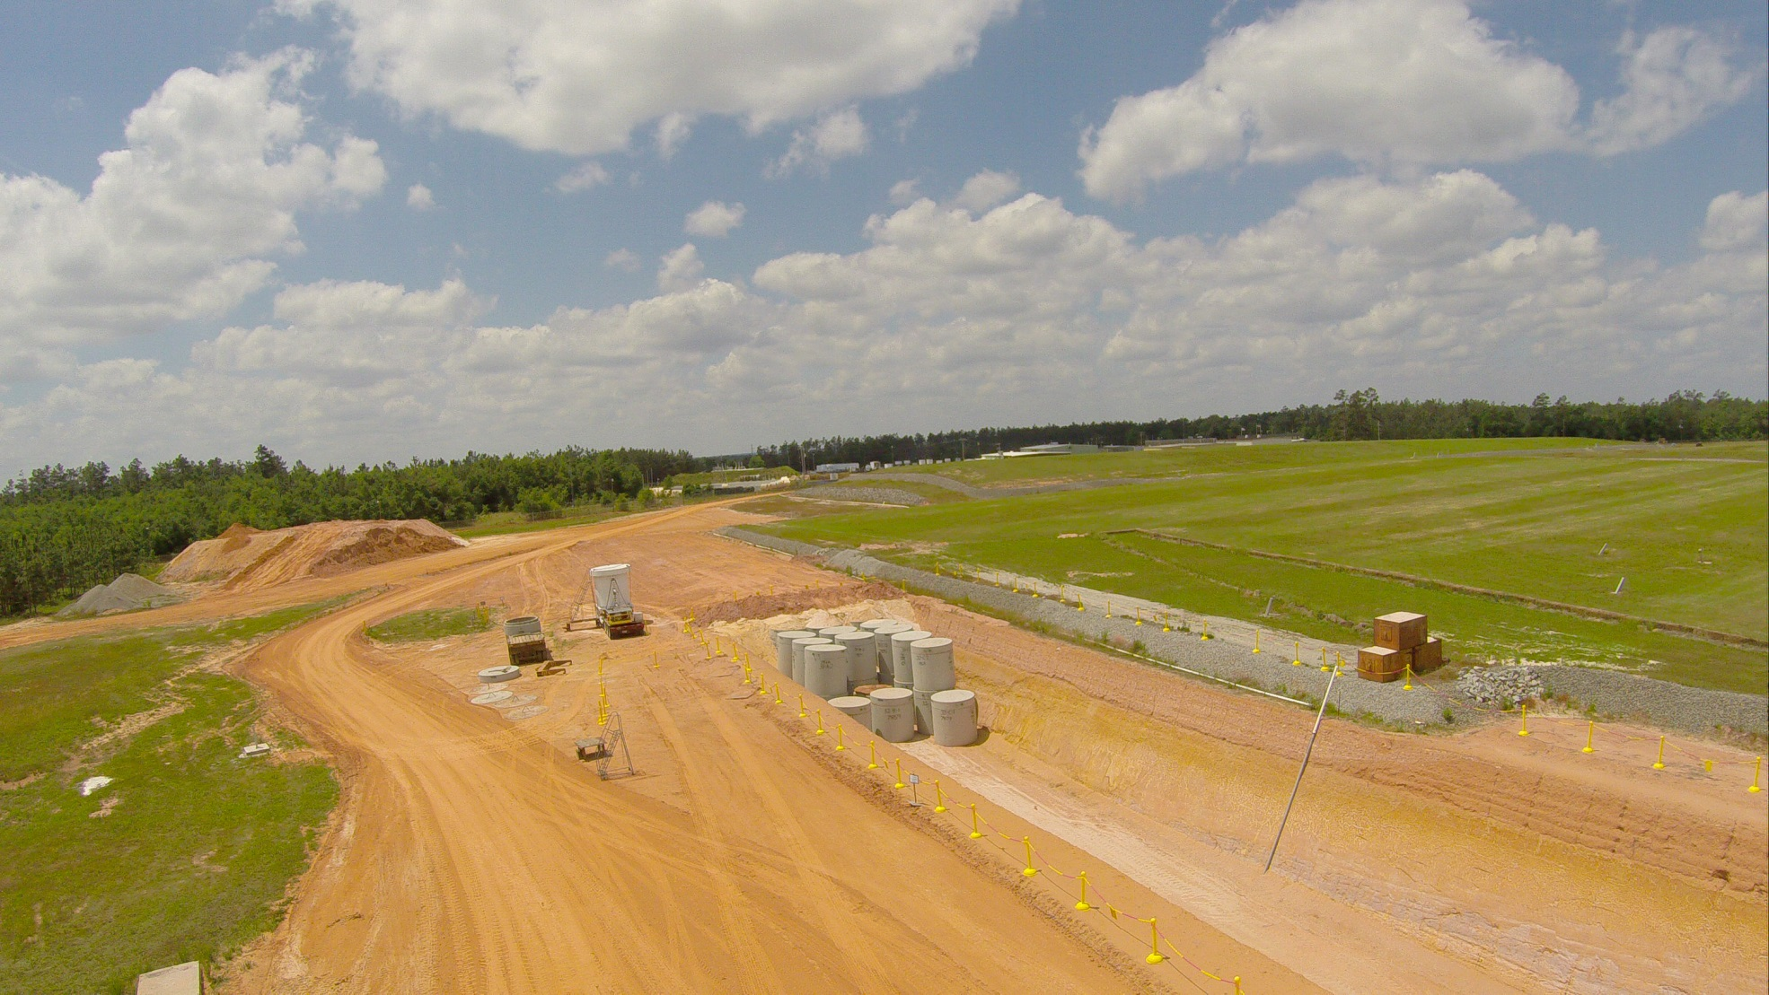
SC Department of
Environmental Services (SC DES)
License and Regulations
SC DES License
  SC DES Radioactive Material Number 097
SC Code of Regulations
  SC DES
    61-63 (Radioactive Materials – Title A)
    61-83 (Transportation of Radioactive Waste into or within SC)
SC Public Service Commission (PSC)
  Determines allowable costs
  Annual hearing process
SC Office of Regulatory Staff (ORS)
  Detailed audits of actual costs
  Sets prices for waste disposal

Slide 6
Barnwell Disposal Operations
Prior to Waste Scheduling – All waste generators, collectors and waste processors must have a SC issued Radioactive Waste Transport Permit.
Prior to Waste Receipt –
  DES Shipment Prior Notification Form 802 is required for shipments greater than 75 ft³ and/or greater than 1 curie and for shipments required to be transported by exclusive-use conveyance. Must be sent 72 hours before arrival in SC.
  DES Shipment Certification Form 803 is required for all radioactive waste shipments
  Must use Barnwell Specific NRC Manifest Forms

Slide 7
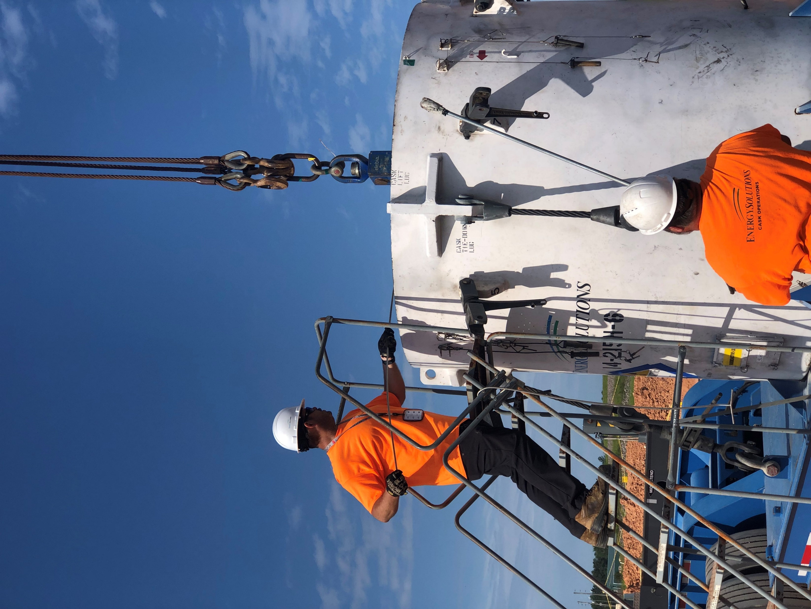
Barnwell Disposal Operations (Cont.)
Prior Notification must be made to the Barnwell Licensing Dept. for all radioactive waste shipments for approval and to receive a unique Shipment Identification Number for each shipment.
Maximum Disposal Package Size is 9’4” (L) x 7’6” (W) x 9’2” (H) unless prior approval is received by the Barnwell Licensing Dept and excluding Large Components.
Maximum Package Weight cannot exceed 54,000 pounds (maximum capacity for the disposal vault).
All Class C waste shipments must have DES approval prior to shipment.
All waste shipments arrive at the Barnwell Disposal Facility by truck.

Slide 8
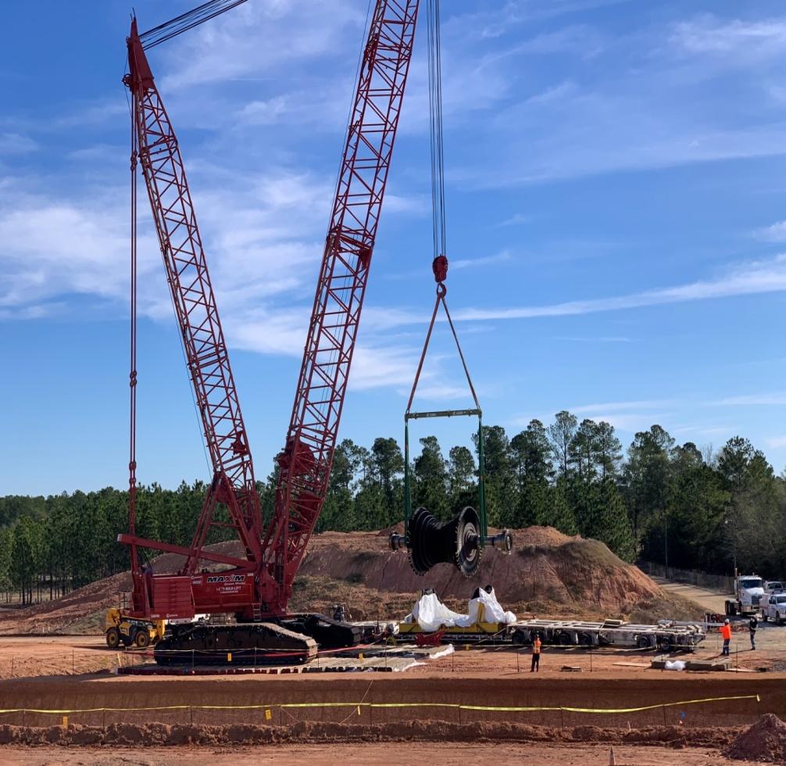
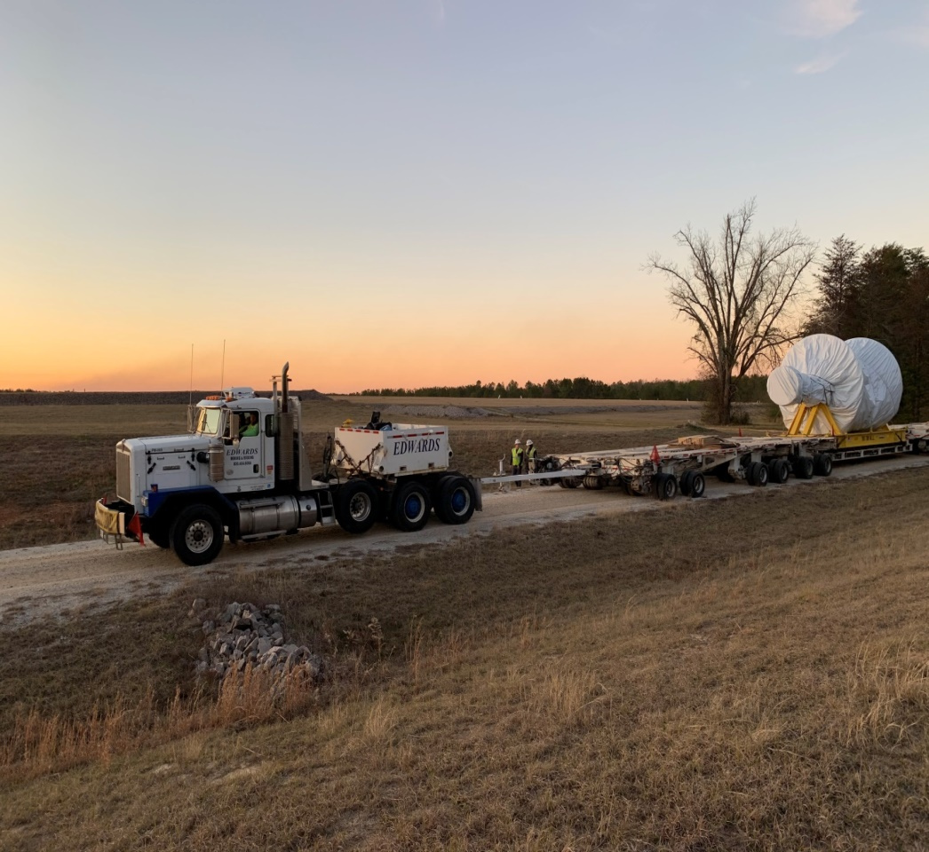
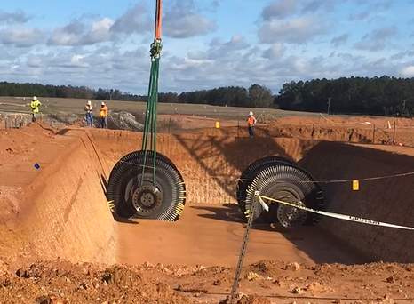
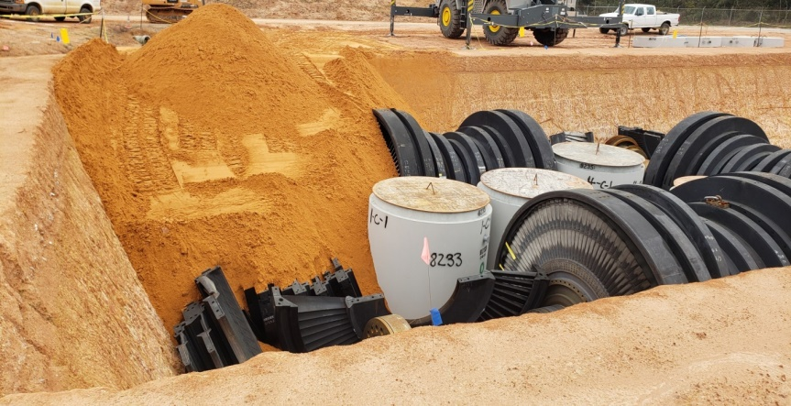
Large Components (Rotors and Diaphragms)

Slide 9
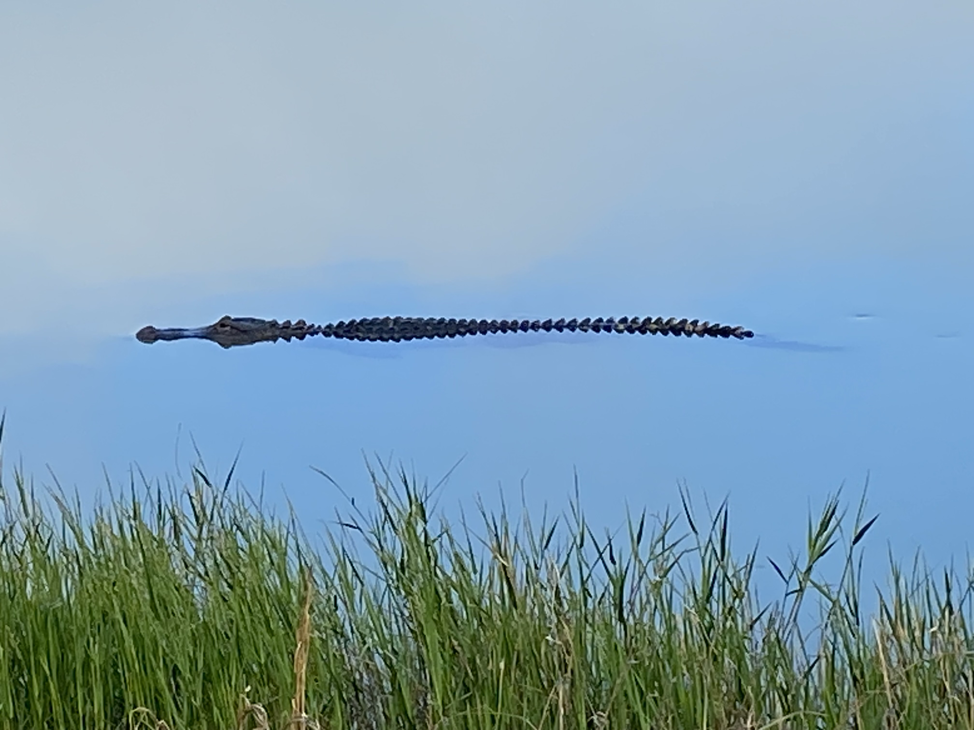
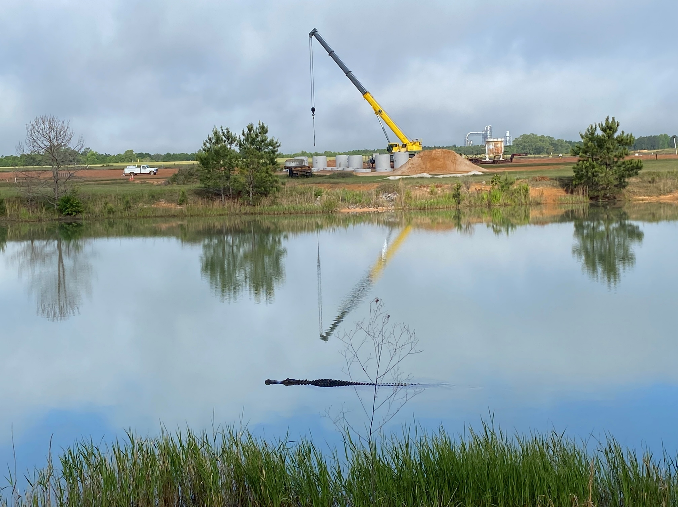
Wildlife at the complex
We do have gators from time to time as well as deer, geese, armadillos, turkeys, rabbits, etc.

Slide 10
Barnwell Disposal Licensing Contacts
Jeff Albano, Operations Director
    (803) 541-5070
    jalbano@energysolutions.com
Josh Grubbs, Licensing and Compliance Manager
(803) 541-5017
jcgrubbs@energysolutions.com

