Slide 1
2026 WAC Summit
Clive Facility WAC Training
Tim Orton
Jake Gardner

Slide 2
EnergySolutions’ Waste Acceptance Criteria and Customer Portal Overview
Technical Services Contact Information
Tim Orton Director of Technical Services 801-649-2144
torton@energysolutions.com 801-209-7251 (cell)
Jake Gardner VP of Technical Services 865-220-1207
jhgardner@energysolutions.com 801-836-1555 (cell)
Veronica Pitts Technical Services Customer Specialist 801-649-2139
vpitts@energysolutions.com 801-573-1707 (cell)

Slide 3


EnergySolutions’ Waste Acceptance Criteria and Customer Portal Overview
Customer Portal Scheduling Steps
Shipping Waste to Clive?
  Use Customer Portal
Need help?
  Call us
Technical Services Help
EnergySolutions Brokers Available

Slide 4
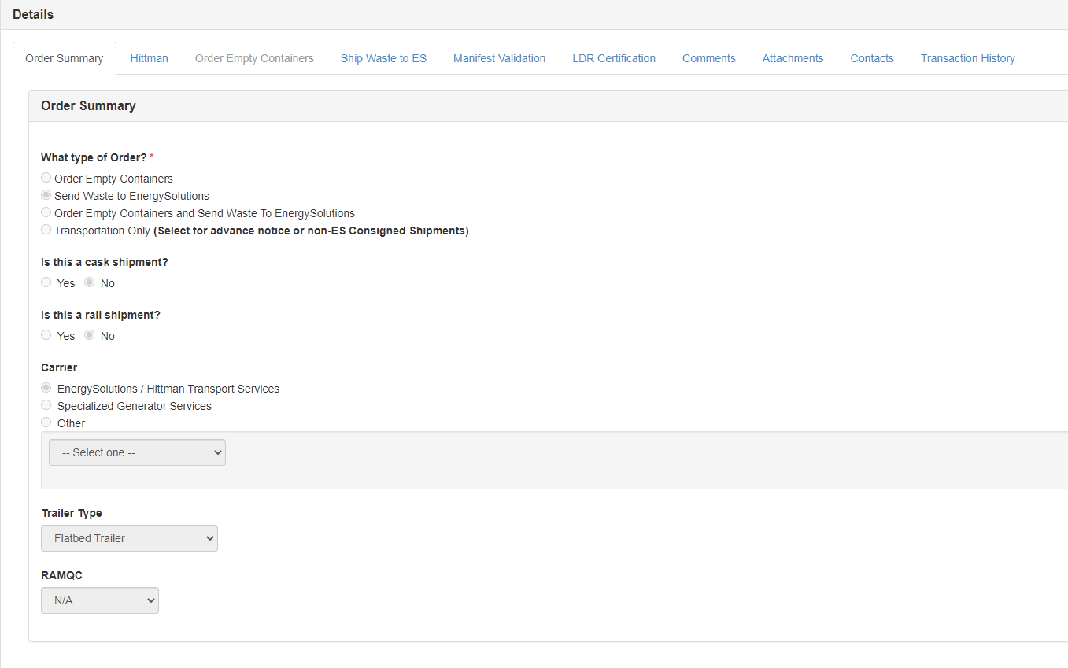
EnergySolutions’ Waste Acceptance Criteria and Customer Portal Overview
Customer Portal Scheduling Steps
Forms
Answer Questions
Depending upon the answers, different sections will open

Slide 5
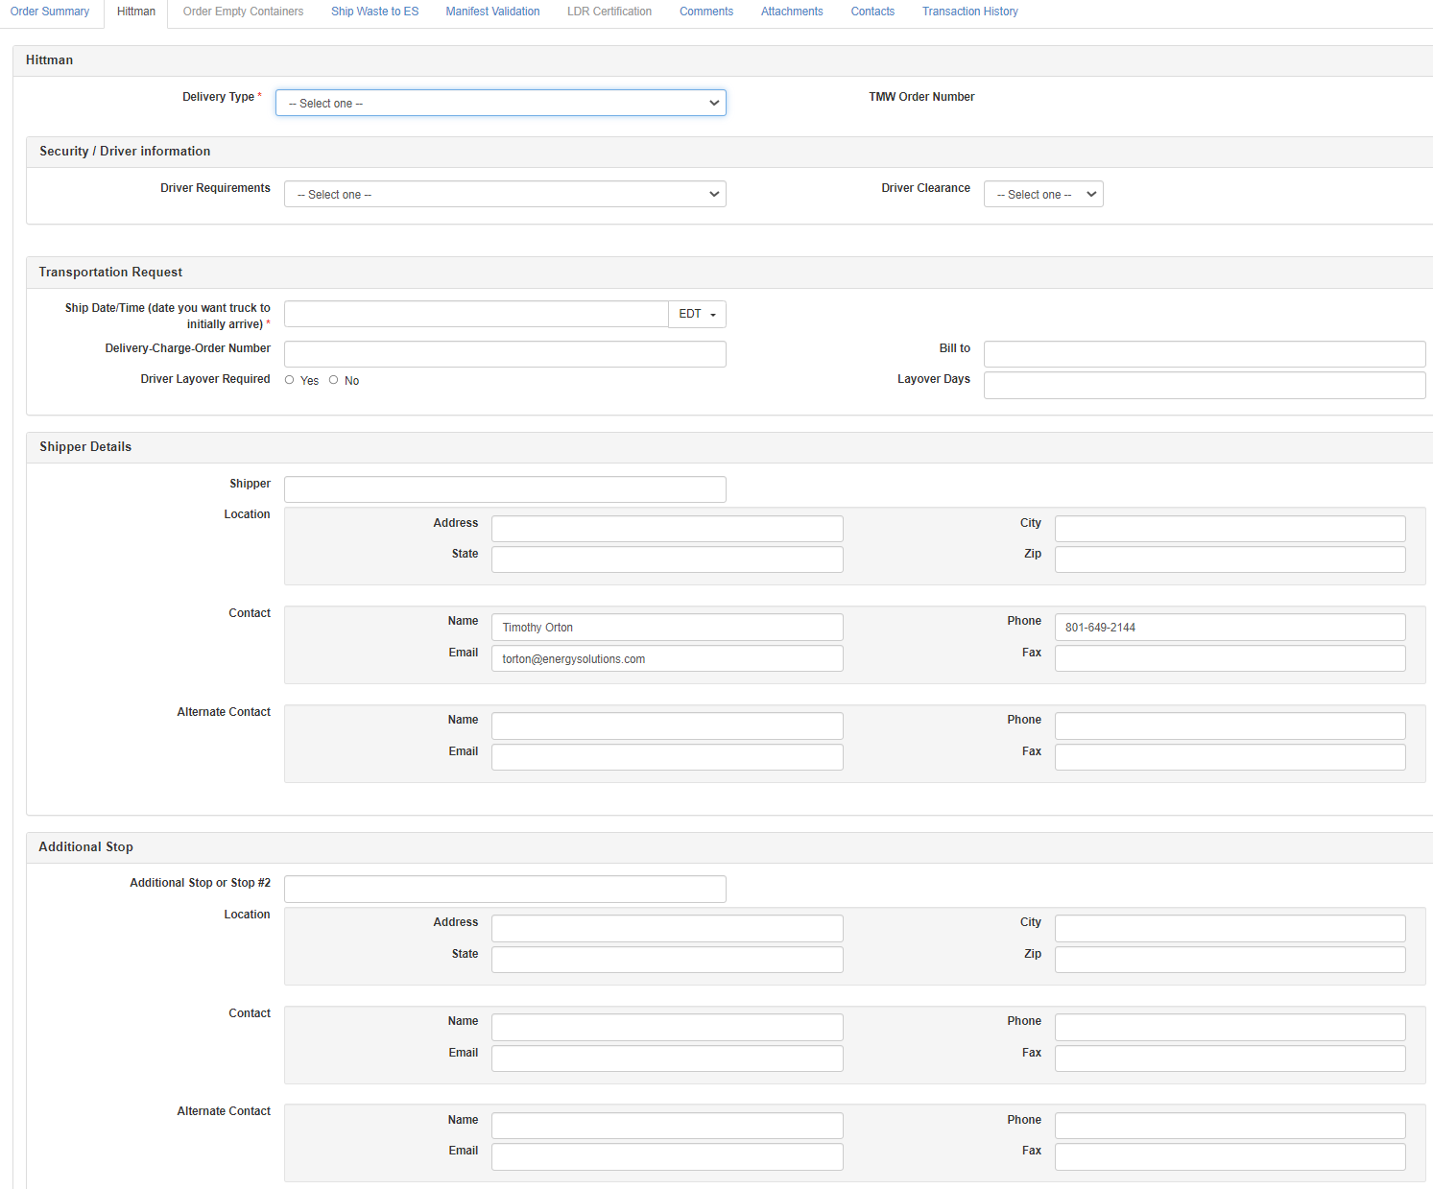
EnergySolutions’ Waste Acceptance Criteria and Customer Portal Overview
Customer Portal Scheduling Steps
If using Hittman Transport :
Enter shipment details
Four Required Fields
  Delivery Type
    Bobtail in
    Deadhead in
    Deadhead away
    Bobtail away
    Drop & Swap
  Date/Time Truck Needed
  Delivery Date/Time
  Trailer Type

Slide 6
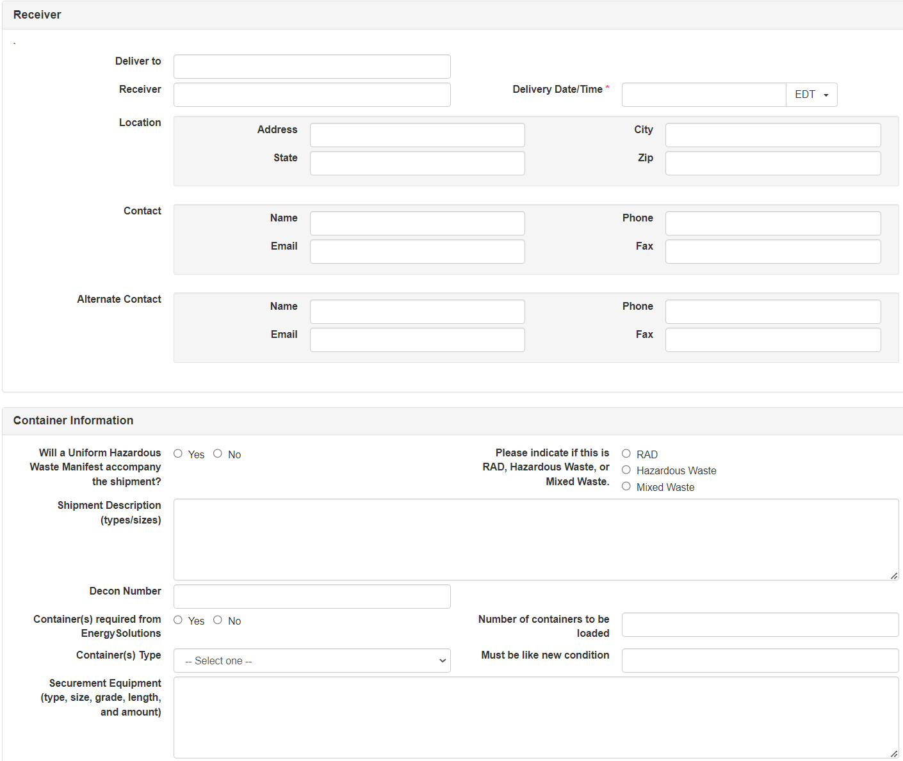
EnergySolutions’ Waste Acceptance Criteria and Customer Portal Overview
Customer Portal Scheduling Steps
Hittman Tab
Deliver to
  Clive
  BCO
Container Info
  Important

Slide 7
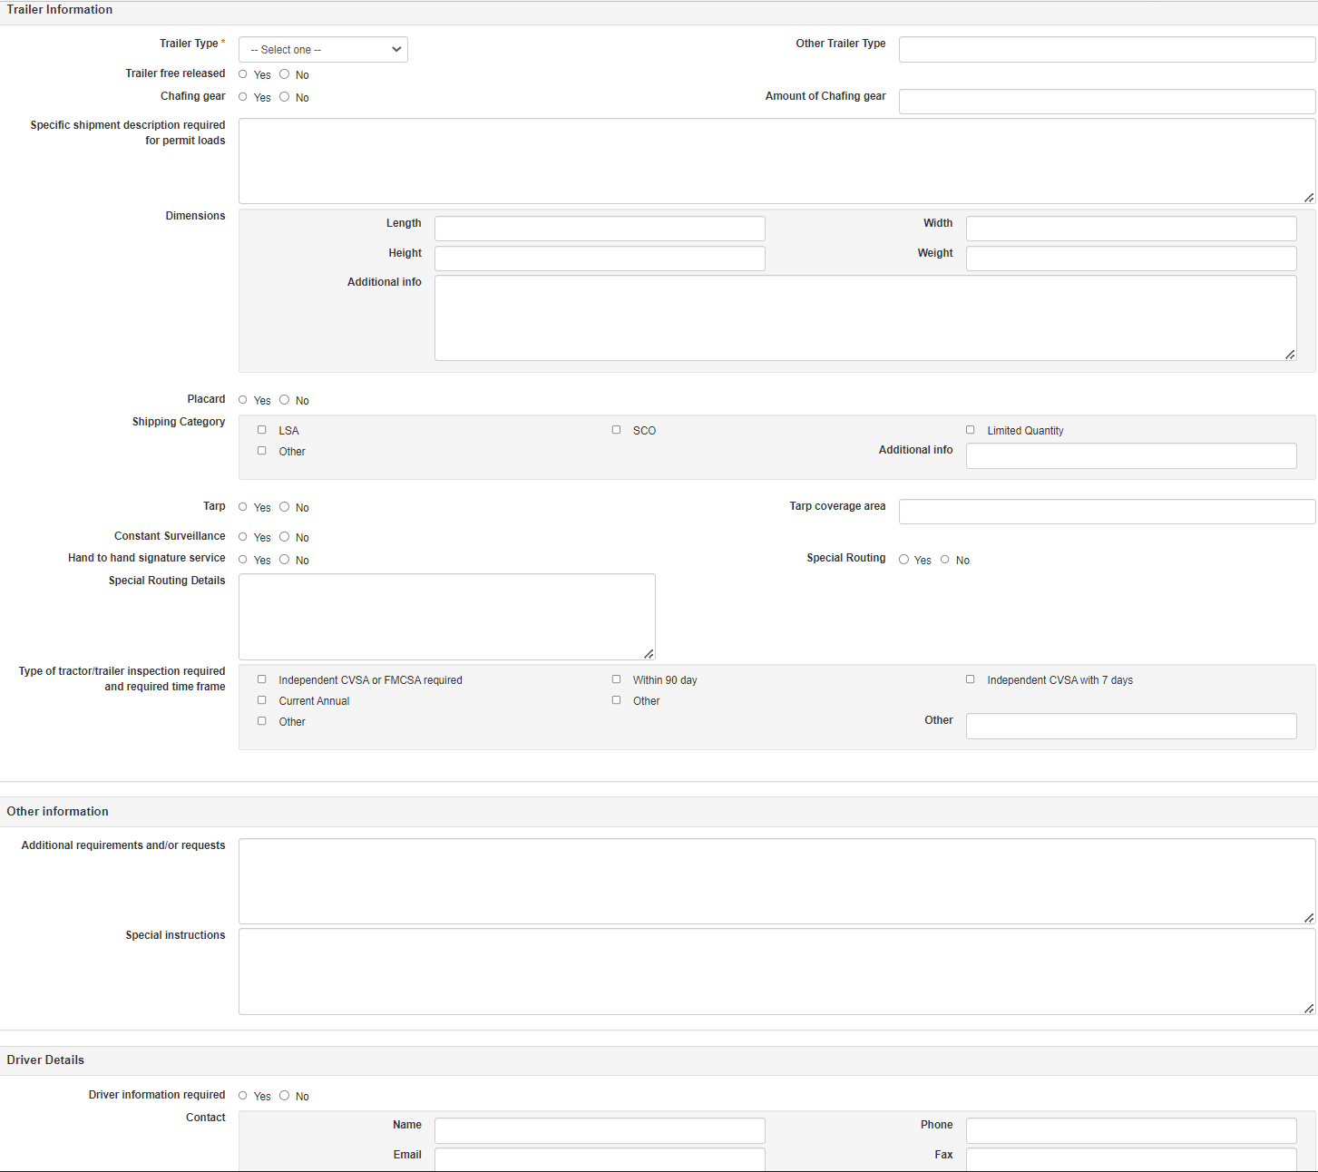
EnergySolutions’ Waste Acceptance Criteria and Customer Portal Overview
Customer Portal Scheduling Steps
Hittman Tab
Additional Info
More detail
Better we can serve

Slide 8
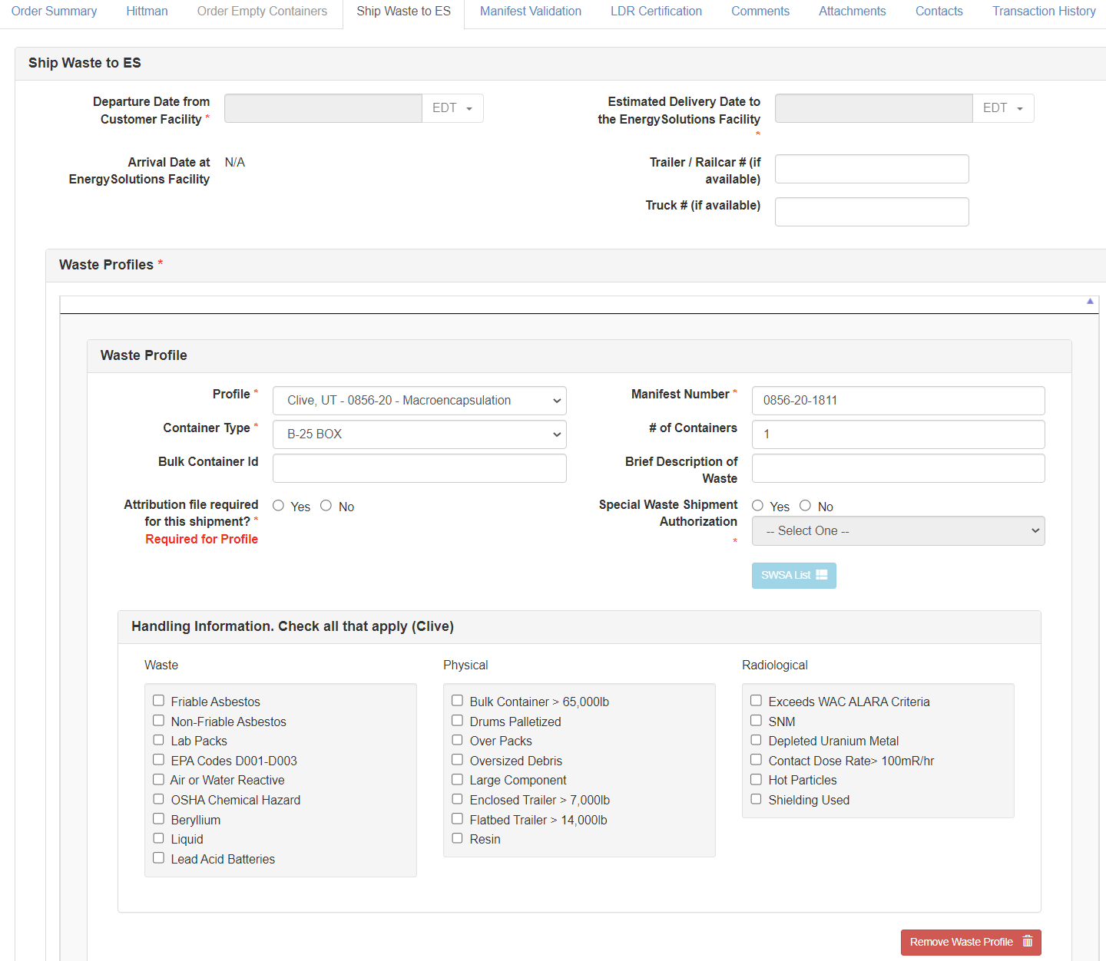
EnergySolutions’ Waste Acceptance Criteria and Customer Portal Overview
Customer Portal Scheduling Steps
Enter Waste Profile Information – Ship Waste to ES Tab
Departure and Arrival Dates
  Required
  Auto-filled if Hittman
Assign a valid Profile and Manifest Number
SWSA
Enter Handling Information
  Make sure to identify all applicable hazards

Slide 9
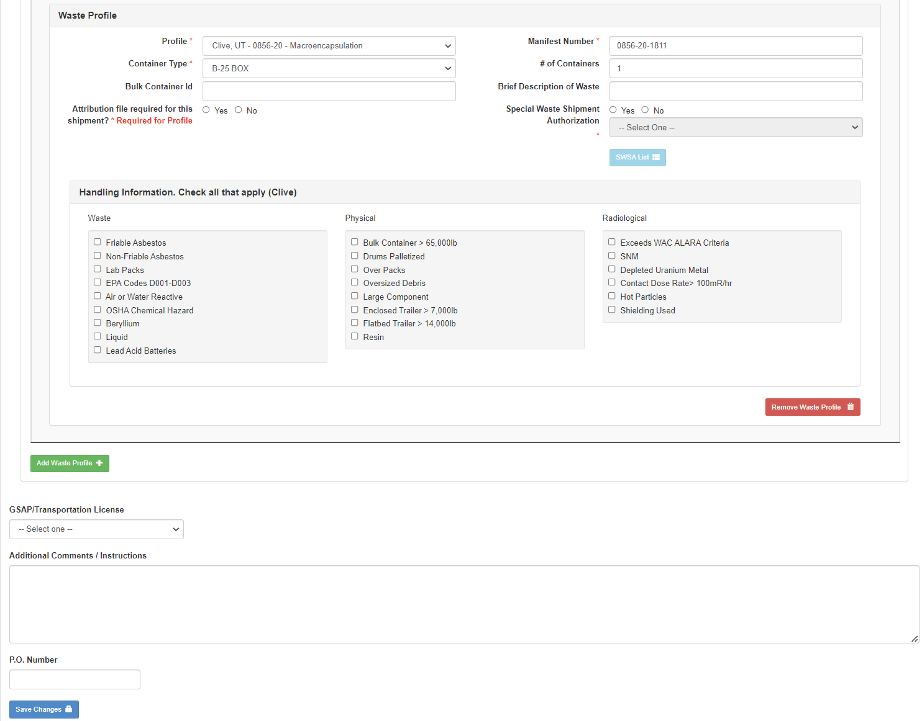
EnergySolutions’ Waste Acceptance Criteria and Customer Portal Overview
Customer Portal Scheduling Steps
Good Communication=
Less Stress!
GSAP!!
Make sure to put good
notes in CP!!

Slide 10
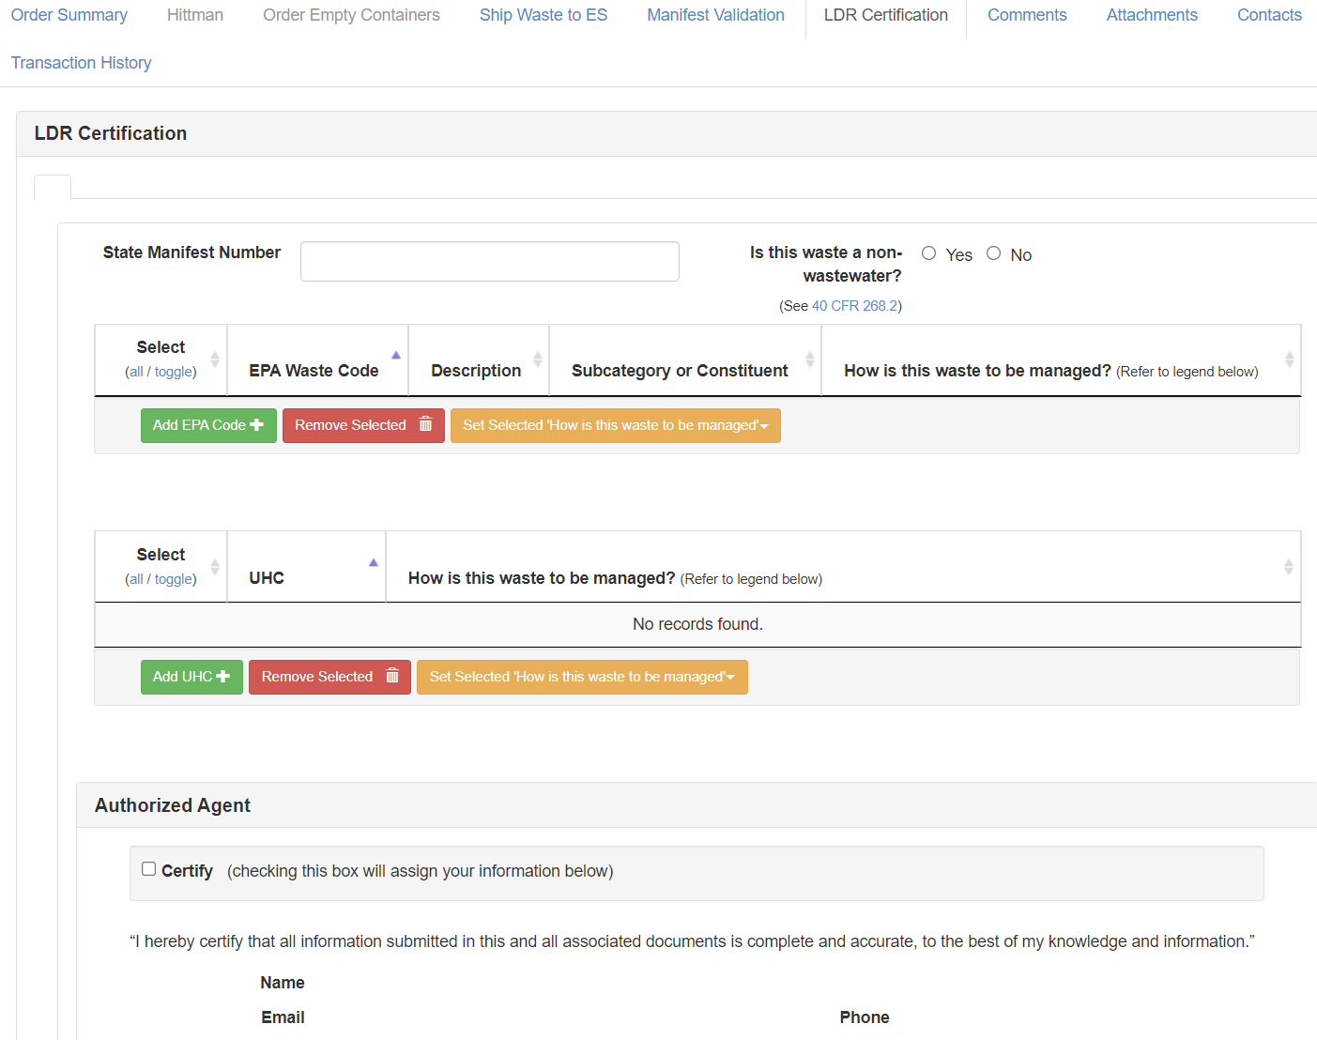
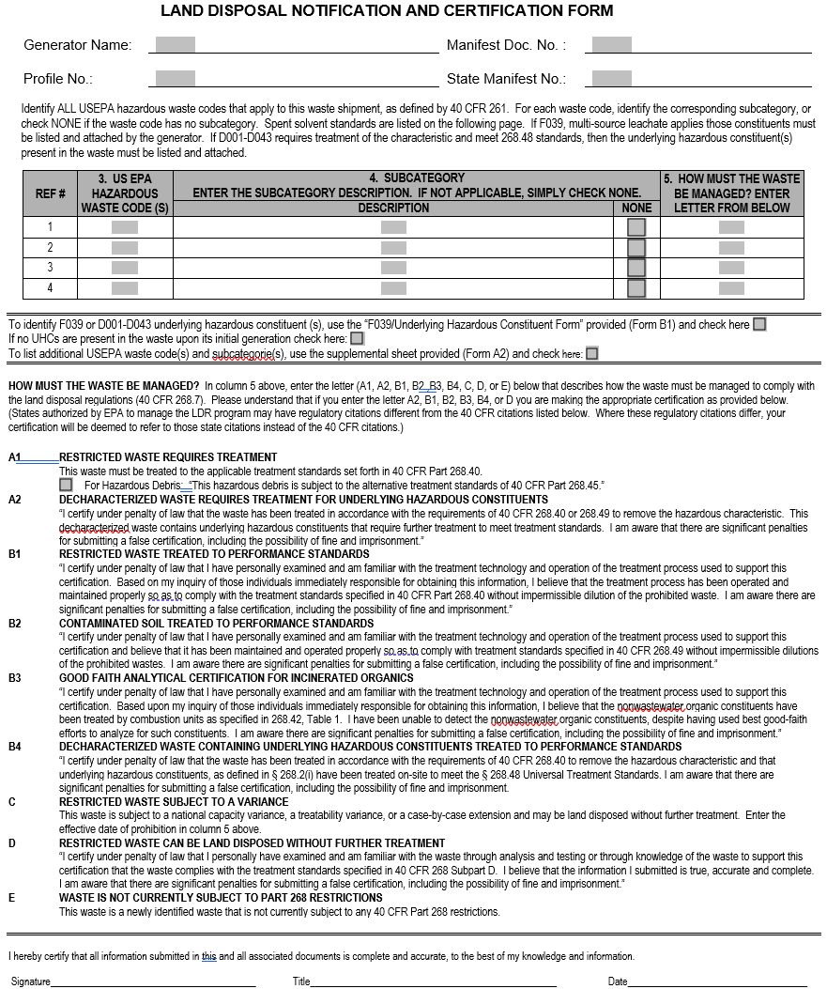
EnergySolutions’ Waste Acceptance Criteria and Customer Portal Overview
Customer Portal Scheduling Steps
Land Disposal Restrictions (LDR) Certification
Required by Clive Permit
CP or Customer-generated
CP Tab opens based on Profile
  Includes Codes of Profile
Include as Attachment
  CP Automatic

Slide 11
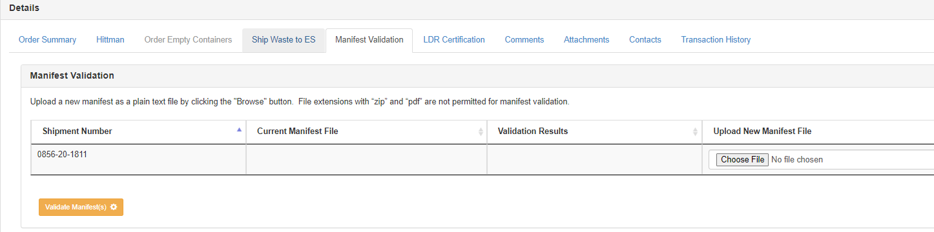
EnergySolutions’ Waste Acceptance Criteria and Customer Portal Overview
Customer Portal Manifest Upload
*Do not upload PDF or Excel files

Slide 12
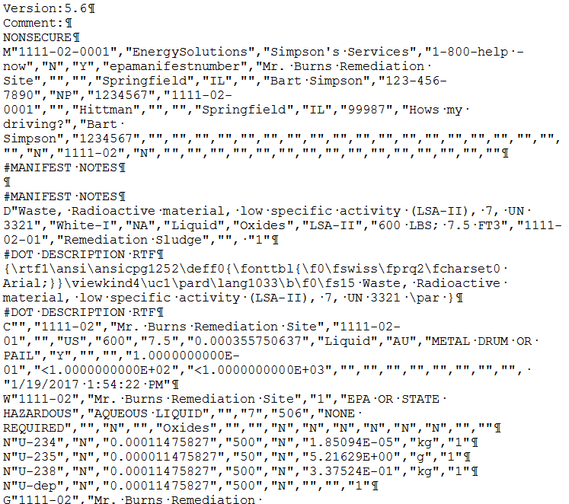
EnergySolutions’ Waste Acceptance Criteria and Customer Portal Overview
Customer Portal Manifest Upload
Generate efile from Manifest Program
*.mc file:
Lowtrack
Radman
DW James
EWT
emWaste
File naming – shipment name only
(e.g., 1111-02-0001.mc)

Slide 13
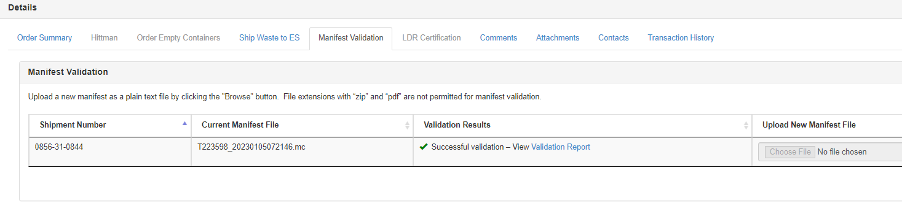
EnergySolutions’ Waste Acceptance Criteria and Customer Portal Overview
Customer Portal Manifest Upload

Slide 14
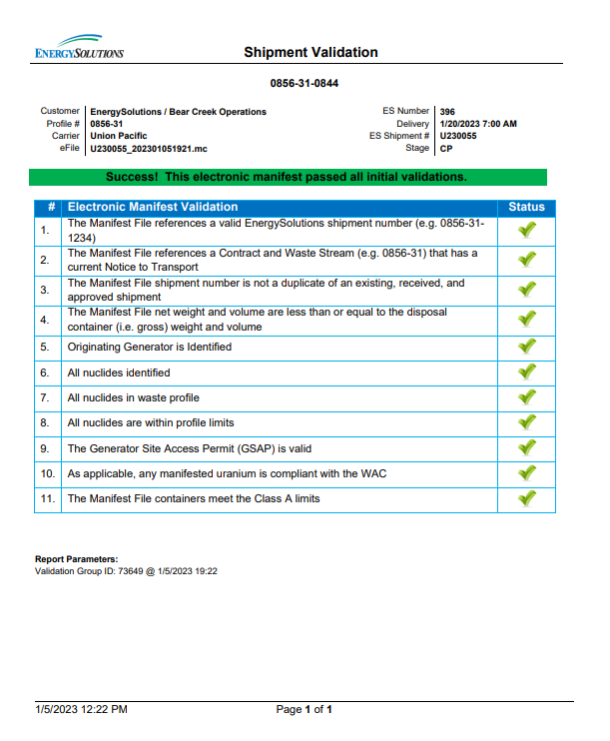
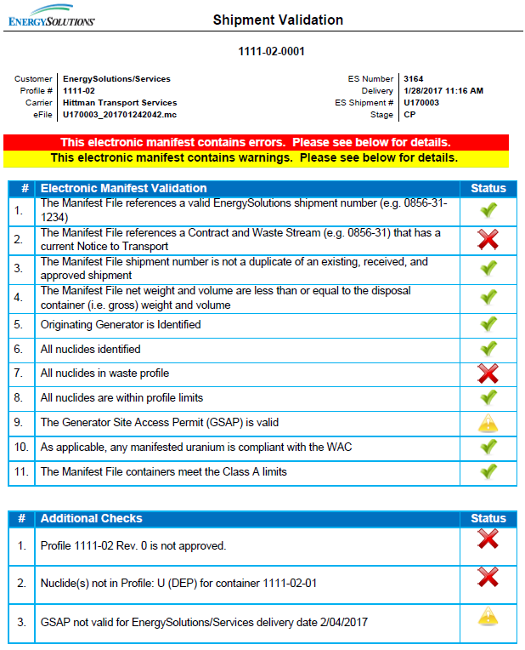
EnergySolutions’ Waste Acceptance Criteria and Customer Portal Overview
Customer Portal Manifest Validation
Good Validation vs. Bad Validation

Slide 15

EnergySolutions’ Waste Acceptance Criteria and Customer Portal Overview
Customer Portal Shipment Revisions
Do not be afraid to revise!
Clive needs as much information as possible
Adding information does not require review
Please add any changes made into notes
Hit Request Schedule
Clive will review and approve
Contact Technical Services with any questions

Slide 16
EnergySolutions’ Waste Acceptance Criteria and Customer Portal Overview
Other Shipping Notes
SNM Exemption Forms
  Specific to Shipment
  Current Revision (Rev. 4)
Postpone Shipments ASAP
  If not shipping, please cancel
REQUEST: (Will expedite Review and Acceptance)
Copy of Shipment Packet into CP
  At time of shipment

Slide 17
EnergySolutions’ Waste Acceptance Criteria and Customer Portal Overview
Other Shipping Notes
Any package >7,500 lbs in Van Trailer
  Set on back, near door
  Prior Approval from Clive
Liner surveys required (prior to shipment receipt at Clive) on all Liners >10R/hr
Waste in Drums or Bags – strongly preferred palletized

