Slide 1


Lessons Learned:
Small Weaknesses, Big Impacts
Notes:
Welcome the audience.
Today’s discussion focuses on operational learning within the waste management lifecycle. Specifically, how small overlooked weaknesses early in the process can eventually become major operational impacts.

Slide 2
Welcome
Jedidiah Emich
EnergySolutions
Tommy Courtemanche
WMG
Mike Reeves
WMG
Notes:
Introduce all the speakers

Slide 3
Purpose
“This presentation is not about assigning blame.”
Notes:
The objective is understanding how small overlooked conditions can compound through the waste management lifecycle. Most operational events are not caused by one catastrophic failure. They develop through accumulated weaknesses, assumptions, degraded controls, or missed opportunities. Often the shipment rejection or transportation event is simply where the industry finally discovers the issue.

Slide 4
The Lifecycle Concept
Planning
Implementation
Execution
Small
Weakness
Process
Degradation
Operational
Event
Notes:
Most operational failures do not begin during execution.
The lifecycle begins with planning. Weaknesses introduced early propagate downstream.
Assumptions, Verification gaps, interface weaknesses, evolving work conditions
The operational event is often the visible symptom – NOT the origin.

Slide 5
Waste Management Lifecycle
WM Planning
Transport Coordination
Packaging & Loading
Disposal Logistics
Notes:
WM Planning
This phase establishes:
characterization
WAC review
packaging strategy
transportation requirements
scheduling and coordination
Many operational issues begin here through assumptions, incomplete information, or weak verification.
Transport Coordination
This includes:
carrier coordination
shipment planning
routing
regulatory alignment
Planning assumptions now begin interacting with real operational constraints.
Packaging & Loading
This is where planning becomes execution:
waste segregation
surveys
packaging
marking and labeling
shipment verification
If conditions evolve but controls do not evolve alongside them, risk increases.
Disposal Logistics
This is often where issues are finally discovered:
WAC exceedances
shipment rejections
dose discrepancies
manifest issues
Key takeaway:
Risk introduced early can affect every downstream organization involved in the process.
This is why lifecycle visibility, strong communication, questioning attitude, and operational integration are critical to reducing operational risk.

Slide 6
Why this matters
Outage Schedules
Transportation Compliance
Disposal Access
Rework
Operational Delays
Regulator Attention
Cost Escalation
Notes:
Problems become exponentially more expensive the later they are discovered

Slide 7
Am-241 GTCC Event
Waste characterized
Shipment approved
Disposal review identified issue
WAC exceeded
Return shipment required
Notes:
At first glance, the event appeared to be a disposal issue. In reality, the failure pathway started much earlier.

Slide 8
Root Causes & Impacts
Input Error
Incorrect Assumptions
Verification Weaknesses
Communication Breakdown
Independent review gaps
Notes:
The operational issue was discovered during disposal review. The actual failure began during planning and characterization.
The result was a return shipment, CAP actions, schedule impacts, management oversight, regulator notifications.
A small planning error propagated through the entire lifecycle.

Slide 9
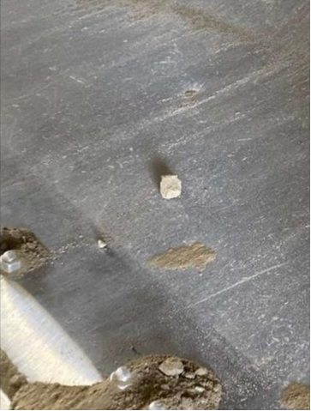
Railcar Dose Rate Event
Shipment Loaded
Surveys acceptable at departure
Elevated dose identified at arrival
Concrete fragment discovered
DOT limits exceeded
Notes:
Conditions changed, but controls did not evolve with those conditions.

Slide 10
Lessons Learned
Changing Work Conditions
Need for evolving controls
Intrusive inspections
Questioning attitude
Independent Verification
Notes:
The work instructions were no longer effective in the changing conditions. Increased surveillance should have evolved alongside operational conditions. Major operational impacts can originate from very small, unrecognized conditions.

Slide 11
Not Isolated Incidents
Different technical failures revealed similar organizational weaknesses:
      Human performance weaknesses
      Oversight gaps
      Verification failures
      Interface breakdowns
Notes:
At this point the organization recognized this was larger than one shipment event.

Slide 12
Programmatic Analysis
Trend Analysis
Lifecycle Evaluation
The objective became understanding the organizational conditions allowing these events to occur.
Interface Reviews
CAP Reviews
Notes:
The organization moved from event investigation to systemic evaluation

Slide 13
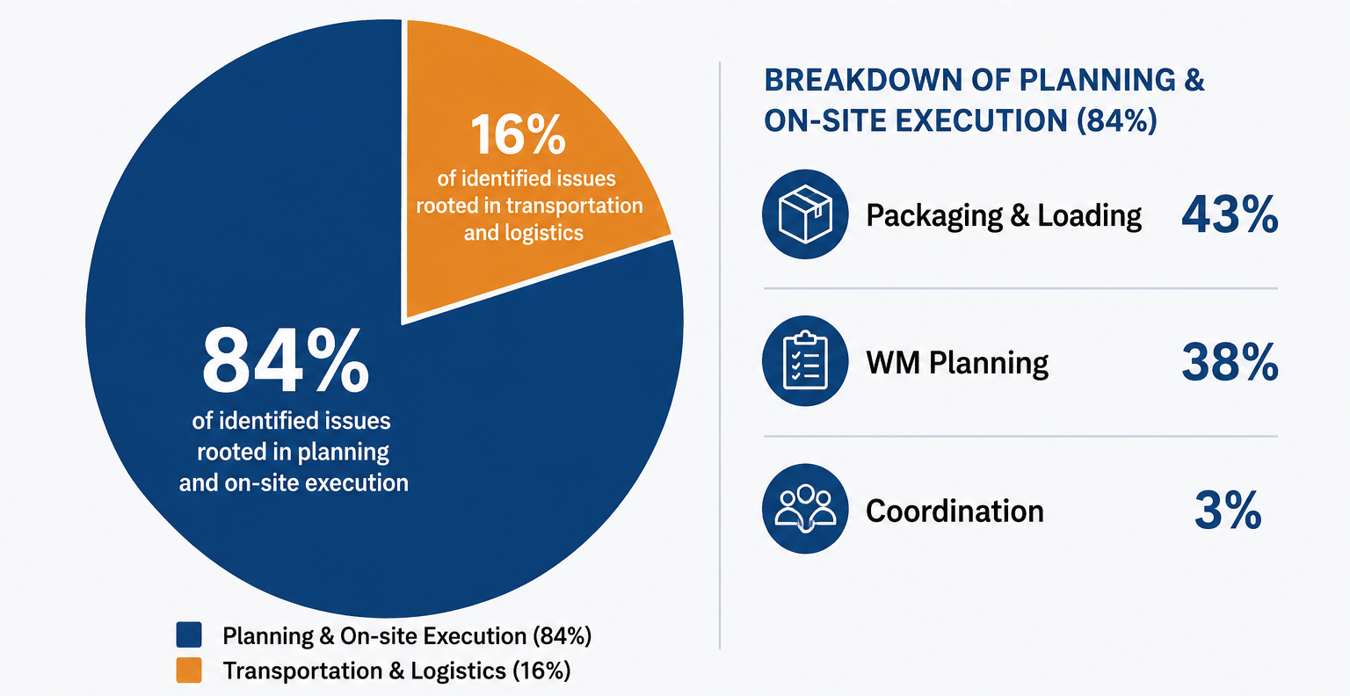
Lifecycle Analysis Results
Notes:
The majority of weaknesses existed long before transportation or disposal discovery.

Slide 14
Common Themes
Human Performance
Program Controls
Organizational Interfaces
Weak questioning attitude
Oversight gaps
Procedure degradation
Weak self-verification
Training gaps
Interface weaknesses
Notes:
These themes appeared repeatedly across unrelated events. This indicates systemic drift, not isolated mistakes.
The human performance themes identified in these events align most closely with the INPO traits of Questioning Attitude and Personal Accountability. In several cases, assumptions were not challenged, changing conditions were not recognized, and opportunities to self-check or independently verify information were missed before the issue progressed downstream.
The program control weaknesses align with the INPO traits of Work Processes and Leadership Safety Values and Actions. Procedures, oversight, verification activities, and management engagement are intended to provide defense-in-depth. When those controls weaken or fail to evolve with changing conditions, organizational risk increases.
The organizational interface weaknesses align with several INPO traits, including Continuous Learning, Respectful Work Environment, and Problem Identification and Resolution. Effective communication between organizations, timely sharing of information, and learning from operating experience are essential to maintaining lifecycle visibility and preventing issues from propagating downstream.
These themes are not unique to waste management. They are the same safety culture traits the nuclear industry has emphasized for decades because weaknesses in these areas consistently appear in event investigations across the industry.

Slide 15
The Real Lessons Learned
The events were operational symptoms.
The real issue was organizational drift.
Notes:
Operational events rarely originate from one catastrophic failure. They develop through fragmented processes and degraded interfaces. As operations become more technically complex, interface management becomes increasingly important.

Slide 16
Integration as Risk Reduction
Integration is not just organizational efficiency — it is operational risk reduction.
Notes:
Discuss benefits of integration:
early transportation involvement
unified lifecycle planning
operational continuity
integrated visibility
training aligned to OE
Key message:
“Integration is not just organizational efficiency — it is operational risk reduction.”

Slide 17
Integration as Risk Reduction
Lesson Learned | Integration Benefit
Verification weaknesses | Shared visibility
Communication gaps | Unified planning
Training gaps | Consistent qualification
Interface breakdowns | Operational continuity
Late issue discovery | Earlier engagement
Notes:
Discuss benefits of integration:
early transportation involvement
unified lifecycle planning
operational continuity
integrated visibility
training aligned to OE
Key message:
“Integration is not just organizational efficiency — it is operational risk reduction.”

Slide 18
The Future of
Waste Operations
Reduced Operational Risk
Strong Planning
Strong Questioning Attitudes
Strong Operational Integration
Strong Work Processes
Notes:
Reduced operational risk is the result of strong work processes, strong questioning attitudes, and strong operational integration.
The goal is not simply responding better to events. The goal is identifying weak signals before they become operational consequences.

Slide 19
The Future
Operational Continuity
Transportation Expertise
Lifecycle Visibility
Training Consistency
Continuous Learning
Notes:
“The future of the industry depends on combining operational experience, strong planning, technical rigor, and continuous learning.”
With that, we’d be happy to take questions.

Slide 20
Thank you!
Jedidiah Emich
EnergySolutions
jlemich@energysolutions.com
509.438.0106
Mike Reeves
WMG
jmreeves@energysolutions.com
225.936.3288
Tommy Courtemanche
WMG
tcourtemanche@energysolutions.com
914.424.4284
Notes:
Add contact information for the speakers.

