Slide 1
2026 WAC Summit
Donnie Brackett

Slide 2
Bear Creak Operations
Waste Acceptance Guidelines (WAG)

Slide 3
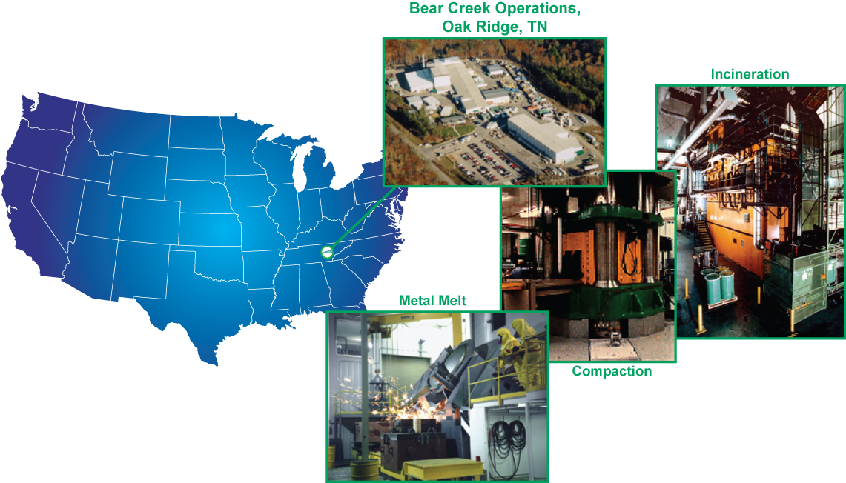

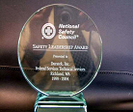
Bear Creek Facility Oak Ridge, TN
Two incinerators
Compactor
Metal melt furnace
5-year storage permit
Two radioactive materials licenses
Mixed waste treatment permit
TN-OSHA VPP SITE since 2008

Slide 4
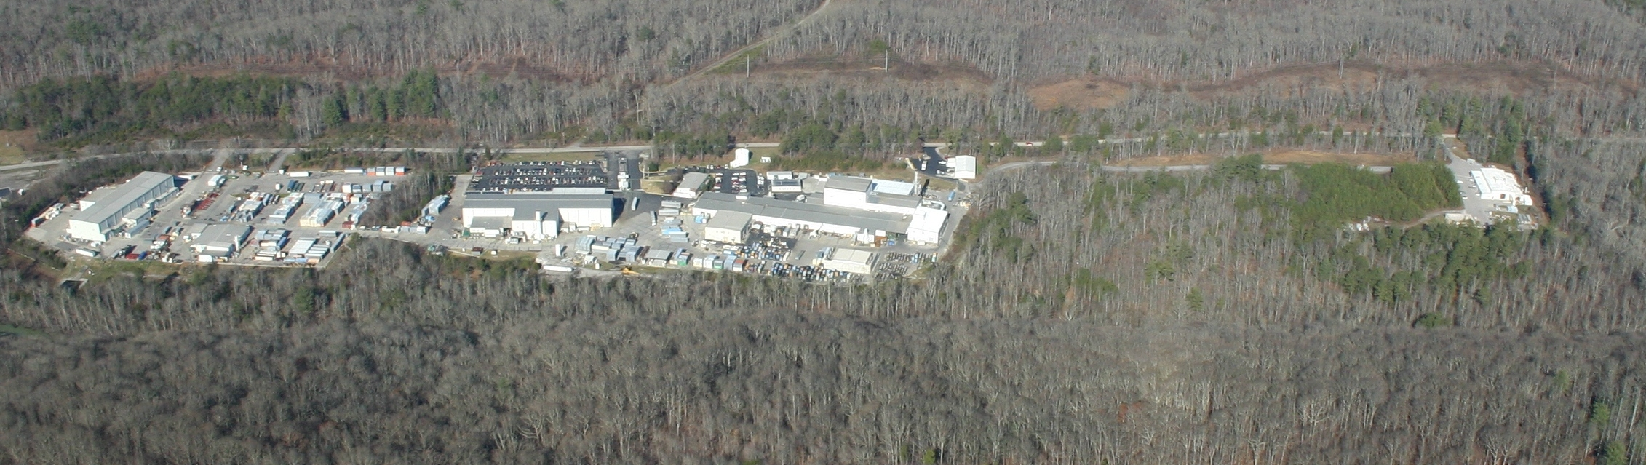
Bear Creek Central Facility Layout
Admin Bld
CVRF/Press
RMS
Containers
Incinerators
LVRF
Instrumentation
P4/RCRA
Metals and Commercial Certification
Over 13,000 tons per annually of Processed Radioactive Material

Slide 5
Incineration
Only 2 commercially available in U.S.
  Unit A constructed in 1989
  Unit B constructed in 1995
Incineration of rad waste solids, liquids, oils, & sludges
Throughput of 1,600 lbs per hour or 38,400 lbs per day
Typical annual throughput
3M lbs per year

Slide 6
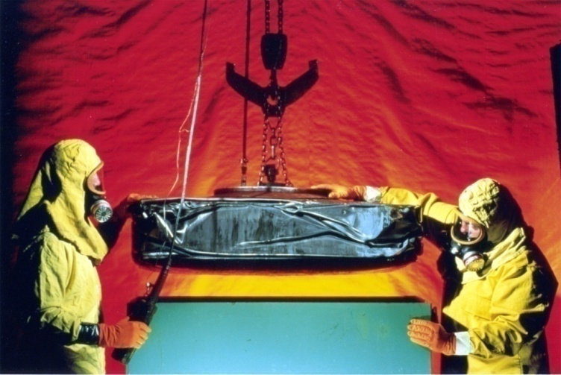
Compaction
Largest compactor in U.S.
constructed in 1985
Compacts drums and boxes
Compaction force of 10M lbs
Operating throughput of
80 cycles per day
Typical VR 2:1 – 5:1
Compaction

Slide 7
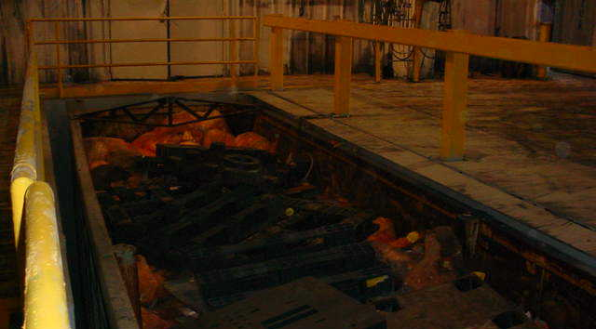
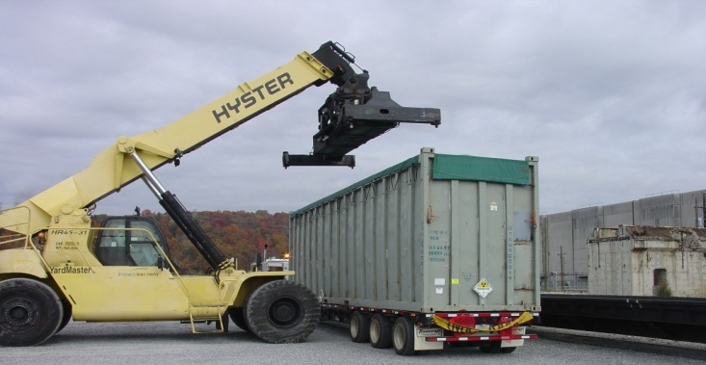
Commercial Certification
Supports Life of Plant (LOP) contracts for Commercial Utilities
Low activity DAW and metals “commercially certified” for Clive disposal
Customer benefit:
  Speed of processing/disposition (less than 45 day average to disposal)
  EnergySolutions waste profiles and GSAP permits used
  Rail delivery for east coast to Clive transportation efficiencies
  100% visual and radiological inspection

Slide 8
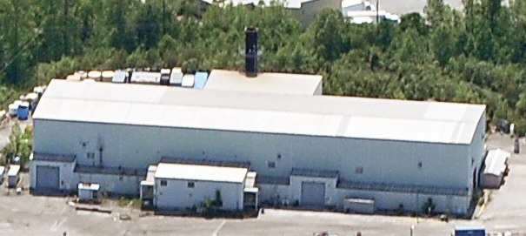
Radioactive Materials Solutions (RMS)
Amendment submitted in March 2014 for advanced characterization, interim storage and staging for enhanced industry optimization of high activity wastes.
The waste streams include
the following:
  High Activity Filter
  Processing
  Solidified and Reformed
  Process Residues
  Resin and
  water processing media
  Mechanical Filtration
  Sludge or sludge like
  waste forms

Slide 9
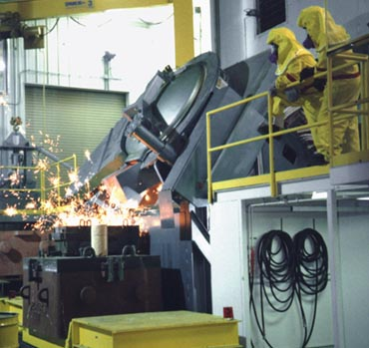
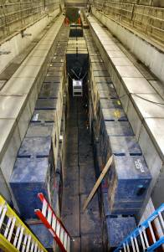
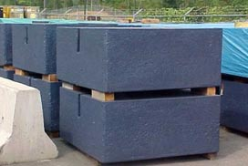
Metal Melt Recycling
Metal melt furnace – joule- heated metal induction furnace for recycling
Constructed in 1991
Produces 10-ton shield blocks for high energy physics labs
Typically 600-900 tons per melt campaign
Capacity of ~6,000 tons
Metal Melt
Shield Blocks

Slide 10
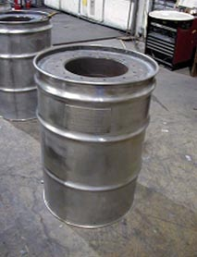
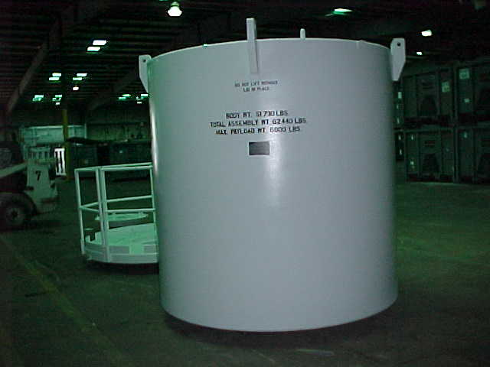
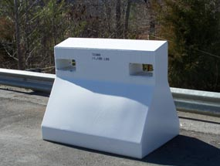
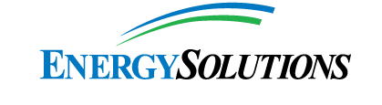
Lead Recycling
Lead recycling into various types of
shield containers and devices
Products for sale to the nuclear industry:
    DOT Type A Packages
    Process Shields for Liners
    Specialty Shields for Accelerators
    Transfer Bells
Security Barrier
Overpack
Drum Shields
LS3 Shield

Slide 11
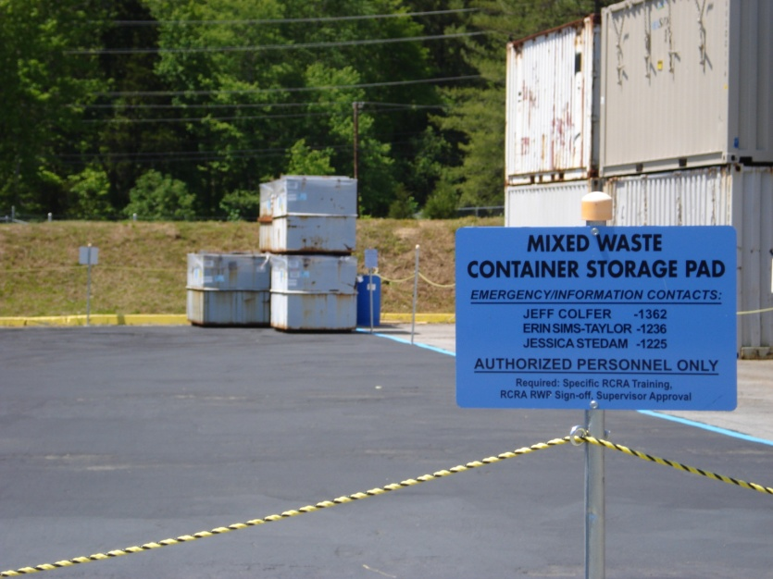
RCRA Permit TNHW-129
Treatment Technologies Include:
    Macroencapsulation
    Waste Sorting and Segregation
    Size Reduction
    Amalgamation
    Chemical Reduction
    Deactivation
    Neutralization
    Stabilization/Solidification
    Recovery of Organics
    Carbon Adsorption
    Chemical Oxidation
    Precipitation

Slide 12
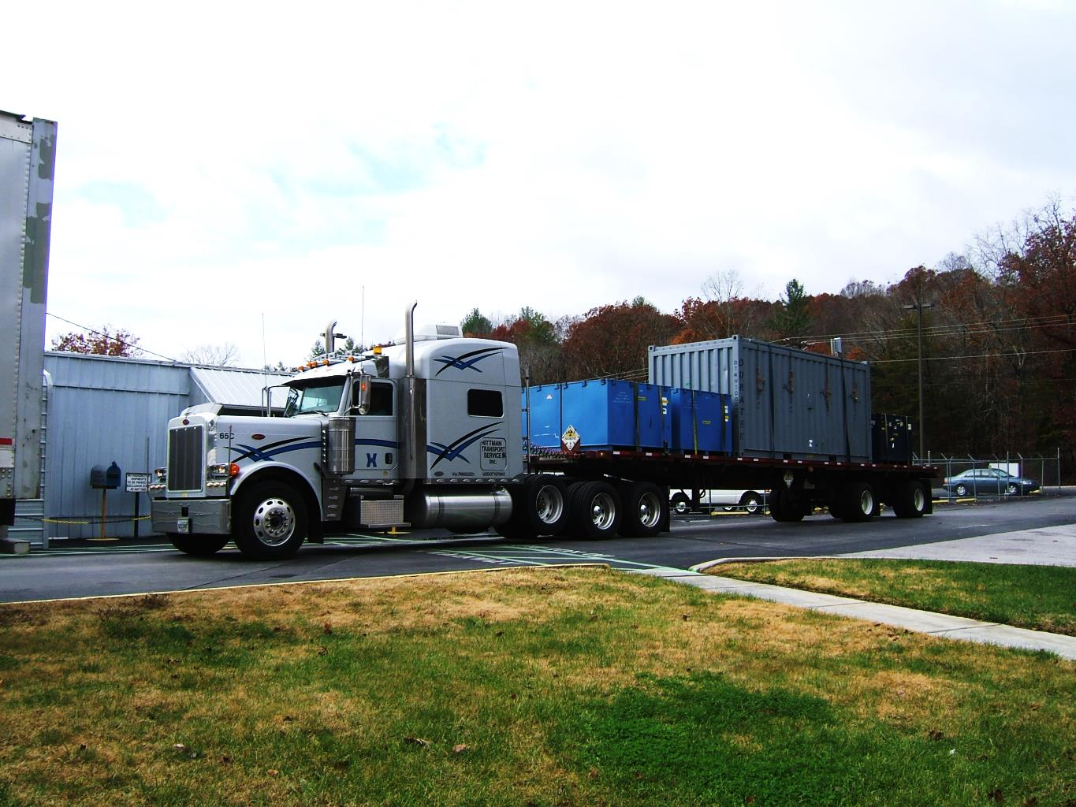
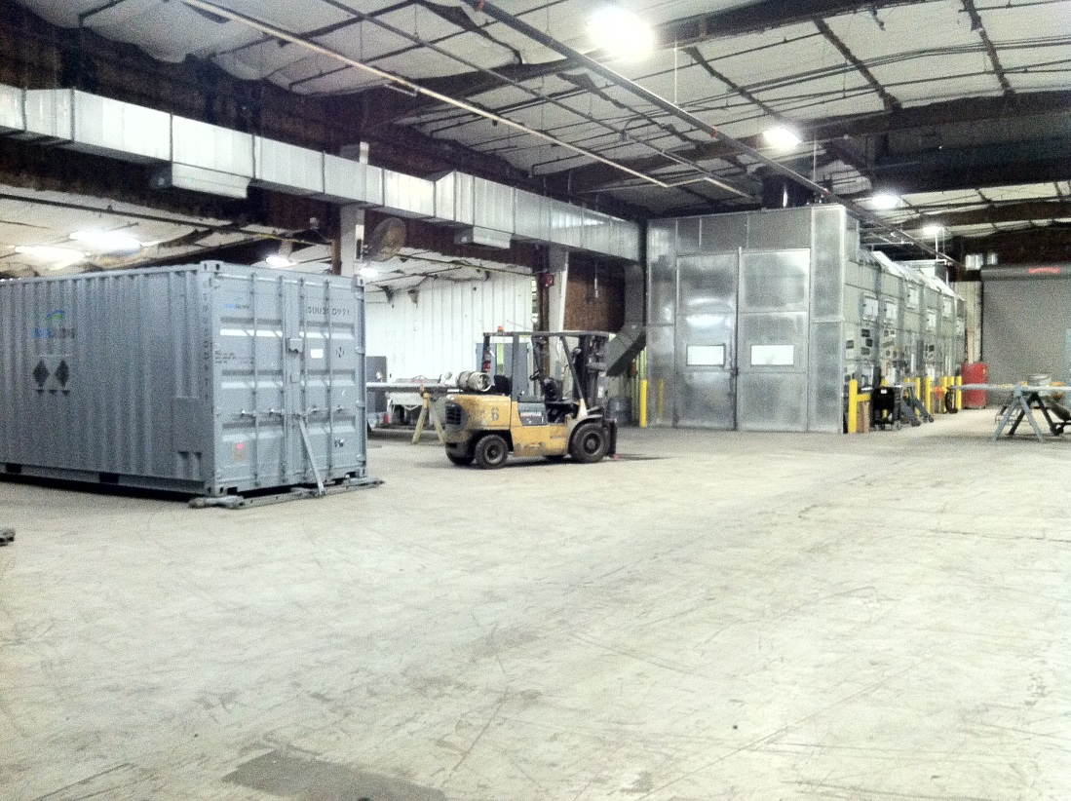
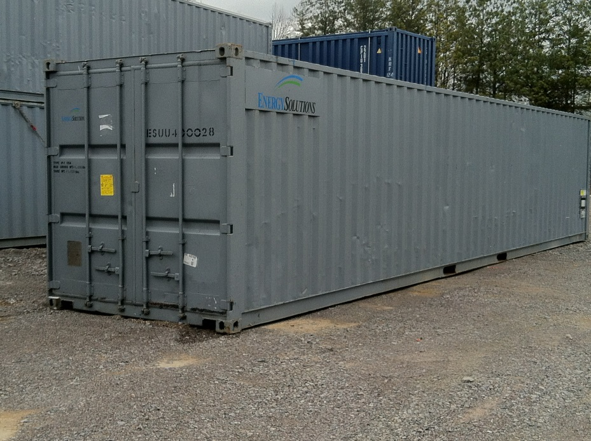
Container Management
BCO maintains an inventory of approximately 1,800 containers which include sealands, intermodals, tankers, water express, oil express, various shielded sealands, sealand overpacks and other specialty containers
Inspections, repairs and painting conducted as necessary
Containers are shipped to customers as demanded
New gaskets, netting and tie downs provided as requested
Excluding cask shipments over 2,100 outbound containers per year

