Slide 1
2026 WAC Summit
Clive Facility WAC Training
Tim Orton
Jake Gardner

Slide 2
EnergySolutions’ Waste Acceptance Criteria and Customer Portal Overview
Technical Services Contact Information
Tim Orton Director of Technical Services 801-649-2144
torton@energysolutions.com 801-209-7251 (cell)
Jake Gardner VP of Technical Services 865-220-1207
jhgardner@energysolutions.com 801-836-1555 (cell)
Veronica Pitts Technical Services Customer Specialist 801-649-2139
vpitts@energysolutions.com 801-573-1707 (cell)

Slide 3
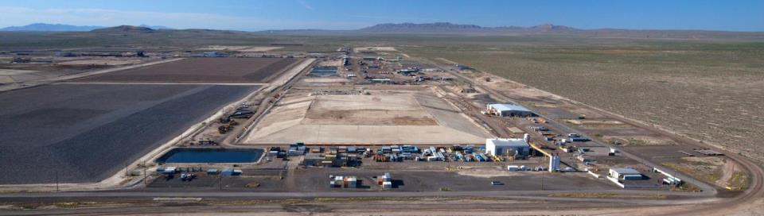
EnergySolutions’ Waste Acceptance and Customer Portal Overview
Clive Facility Overview
Over 35 years of proven experience treating and disposing of Class A radioactive waste.
One-of-a-kind bulk waste and containerized waste facilities with unique licenses and permits.
Long-term federal and commercial contracts.

Slide 4
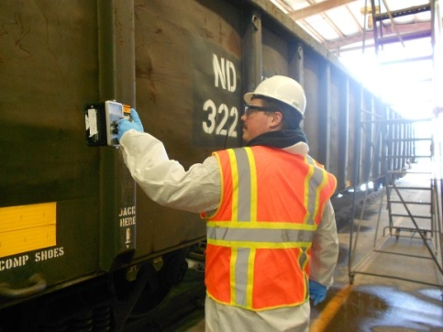
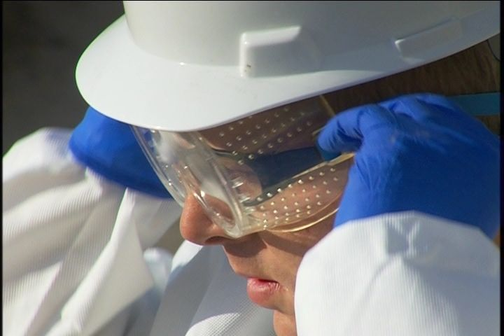
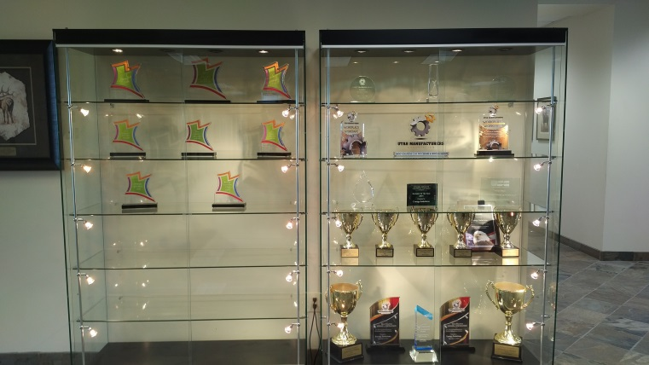
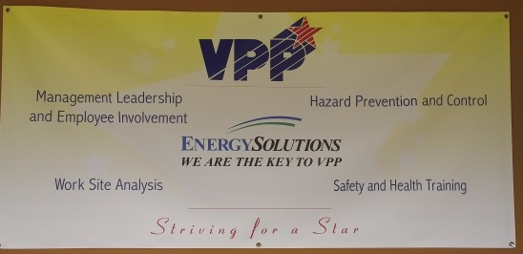
EnergySolutions’ Waste Acceptance and Customer Portal Overview
Facility Overview – Clive Operations
Industrial
  Behavior Based/HPI
  Employee directed / Management Commitment
  Between 2004 & 2026, over Seven Million hours worked without a lost-time injury
  Numerous Safety Awards between 2005 and 2025:
    Utah Safety Council Award of Merit
    Utah Safety Council Perfect Record Award
    Utah Safety Council 1 Million Man Hour Award
    Utah Safety Council Award of Honor
    National Safety Council Perfect Record Award
    National Safety Council Million Man Hour Award
    National Safety Council Occupational Excellence Achievement Award
    National Safety Council Safety Leadership Award
  VPP Star – 2017 & Recertified in 2025
Radiological
  ALARA
  Personnel exposures very low
  34 mRem average annual employee exposure

Slide 5
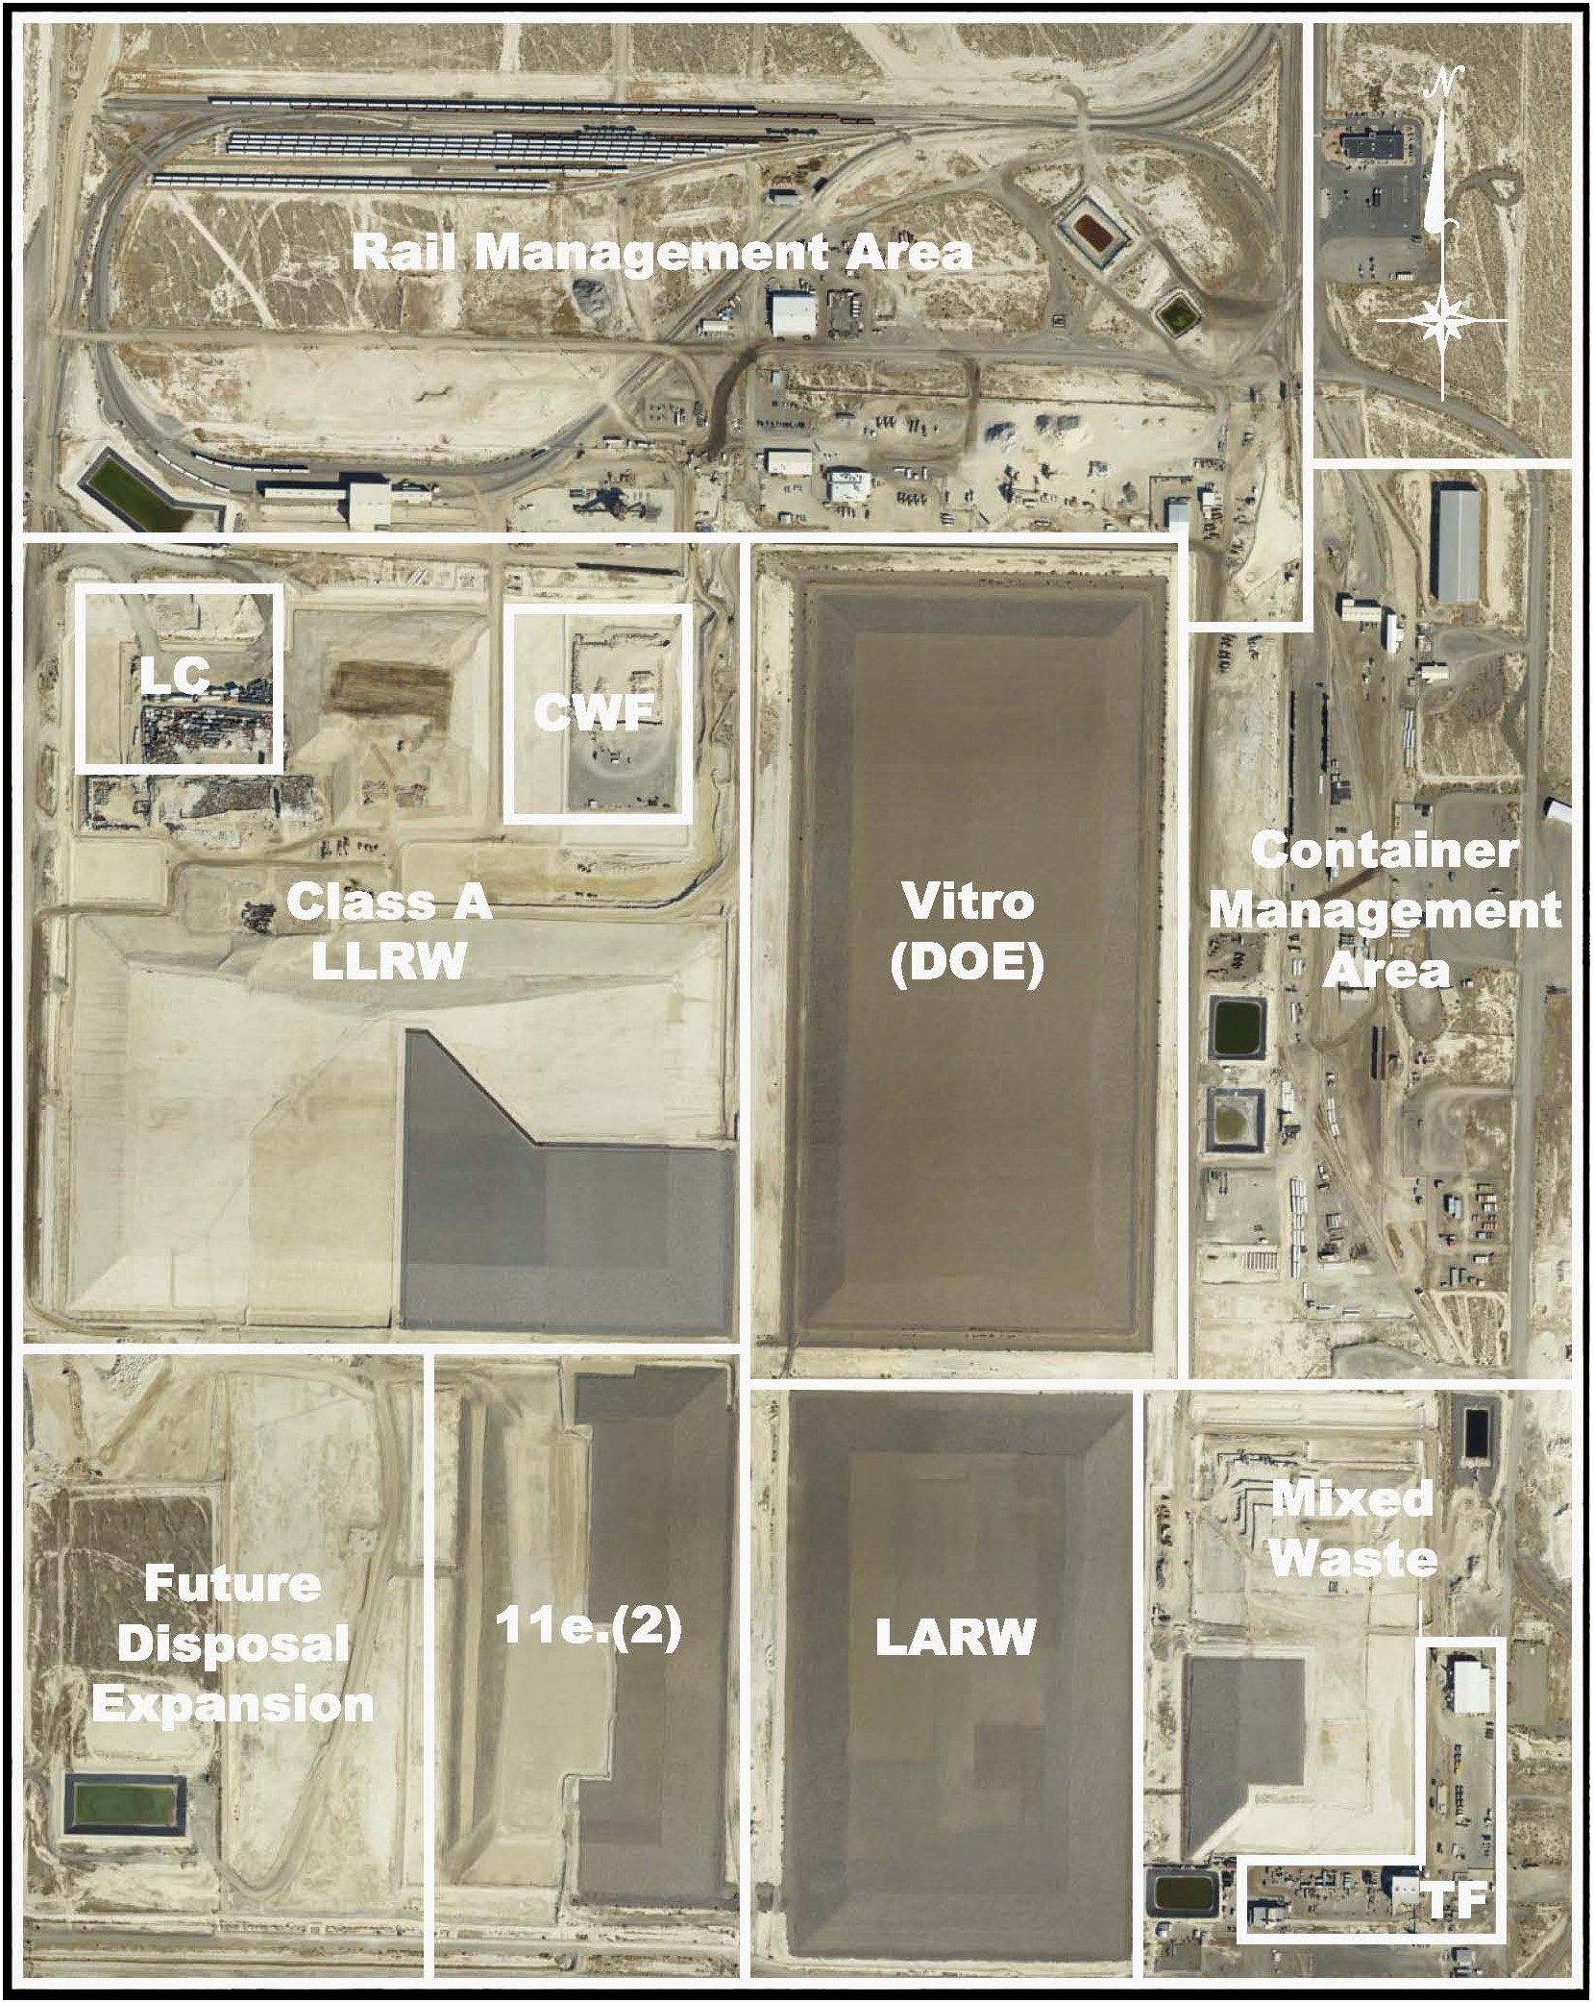
EnergySolutions’ Waste Acceptance and Customer Portal Overview
Clive Facility Overview

Slide 6
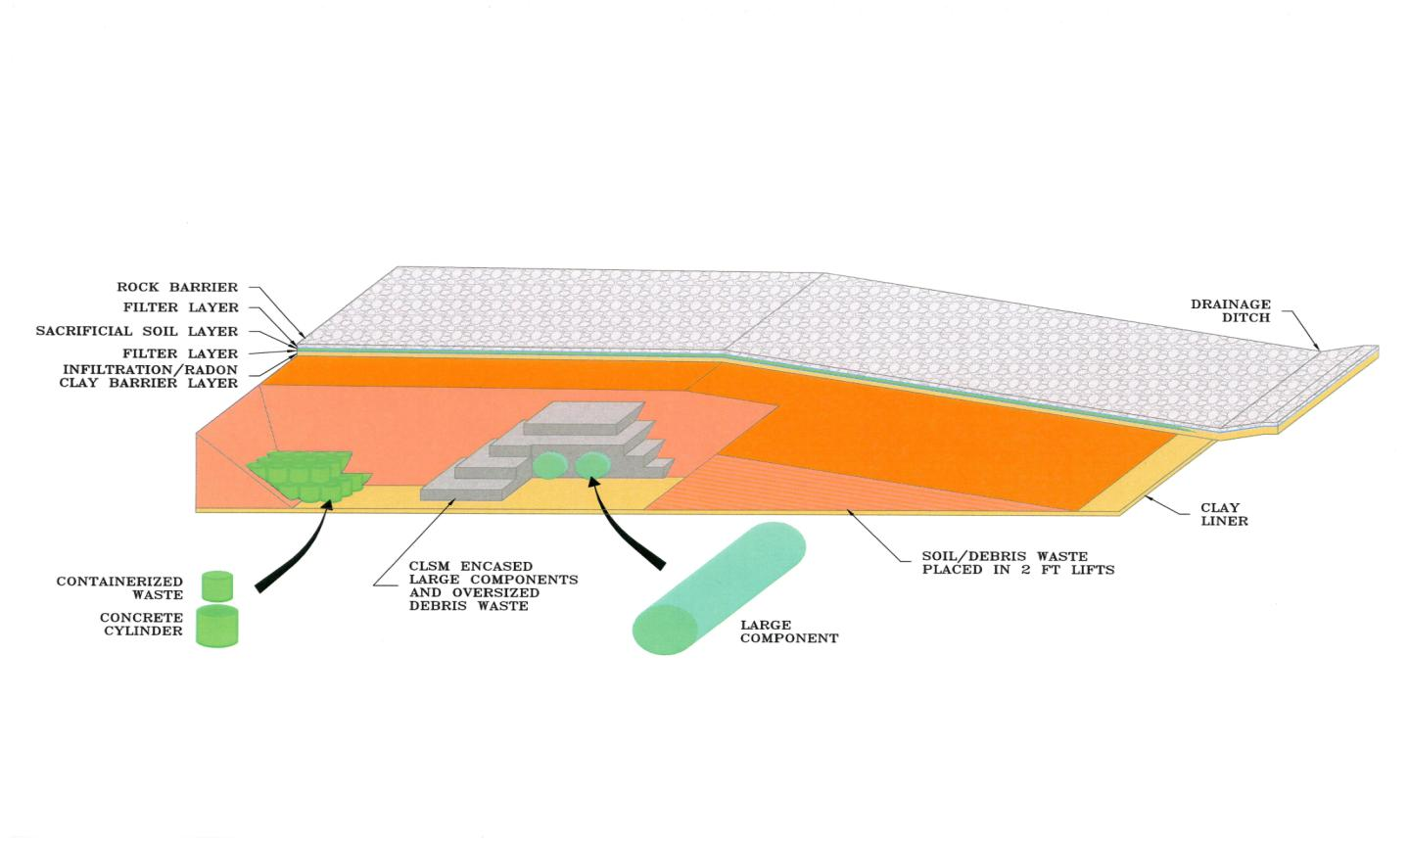
EnergySolutions’ Waste Acceptance Criteria and Customer Portal Overview
Facility Overview - Clive Waste Disposal
Cell Construction Design

Slide 7
EnergySolutions’ Waste Acceptance and Customer Portal Overview
Clive Permits and Licenses
EnergySolutions is permitted, licensed, and authorized to receive, treat and dispose of the following wastes:
Class A LLRW as defined in Utah Administrative Code R313-15-1009
Class A Mixed LLRW (radioactive and hazardous)
NORM/NARM
11e.(2) Byproduct Material as defined by the AEA
Receipt and storage of RCRA-regulated mixed waste
Treatment of mixed waste for RCRA constituents
Mixed waste disposal
BWF - Receipt, storage, treatment, and disposal of waste containing SNM - concentration-based receipt limits (versus mass-based)
Receipt, treatment, management and disposal of
PCB radioactive and PCB mixed waste
Radioactive Material License
RML UT 2300249, as amended
11e.(2) Byproduct Material License
RML UT 2300478, as amended
State-issued Part B Permit
EPA ID Number UTD982598898
Special Nuclear Material Exemption Order issued by NRC, as amended
Two TSCA Approvals issued by EPA Region 8

Slide 8
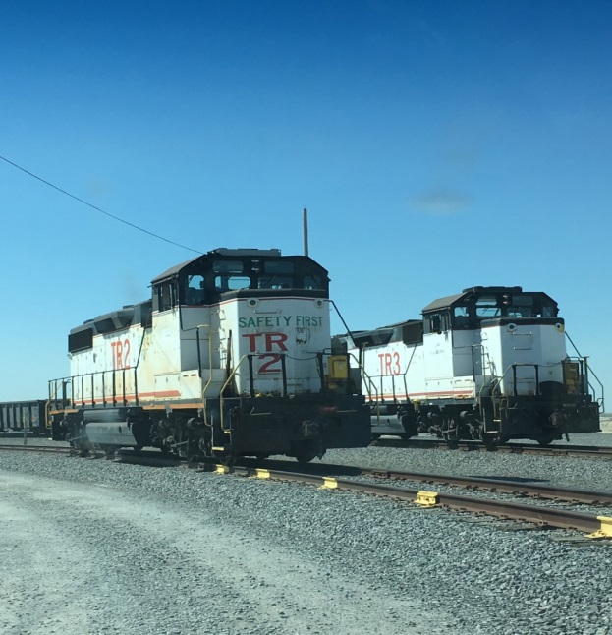
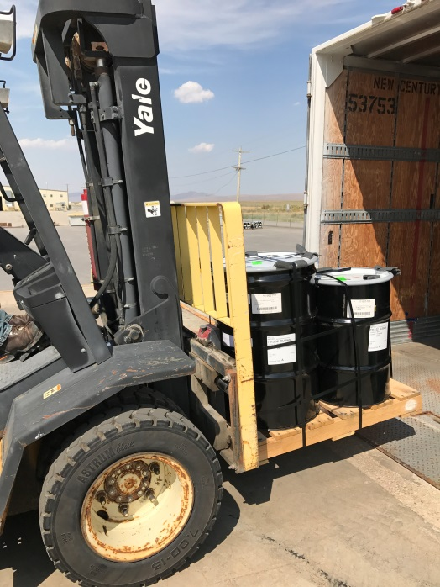


EnergySolutions’ Waste Acceptance Criteria and Customer Portal Overview
Clive Waste Acceptance Capability
Class A LLRW and NORM
  Containerized Waste (CWF) and Bulk Waste (BWF)
Rail – Clive Rail Spur off the Union Pacific Railroad
Truck – Five Miles South of I-80 in Western Utah
Radioactive Liquids
Mixed Waste (Radioactive and RCRA Hazardous)
PCB/Radioactive Waste - TSCA Regulated
Approved to accept CERCLA Waste
Large Components
UCNI and Export Controlled Waste
Other hazardous substances
  Asbestos, beryllium, etc.

Slide 9
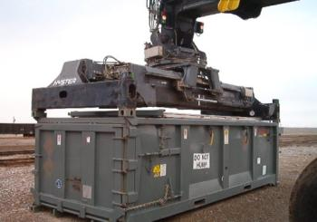
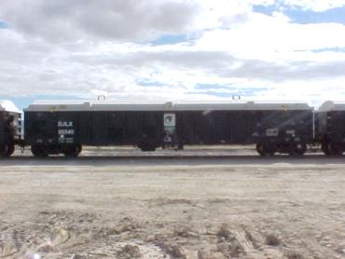
EnergySolutions’ Waste Acceptance Criteria and Customer Portal Overview
Clive Waste Acceptance
Bulk Waste Facility (BWF)
MW, 11e.(2), & Most of Class A LLRW
Receive Bulk and non-Bulk Containers
Soil, Debris and Oversized Debris
Low Dose Resin (< 500 mR/hr, Dewatered)
  Liquid Verification for Grossly Dewatered
Soil/Debris compacted lifts
CLSM (Grout) disposal
  Higher Contamination / Dose Waste
  Larger Debris

Slide 10
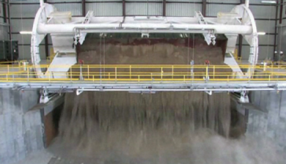
EnergySolutions’ Waste Acceptance Criteria and Customer Portal Overview
Clive Waste Acceptance
Bulk Waste Facility – (Rail)
Direct Union Pacific rail service to facility
Over 16 Miles of rail lines onsite
Railcar Dumping
  Two Rotary Dumpers in Operation
Rail Decon Facility is part of Rotary
Railcar transloading capabilities (Intermodals and Cargo Containers)

Slide 11
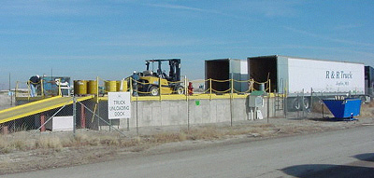
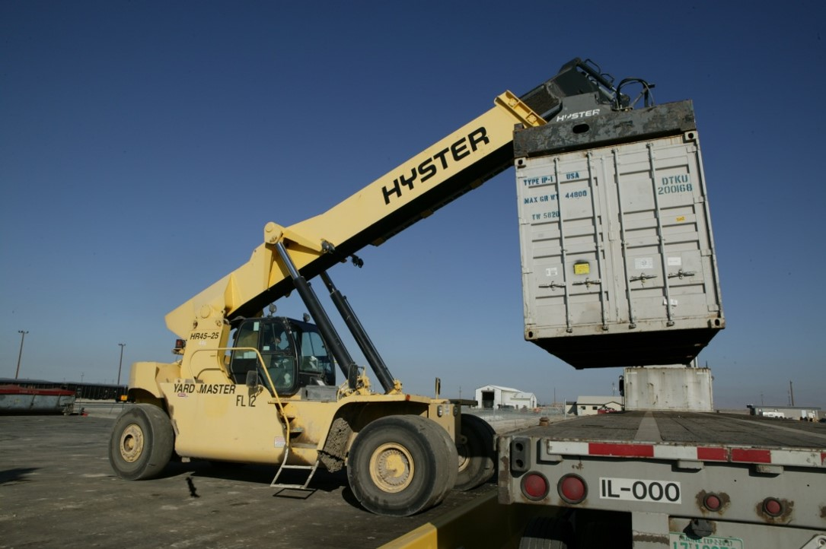
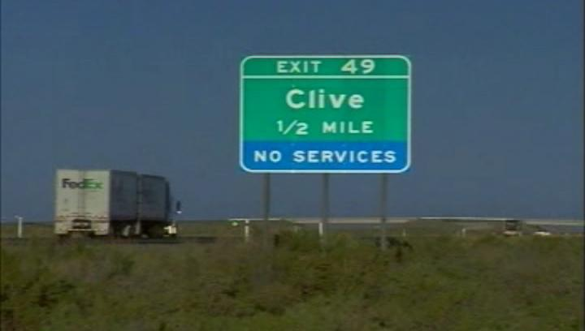
EnergySolutions’ Waste Acceptance Criteria and Customer Portal Overview
Clive Waste Acceptance
Bulk Waste Facility – (Highway)
Facility is located just 5 miles off I-80
Security Officers onsite 24/7
Parking for over 40 Trucks / Trailers
2 Unloading Docks
Live unloading of all shipments
  Driver doesn’t have to enter restricted area
Flatbed, Van, Conestoga Trailers all acceptable
Showers, Laundry, Lounge for Driver Use

Slide 12
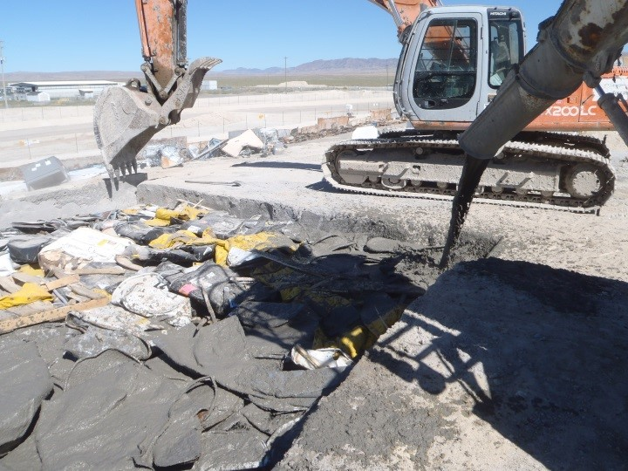
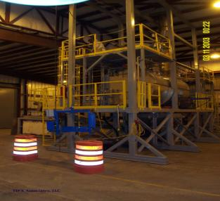
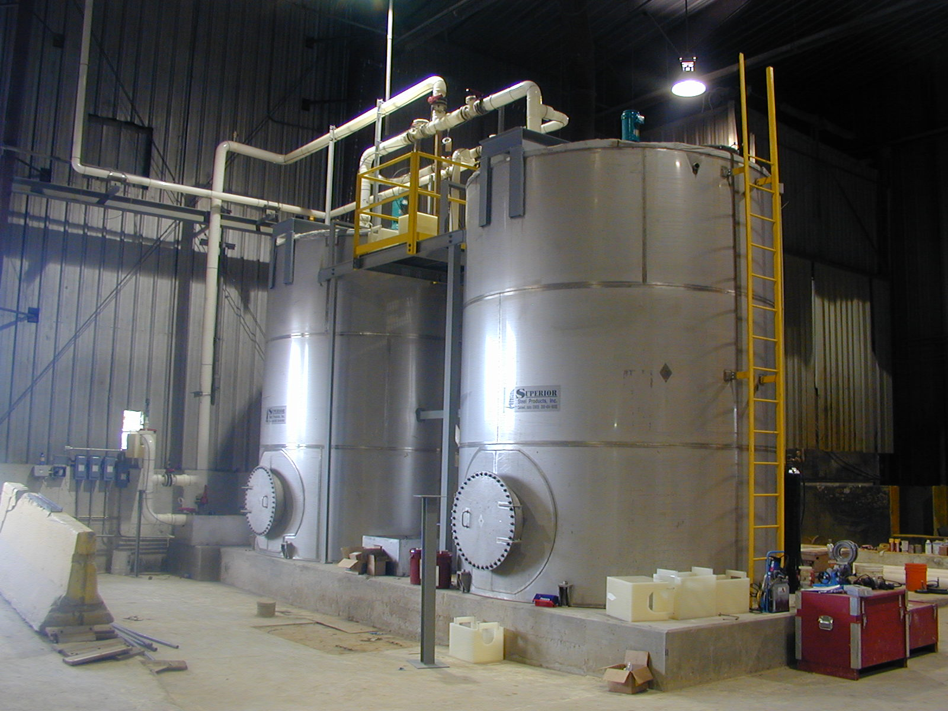
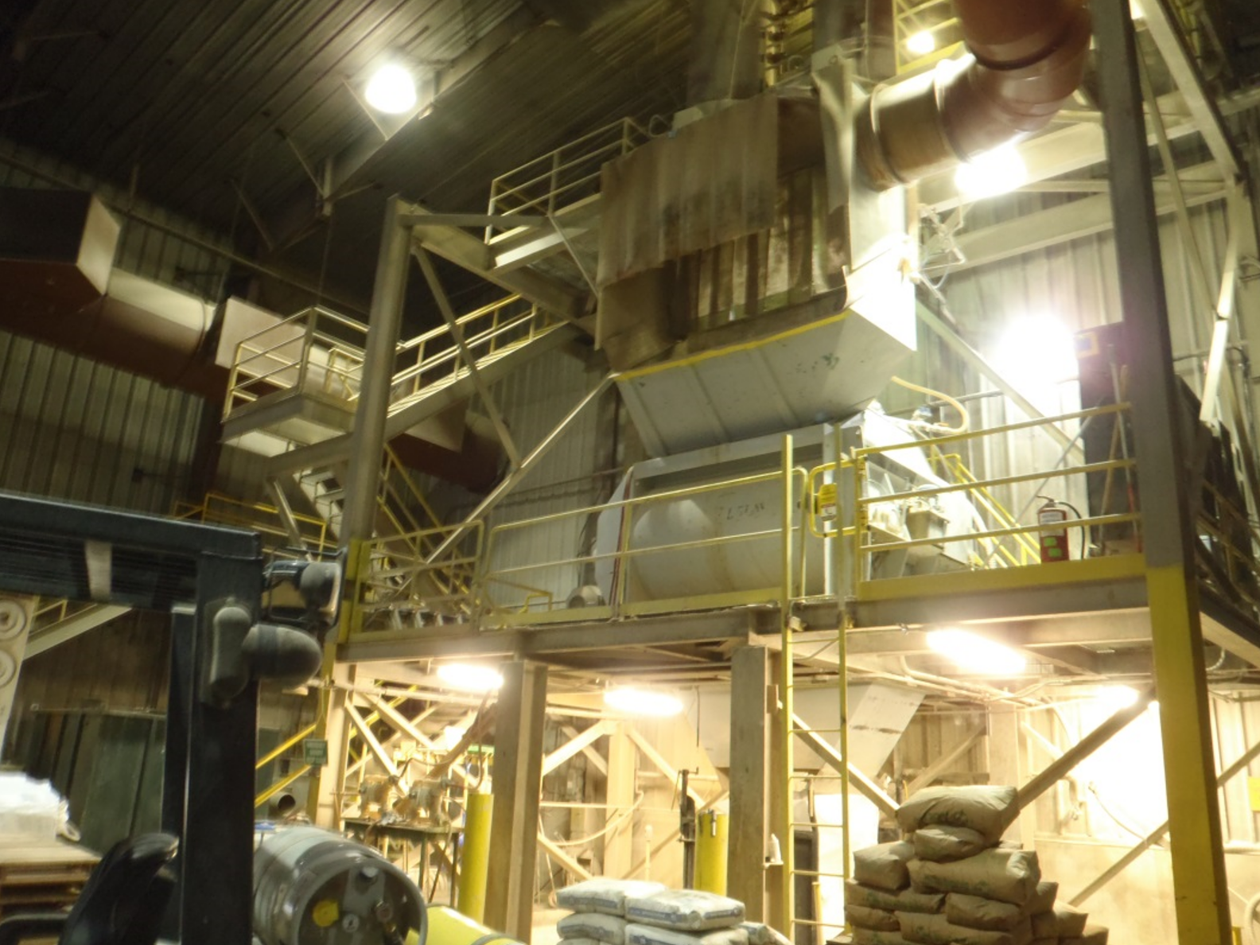
EnergySolutions’ Waste Acceptance Criteria and Customer Portal Overview
Clive Waste Acceptance
Mixed Waste Treatment Facility
Macroencapsulation
Stabilization
  Deactivation / Neutralization / Ox / Red
Mercury Amalgamation
Liquid Solidification
  Aqueous and Non-aqueous
Vacuum Thermal Desorption (VTD)
  Organics, PCB’s

Slide 13
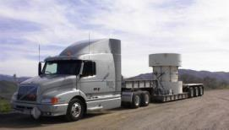
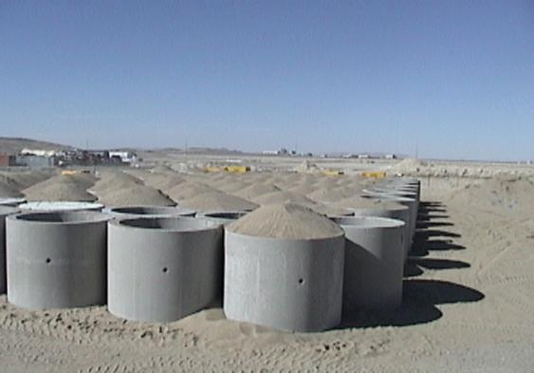
EnergySolutions’ Waste Acceptance Criteria and Customer Portal Overview
Clive Waste Acceptance
Containerized Waste Facility (CWF)
Higher Dose / Higher Activity liners / packages for disposal
Low contamination “clean area” material handling
Void Remediation on packages that are <85% full (prior approval needed)
Capabilities to handle multiple casks per day (same day turnaround)
Certified Generator Program

Slide 14
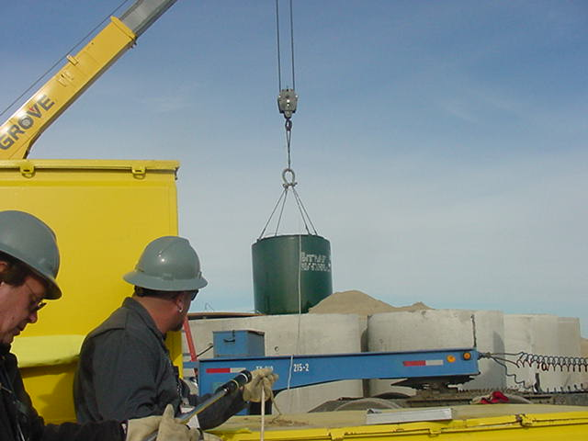
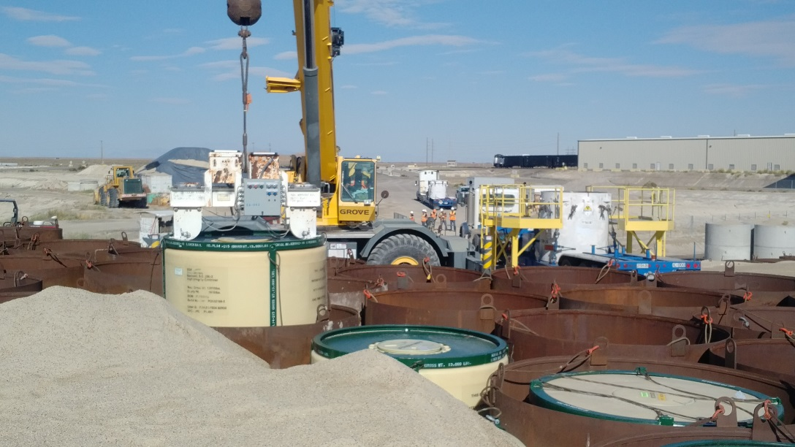
EnergySolutions’ Waste Acceptance Criteria and Customer Portal Overview
Clive Waste Acceptance
Containerized Waste Facility (CWF)
Certified Generator Program
  Certification required to ship to CWF
  Required by Waste Characterization Plan
  Constant Waste
  One-Time, unless changes made
  Requirements:
    Procedures for radiological and hazardous characterization
      Rad characterization
      free-liquid management
      void space minimization
    QA/QC Program
    Regulatory Inspection Reports – Last 3 Years

Slide 15
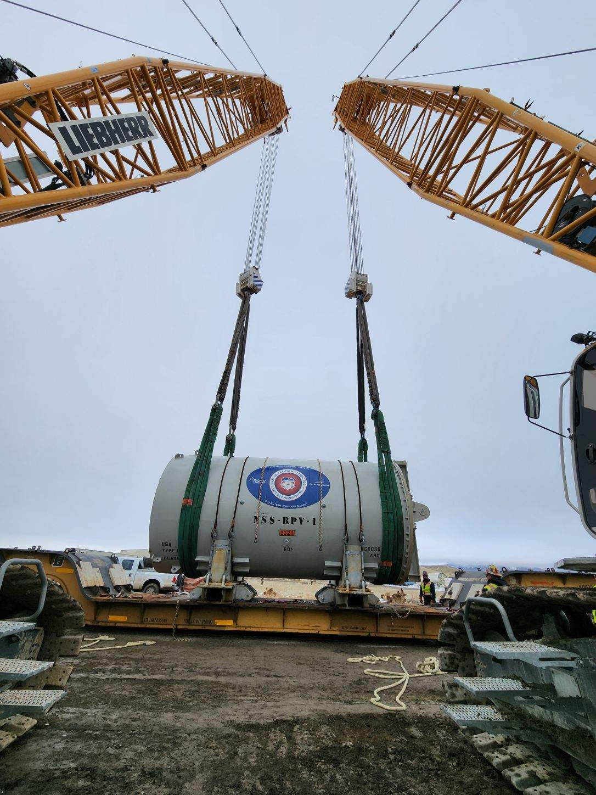
EnergySolutions’ Waste Acceptance Criteria and Customer Portal Overview
Clive Waste Acceptance
Large Component Disposal
Receive by highway or rail
Typically – Greater than 20,000 lbs
Heaviest component received - 1.52 million pounds
All Large Components undergo an Engineering Review prior to approval
All Large Components are placed for final disposal (will be grouted in place)

Slide 16
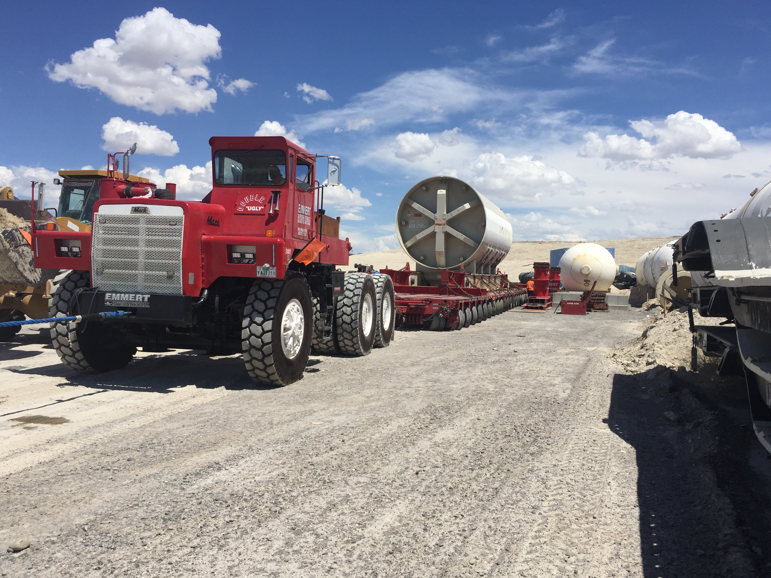
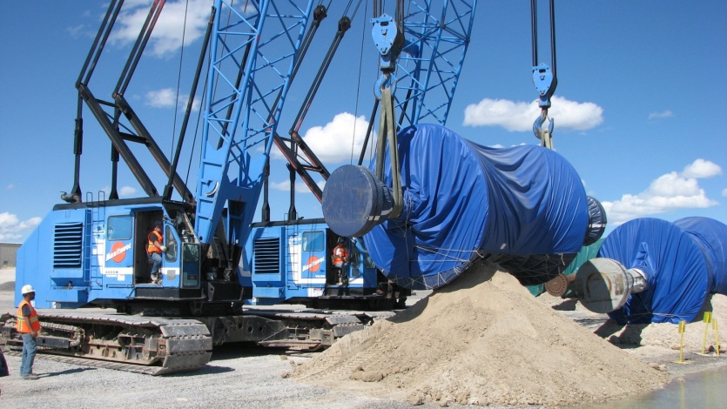
EnergySolutions’ Waste Acceptance Criteria and Customer Portal Overview
Clive Waste Acceptance
Large Component Disposal Offload Process
Large Component is received at Clive
Component is removed from conveyance
Component is moved into LC Disposal area
Component is placed for Final Disposal

Slide 17
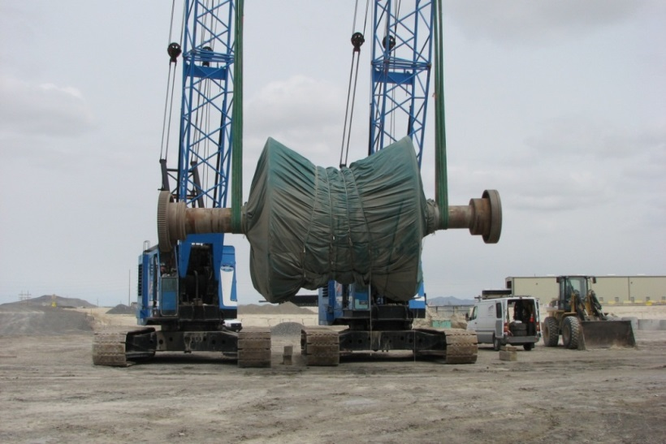
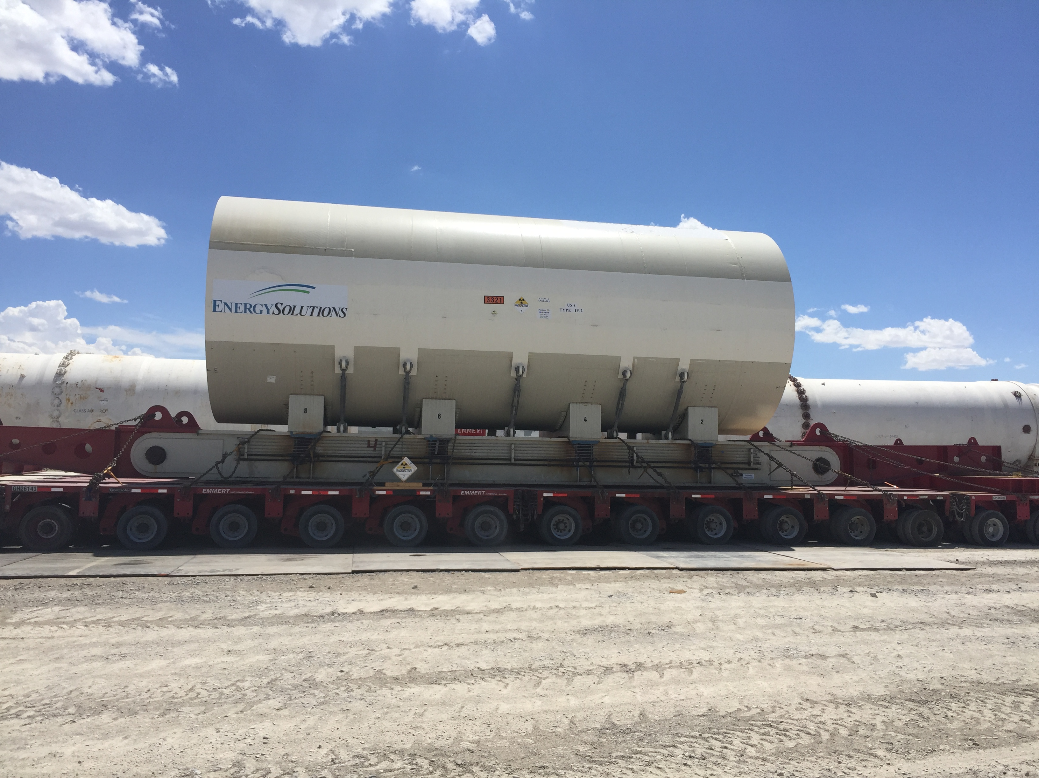
EnergySolutions’ Waste Acceptance Criteria and Customer Portal Overview
Clive Waste Acceptance
Large Component Generator Information
As much info as possible, as soon as possible
  Drawings
  Photographs
  Weights and Dimensions
  Description of enclosed voids
  Identification of lifting points and rigging
  Radiological characterization & survey documentation
    CWF Area is a clean area – No external rad material

Slide 18
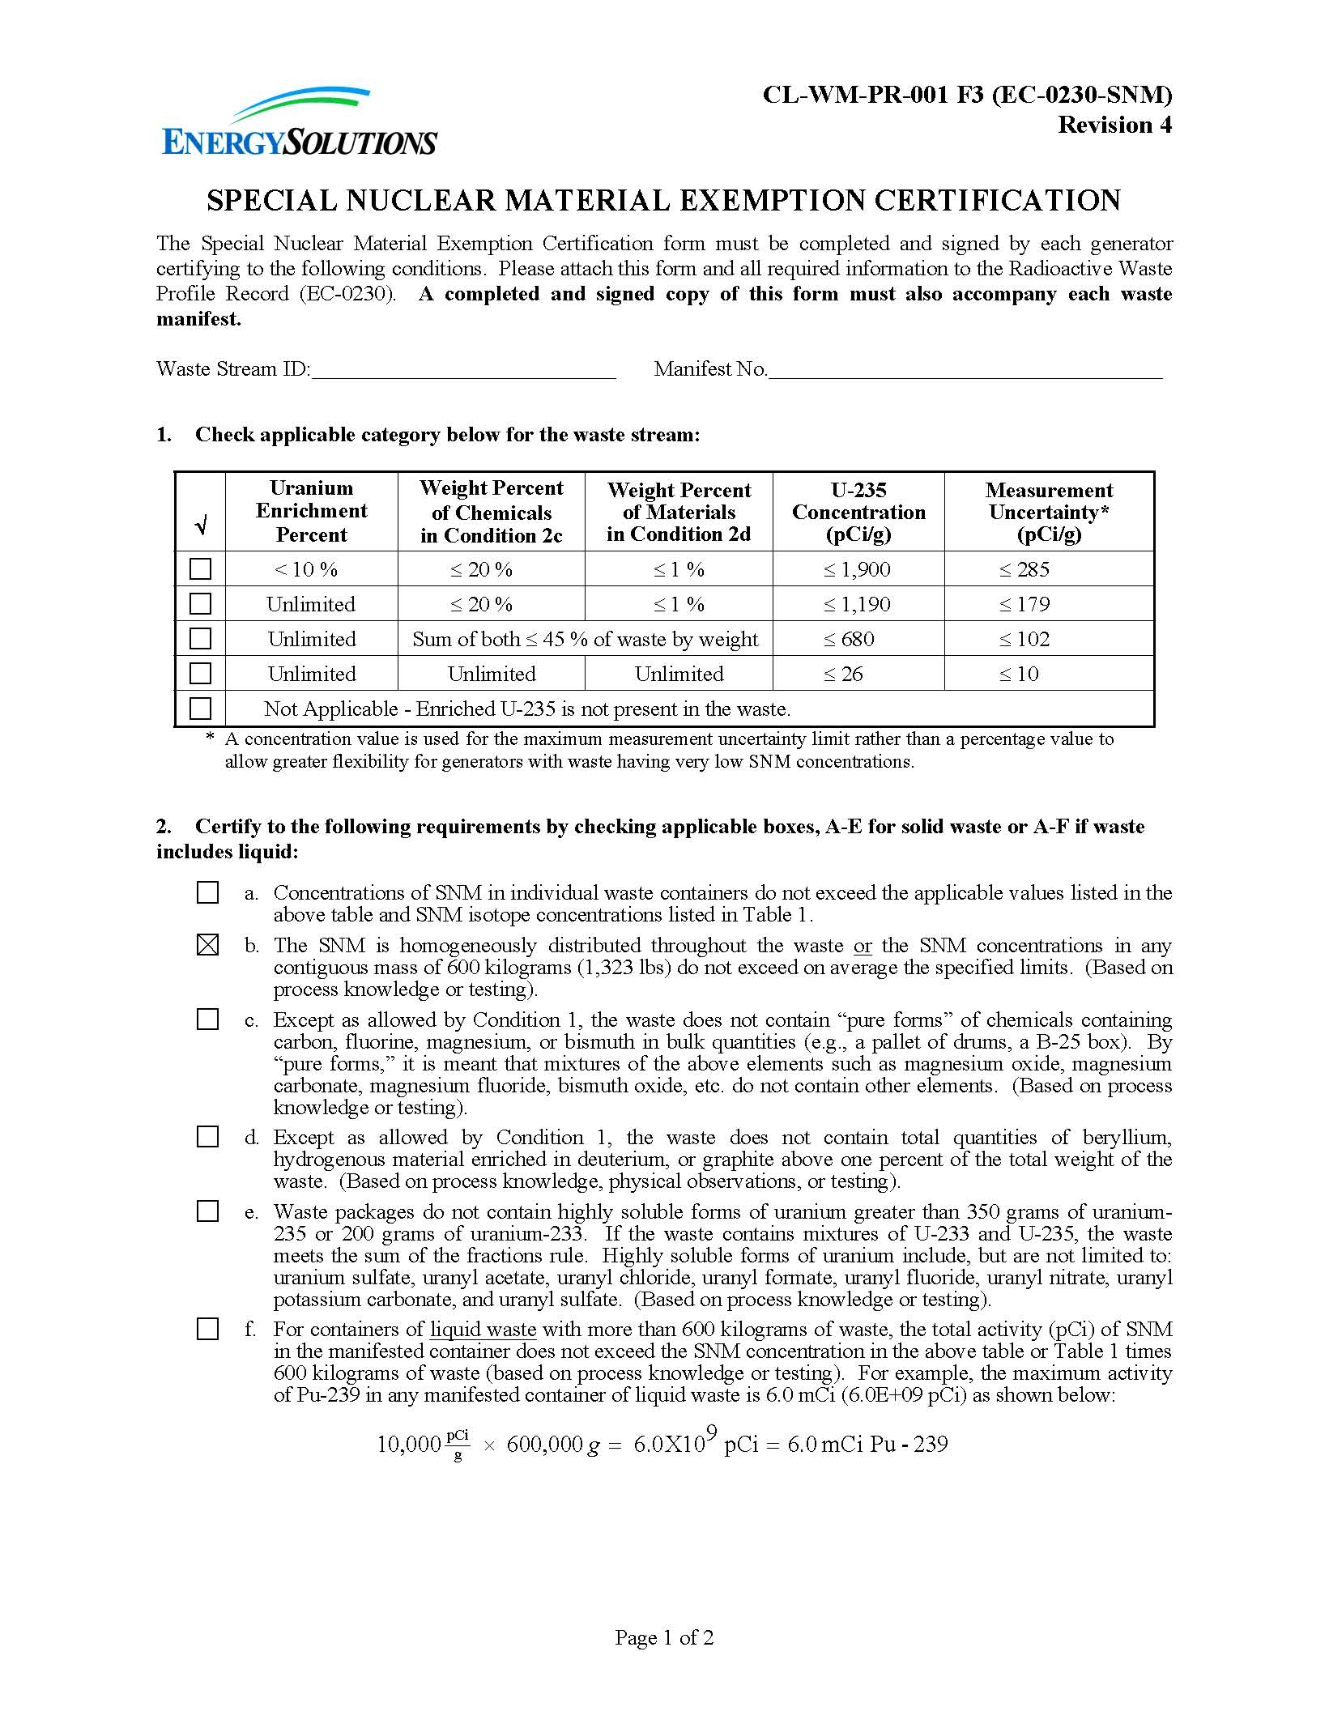
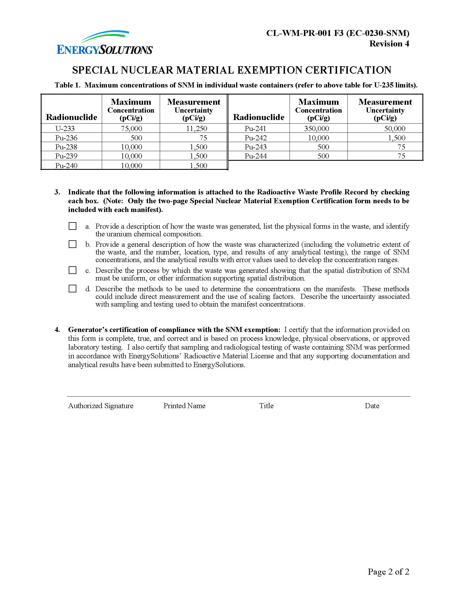
EnergySolutions’ Waste Acceptance Criteria and Customer Portal Overview
Clive Waste Acceptance
Special Nuclear Material (SNM)- *Must Accompany Every BWF Shipment with SNM
CWF = 350 grams U-235
  SOF with U-233 and Pu
BWF = Concentration-based Limits
  Maximum enriched U-235
    1,900 pCi/g (<10% enriched)
    1,190 pCi/g (greater enrichment)
    < if other chemicals present
  Narrative for condition 3
    Generation – U Chem Composition
    Characterization
    Uniform Spatial Distribution
    Methods to determine concentrations

