Slide 1
EnergySolutions Cask Division
2026 EnergySolutions WAC Summit

Slide 2
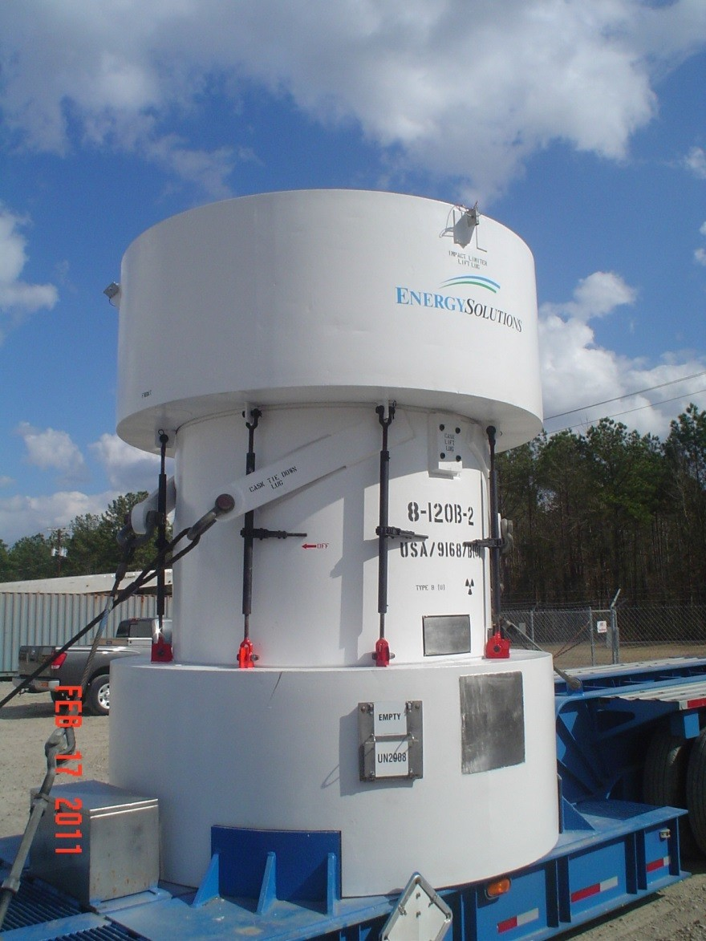
Cask Inventory
DOT 7A Type A casks – 80 + units including 6-80-2, 8-120A, 8-121A, 10-142A, 14-170,14-190,14-195,14-210,14-215 and 21-300 casks models.
Type B Packages – 13 units (including 8-120B, 10-160B, 3-60B).

Slide 3
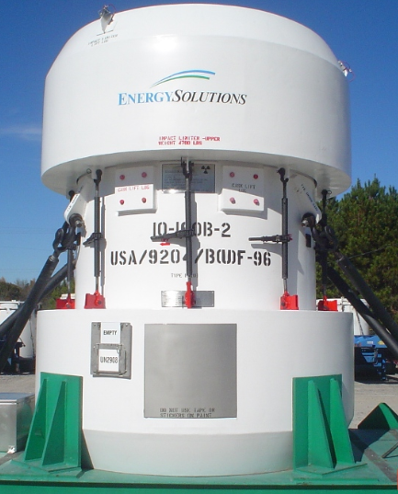
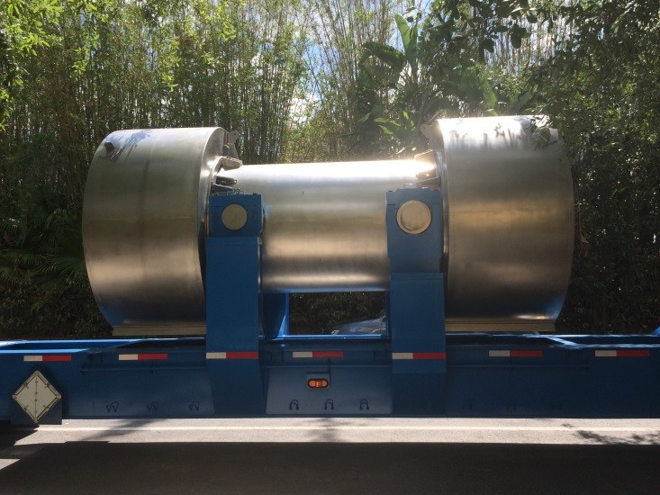
EnergySolutions Type B Cask Fleet
8-120B 10-160B 3-60B

Slide 4
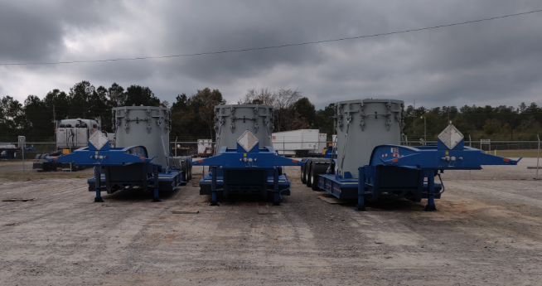
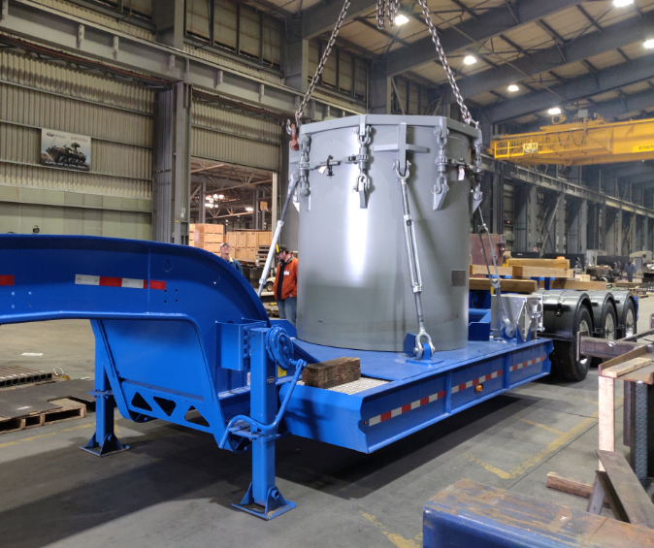
DOT 7A Type A Packagings

Slide 5
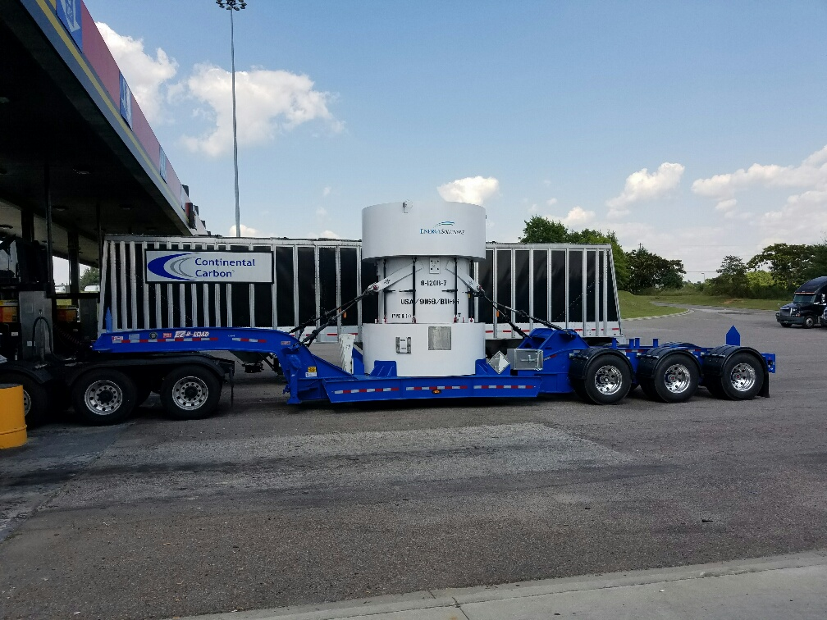
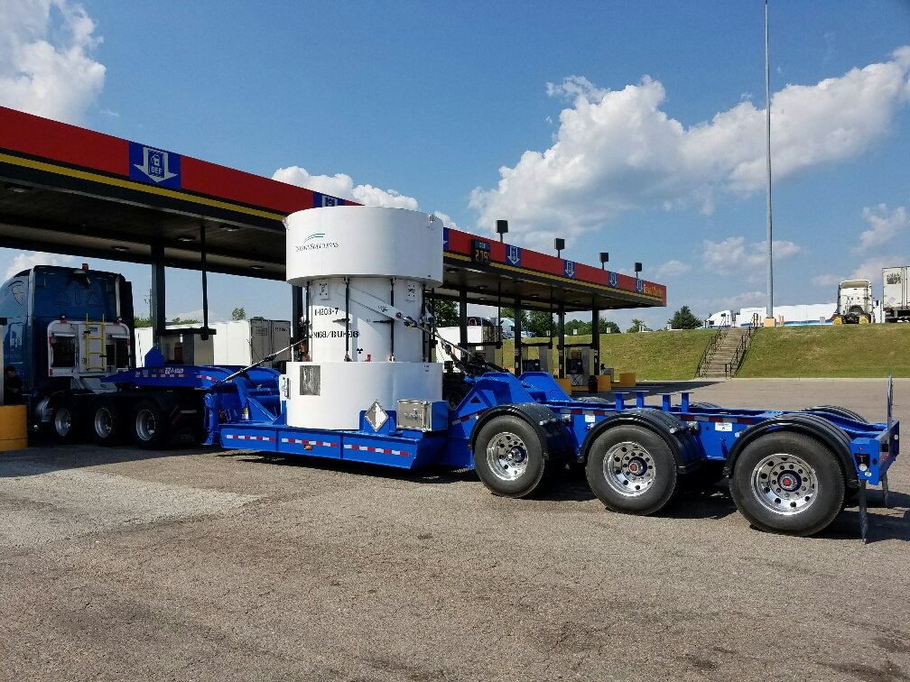
8-120B Cask: Pictures

Slide 6
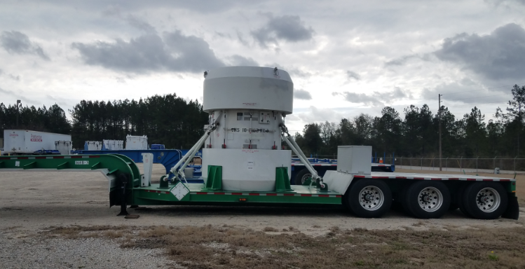
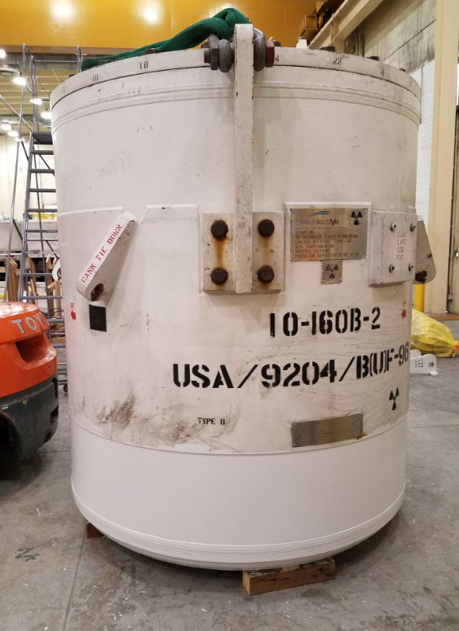
10-160B Cask: Pictures

Slide 7
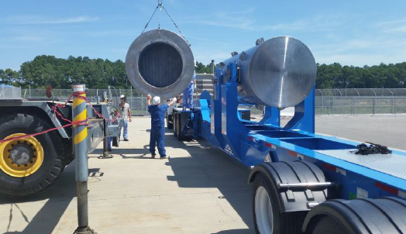
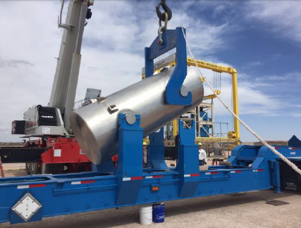
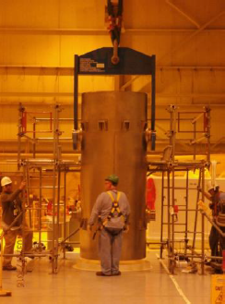
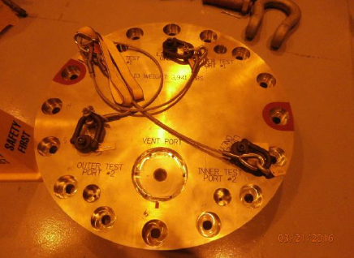
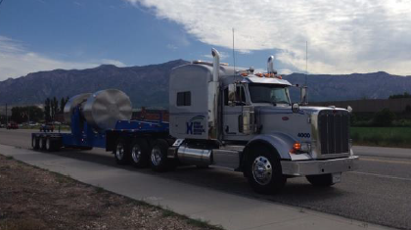
3-60B Cask: Pictures

Slide 8
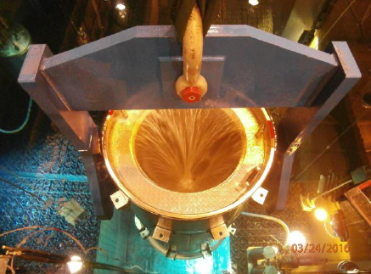
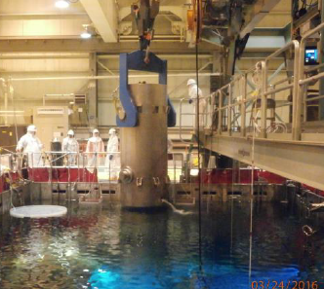
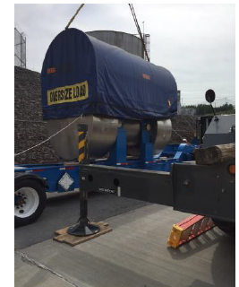
3-60B Cask: Pictures

Slide 9
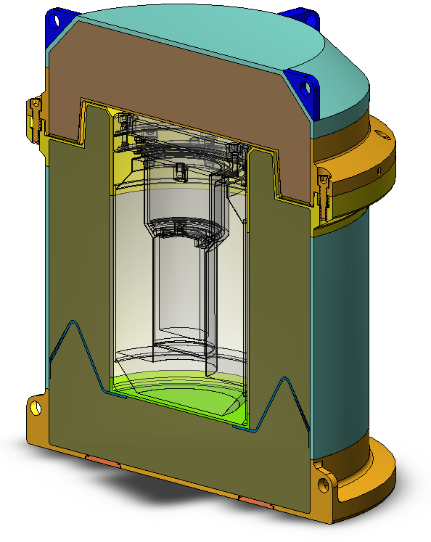
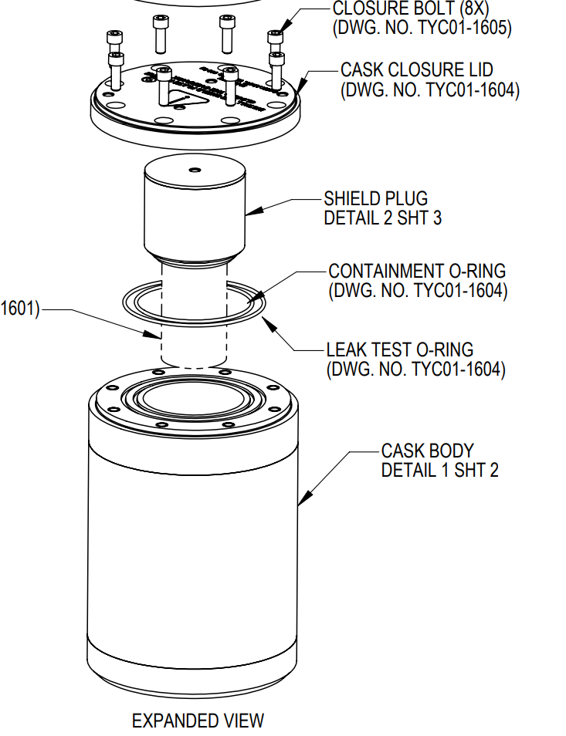
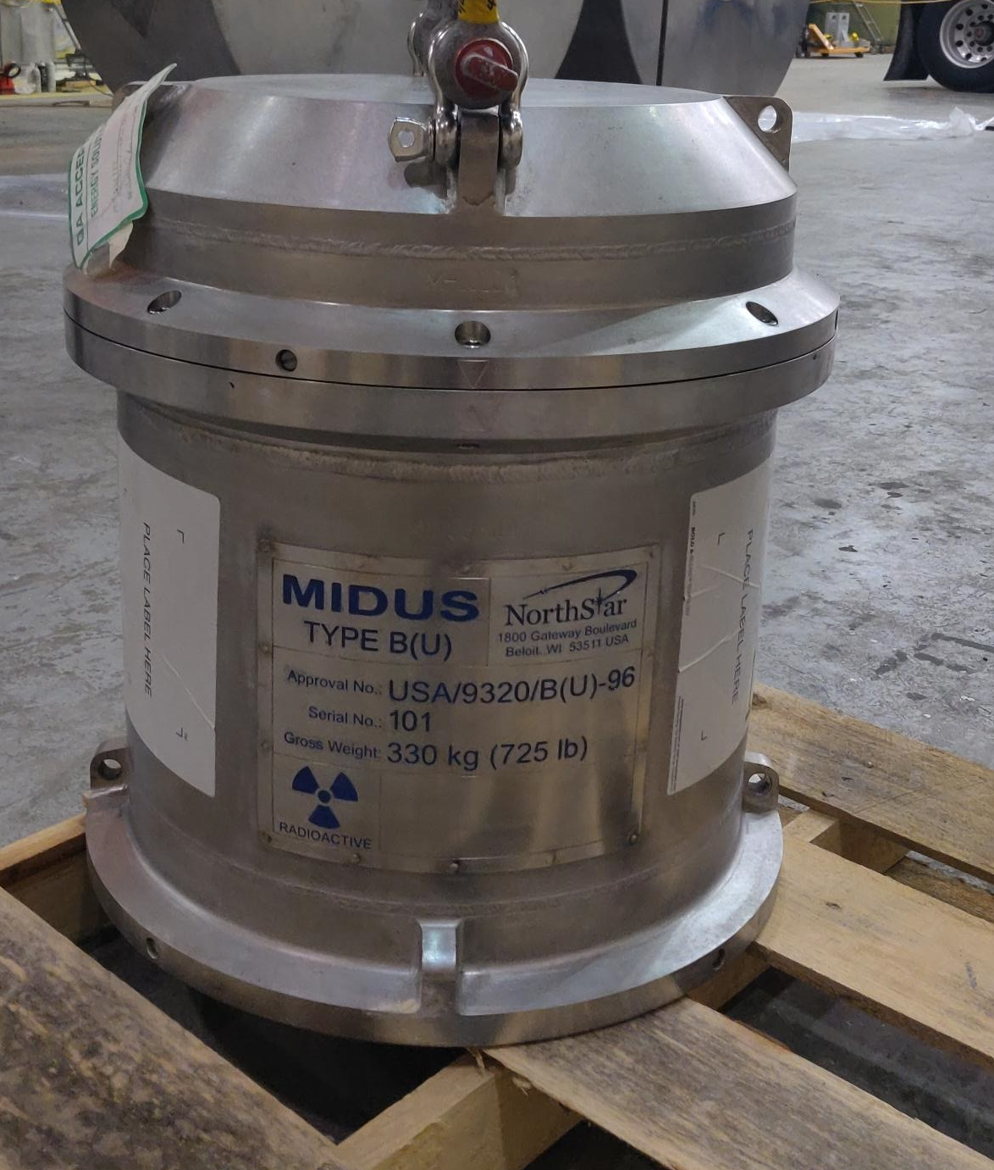
MIDUS Cask
A depleted-uranium shielded packaging for the transport of medical isotope (Mo-99).

Slide 10
EnergySolutions CoC Status
8-120B Cask Certificate of Compliance
# | License Number | Authority | Country
1 | CDN/E253/-96 | CNSC | Canada
2 | USA/9168/B(U)-96 | NRC | USA
3 | USA/9168/B(U)-96 | DOT | USA
4 | USA/9168/B(U)F-96 (DOE) | DOE | USA
10-160B Cask Certificate of Compliance
# | License Number | Authority | Country
1 | CDN/E254/-96 | CNSC | Canada
2 | USA/9204/B(U)F-96 | NRC | USA
3 | USA/9204/B(U)F-96 | DOT | USA
4 | USA/9204/B(U)F-96 (DOE) | DOE | USA
3-60B Cask Certificate of Compliance
# | License Number | Authority | Country
1 | USA/9321/B(U)-96 | NRC | USA
2 | USA/9321/B(U)-96 | DOT | USA
MIDUS Cask Certificate of Compliance
# | License Number | Authority | Country
1 | USA/9320/B(U)-96 | NRC | USA
2 | USA/9320/B(U)-96 | DOT | USA

Slide 11
Cask Division Engineering/ Licensing Activities
Qualification of various content, letter of authorization(s) and/or 8-120B/10-160B cask DOE CoC amendments
Support engineering activities for new trailers applicable to Type A and B casks
IAEA/Part 71 Harmonization Affect on the existing EnergySolutions cask fleet
Supporting licensing and fabrication of new Type B packaging.
Training of shipping personnel

Slide 12
Customer Interface Improvements
EnergySolutions Web based Customer Portal https://customerportal.energysolutions.com which provides access to the following essential documentation:
Cask Manuals/ Cask related procedures
Safety Analysis Reports and Certificates of Compliance
Technical Bulletins
Position Papers
Newsletters on significant developments/events distributed to the cask users

Slide 13
Cask Operations Update
Purchase and refurbishment of trailers for Type (A) and Type (B) casks.
Provide qualified/certified leak testing technicians to support Type (B) cask pre-shipment leakage rate tests.
Introduction of new casks into fleet/ refurbishment of the existing casks.
Purchasing of new cask ancillary components and keep readily available inventory on hand (ratchet binders, gauges, manifolds, fasteners).
Continuous improvement of procedures based on the latest regulatory and standards requirements, industry practices and customer input.
Improvement of the user experience during pre-shipment leak tests in accordance with new revision of ANSI N14.5-2014.
Enhancing EnergySolutions Web-Based Customer Portal

Slide 14
Questions?
THANK YOU!

