Slide 1
Barnwell Processing Facility
Barnwell, South Carolina

Slide 2
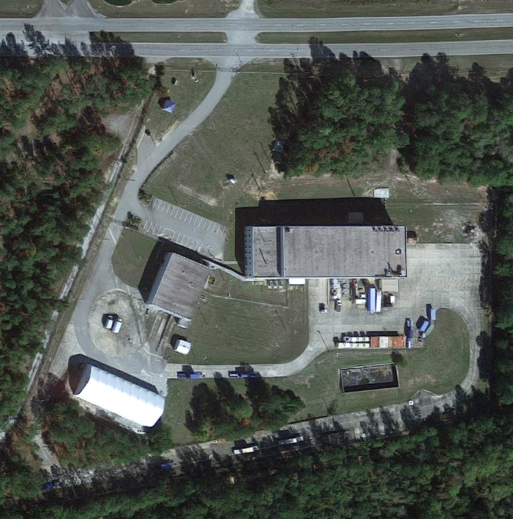
Barnwell Processing Facility
  17-acre facility that consists of two primary buildings
      101 – 7,500 ft2
      201 – 24,500 ft2
  Services provided
      Volume reduction
      Dewatering
      Waste treatment
      Decontamination
      Water processing
      Heavy Component Lifting

Slide 3
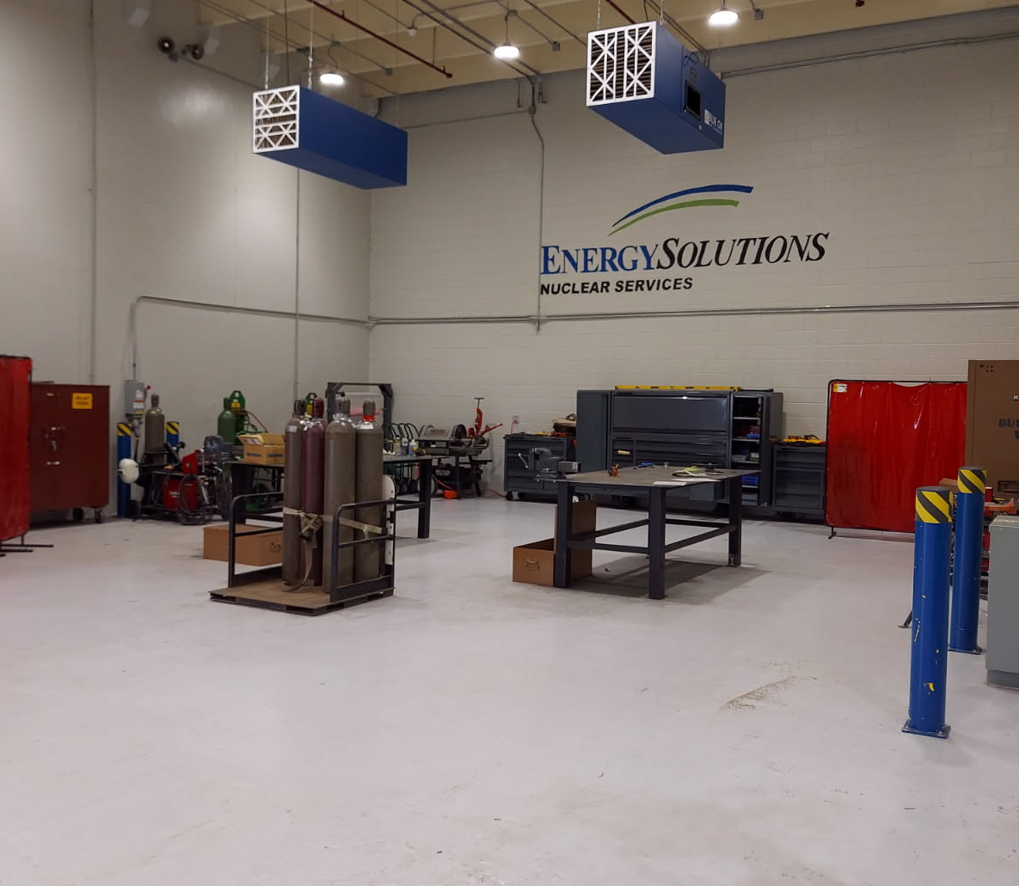
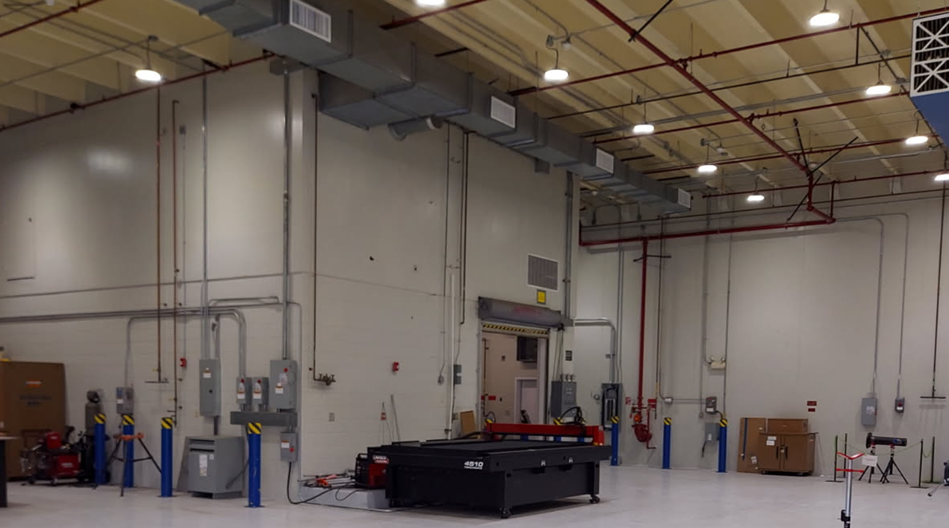
BPF Building 101
Climate controlled concrete facility
  7,500 square feet
  Large climate controlled open work bay for welding purposes

Slide 4
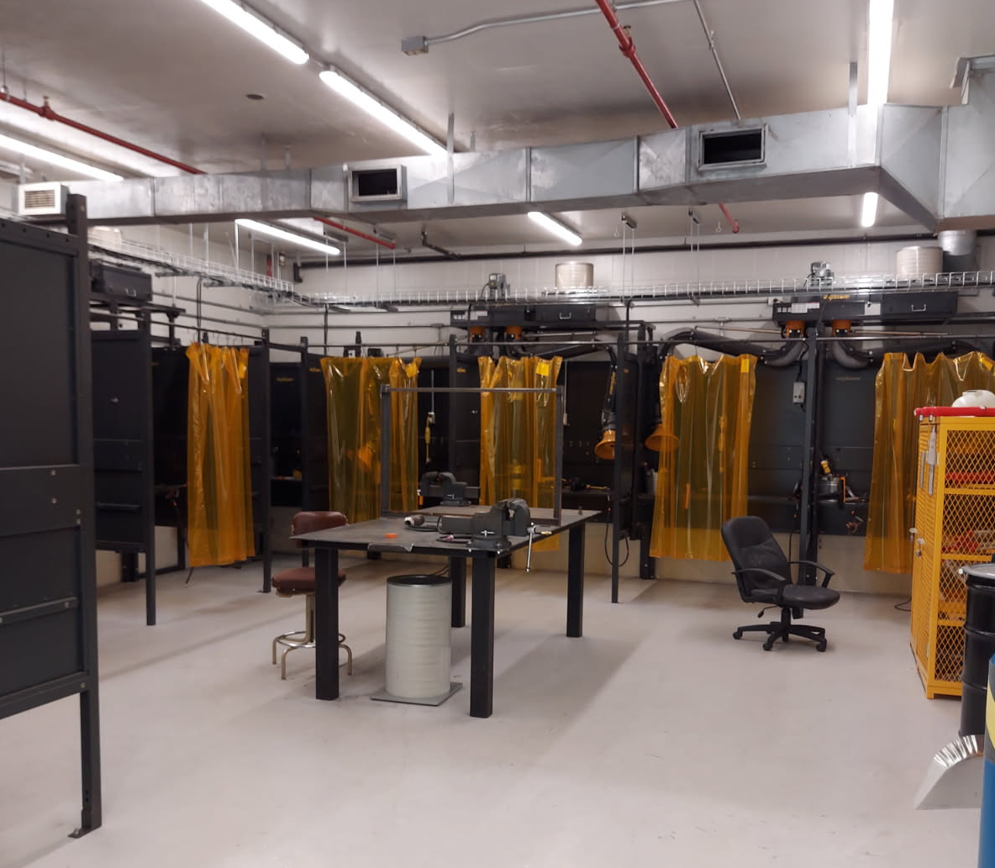
BPF Building 101
Welding Training Area
700 square feet

Slide 5
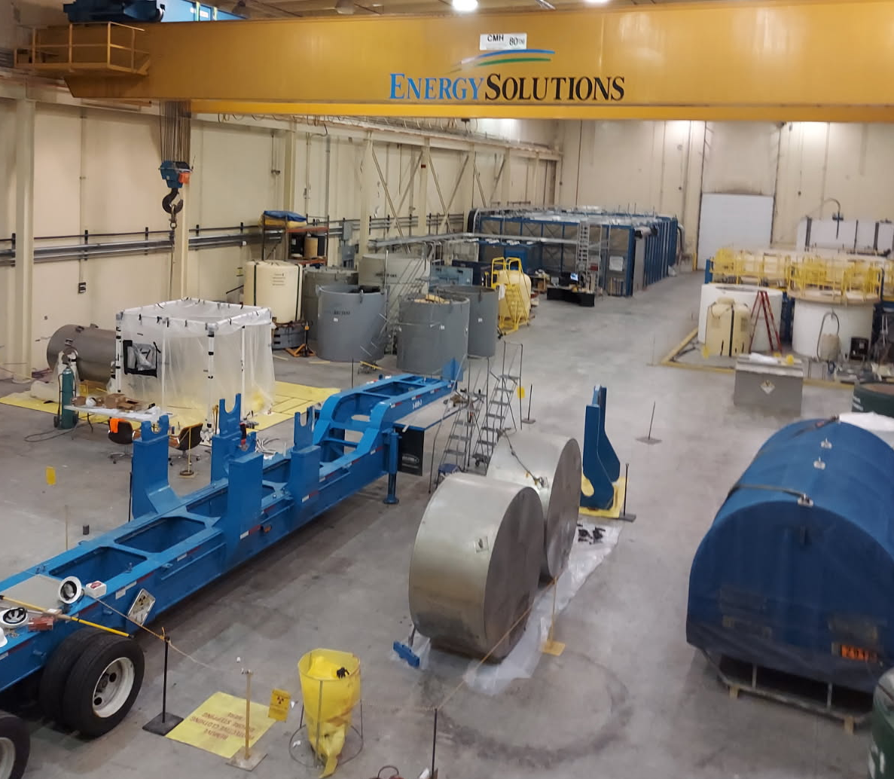
BPF Building 201
24,500 square foot climate-controlled concrete facility
Radioactive Water Processing
Radiological waste testing laboratory
80-ton overhead bridge crane

Slide 6
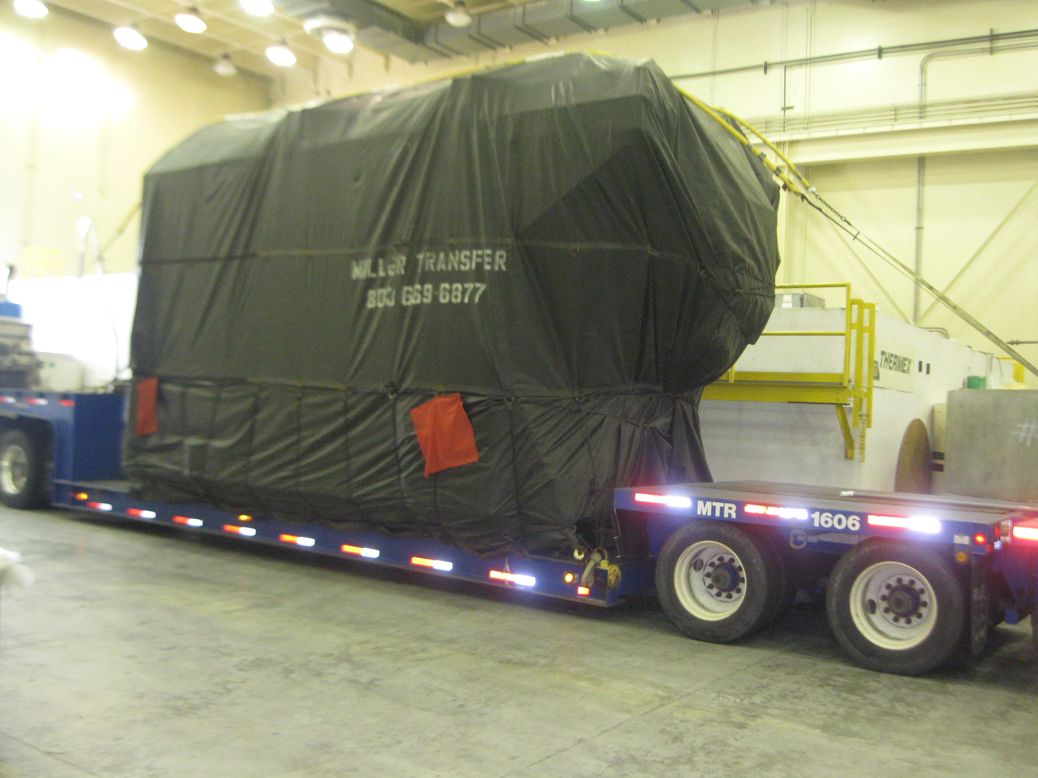
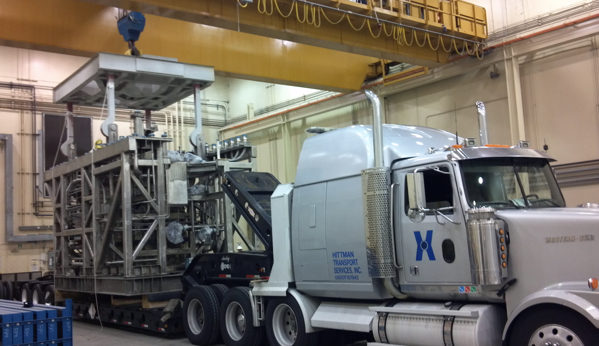
BPF DOE Melter Project

Slide 7
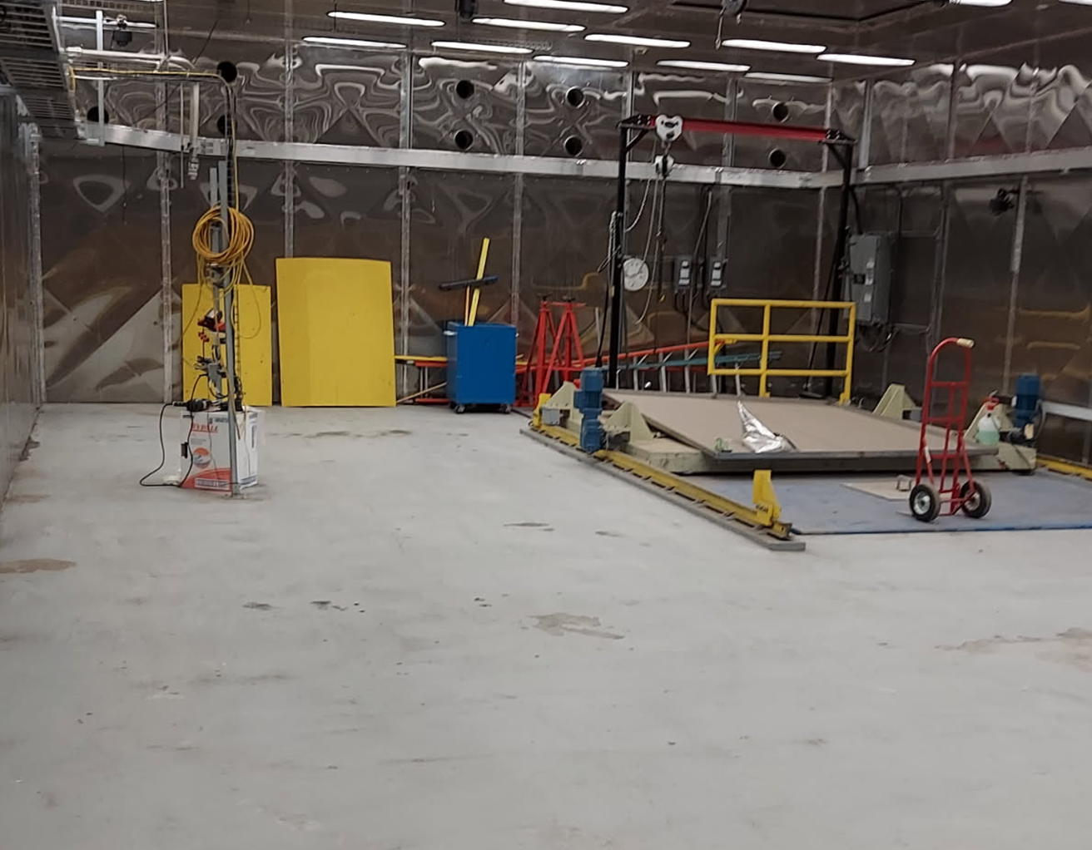
BPF Building 201 Perma-Con
Self contained area
HEPA self contained ventilation system
Overhead crane
Shielded underground pit
Robotic capabilities
Approximately 1,400 sq ft

Slide 8
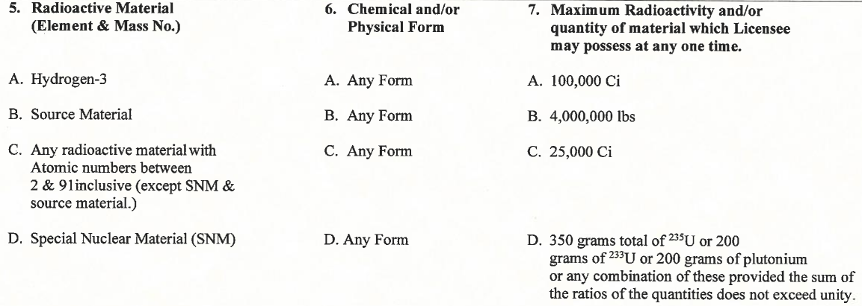
BPF License Limits

Slide 9
Barnwell Processing Facility Licensing Contacts
Phillip Thomas, Operations Director
    (803) 541-5016
    phthomas@energysolutions.com
Josh Grubbs, Licensing and Compliance Manager
(803) 541-5017
jcgrubbs@energysolutions.com
Josh Testi, Training Coordinator
  (803) 450-2229
  ljtesti@energysolutions.com

