Slide 1
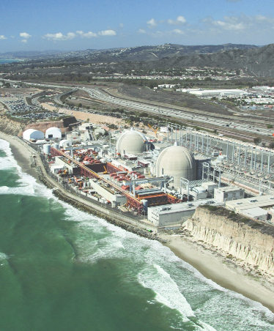
2026 WAC Summit
Memphis Processing & Logistics Center
Ralph Pena

Slide 2
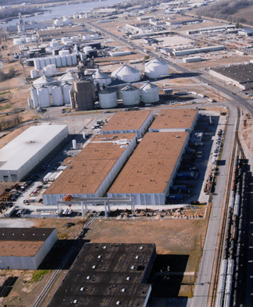
Memphis Logistics Center
Barge, Rail, Road Access
“Safeshop” Customer Hotshop Rental
Rad Equipment Storage
Outage Equipment Service Center
Equipment Decontamination
Container Decontamination
Large Component Processing, Storage and Staging

Slide 3
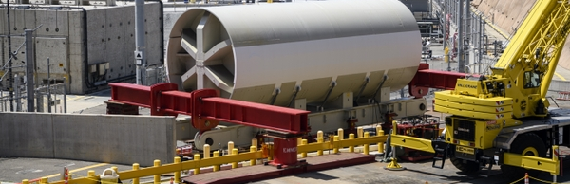
Processing
    Bulk Waste Assay Program (BWAP)– Release of LLRW from license control for disposal at local industrial landfills
    Large Components Processing – Cut/Size for packaging for disposal or preparation for recycle
    Decontamination of material for unconditional release and/or BWAP – licensed for several modes including blasting, chemical decon, and other R&D (i.e., laser ablation, etc.).

Slide 4
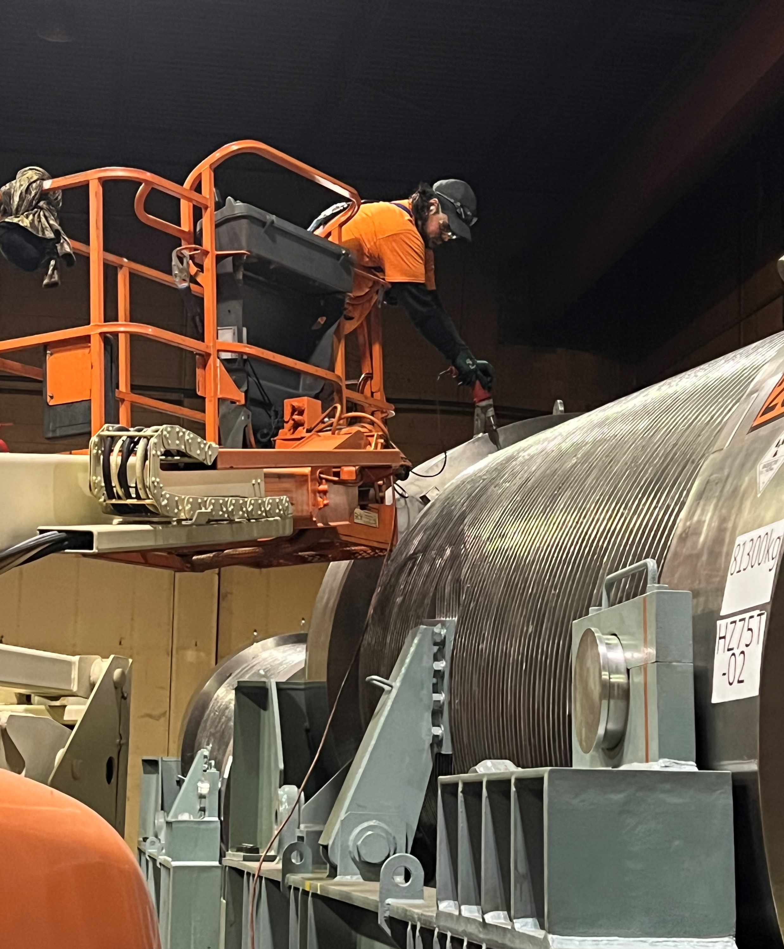
Storage
    Rental of Safe Shop spaces for customer projects
    Storage of equipment – service includes inventory and decon as required
    Support and license use – the site is accustomed to serving as a maintenance and decon shop for customers looking to have support staff focused on their project/goal.

Slide 5
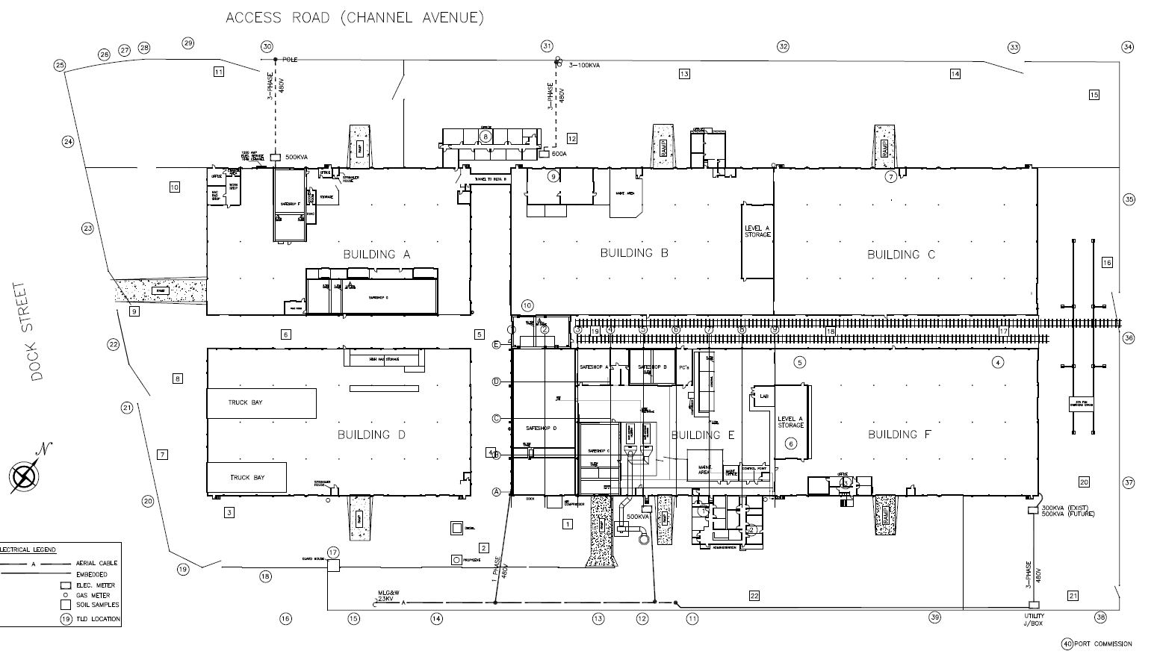

Slide 6
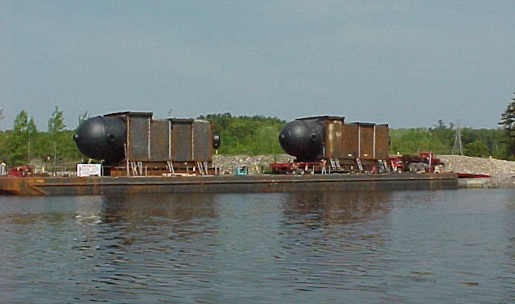
Offerings
Equipment Storage – Outage Equipment, long-term storage of back-ups, temporary storage for transfer between sites utilities that use Flowserve for pump/seal refurbishment sometimes choose to store while drafting PO for repair or inspection work
Support Work – Site space rental for maintenance, inspections, etc.
Inventory/Release – Work involves inventory and/or unconditional release or decon to meet storage requirements for sites

Slide 7
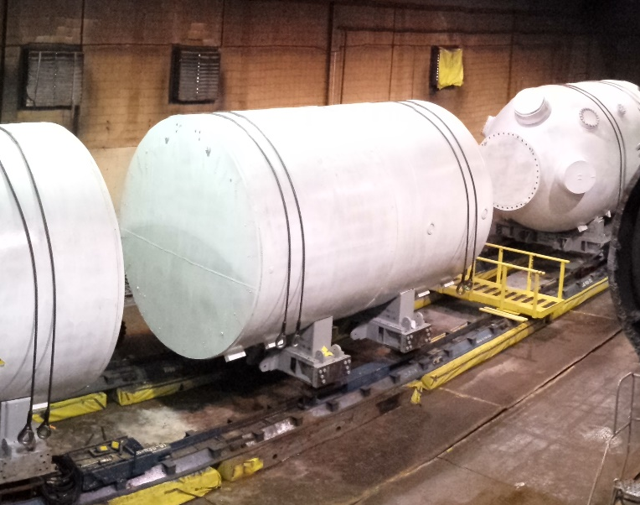
The Memphis site is a projects site:
Serves as a go-between for materials that otherwise don’t comply with the WAC at a downstream process. Focus is on processing to comply with those restrictions to reduce risk to customers
Primary focus is on components segmentation for recycle or disposal. As sustainability becomes more and more important Memphis Processing is rising to the challenge to provide solutions to avoid disposing of valuable metals and other resources that could be reused.

Slide 8
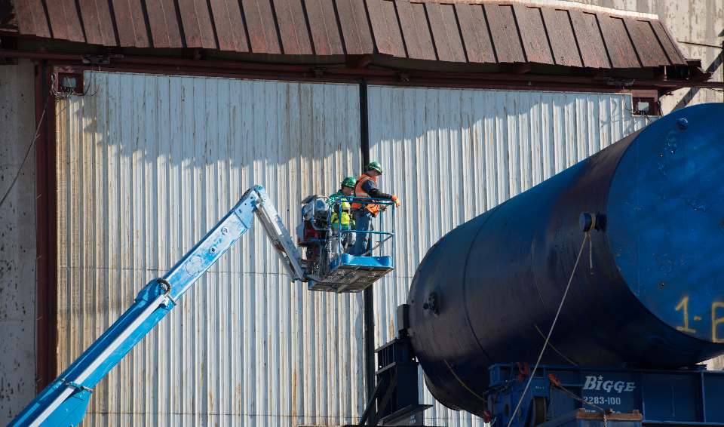
Memphis Processing – Forms and Types of Waste accepted under the WAC:
DAW
Metals
Resins – BWAP and/or Disposal
Liquids – Accepted only when contained within a component
Asbestos waste for both BWAP and Clive disposal
Soils
Sludges – Wastewater, Sewer, Pond, etc.
Building Debris

Slide 9
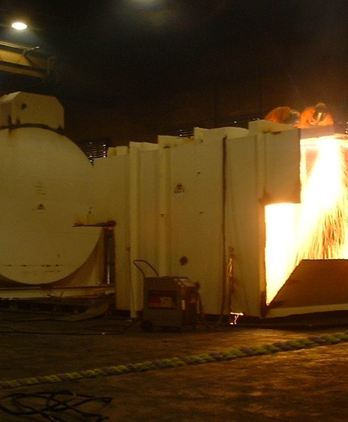
Memphis Processing – Items Requiring Special Approval:
Waste types not listed above
Metals/DAW >200 mR/hr contact dose rate
SNM/Source Material
High Smearable Contamination, Hot Particles and Activated Materials
Material intended for Trans-shipment
First time profiling through BWAP
Special Projects – Component decontamination for release, materials segmented and processed through multiple WAG’s, etc.
Lead acid batteries/computer parts – Considered for unconditional release, failure material disposed or returned as hazardous waste

Slide 10
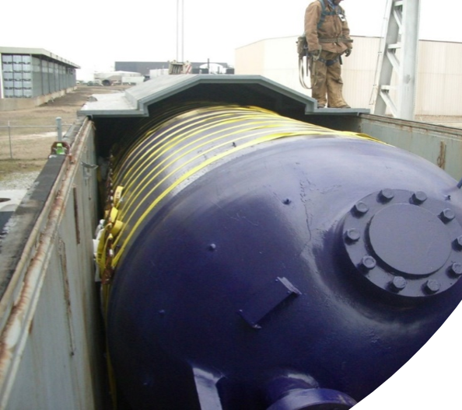
Memphis Processing - BWAP
Bulk Waste Assay Program requirements:
  Profiling – Required for new waste streams, and requiring renewals for existing ones.
  Sampling Changes – The disposal site has some very specific requirements we need to meet on our profiles with them with regards to sampling for disposal of soils, gravel and sludges:
TCLP Metals
SVOA
VOA
Total PCB’s
Total PFAS
Sulfur

Slide 11
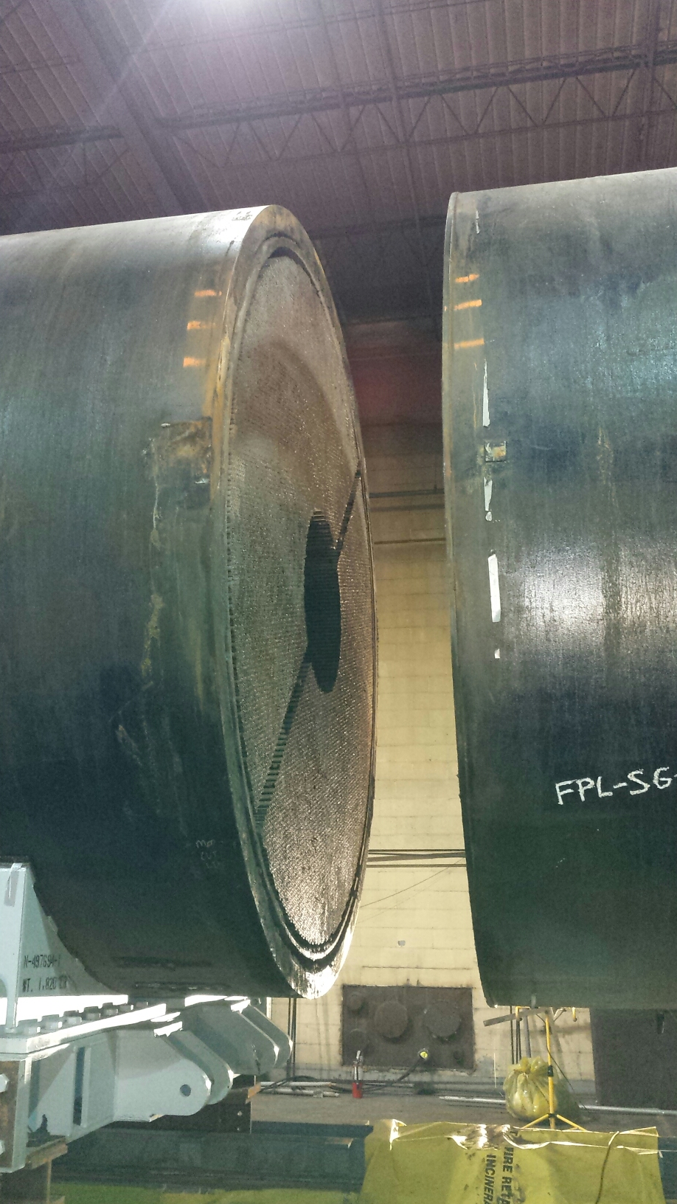
Memphis Processing - BWAP
Standard requirements for materials considered for BWAP Processing:
1. Surface radiation dose of less than or equal to 50 microrem/hr
2. Loose contamination under 1000 dpm/100 cm^2 3. Beta-Gamma
4. No standing liquids
5. No oils
6. Homogenous materials/density
7. Asbestos labeling

Slide 12
CONTACTS:
Lakisha Brooks – Shipping & Scheduling
Phone: (901) 343-8078 lrbrooks@energysolutions.com
Ralph H. Pena – Director of Operations
Phone: (901) 343-8041
Email: rhpena@energysolutions.com
Te’Koa Price – Radiation Safety Officer
Phone: (901) 343-8063
Email: tkprice@energysolutions.com

