Slide 1
2026 WAC Summit
Clive Facility WAC Training
Tim Orton
Jake Gardner

Slide 2
EnergySolutions’ Waste Acceptance Criteria and Customer Portal Overview
Technical Services Contact Information
Tim Orton Director of Technical Services 801-649-2144
torton@energysolutions.com 801-209-7251 (cell)
Jake Gardner VP of Technical Services 865-220-1207
jhgardner@energysolutions.com 801-836-1555 (cell)
Veronica Pitts Technical Services Customer Specialist 801-649-2139
vpitts@energysolutions.com 801-573-1707 (cell)

Slide 3
Clive Facility Waste Acceptance Process
Profile
Shipment
Receipt/Inspection/Sampling
Treatment/Disposal
  COD

Slide 4
EnergySolutions’ Waste Acceptance Criteria and Customer Portal Overview
Clive Waste Acceptance Process
Generator Characterizes their Waste
  Radiological, chemical and physical properties
  General waste stream categories
    Soil / Soil-like
      Less than four-inch size
      Bulk density greater than 70 pcf
      Compactible, passing standard tests (90% Proctor)
    Debris - Standard or Oversized (OS)
      OS Debris: Greater than 10” in any dimension and/or greater than 12’ in a single dimension
    Liquid – Needing Solidification
    Mixed Waste (MW)
      Previously treated MW (including formerly characteristic managed as LLRW)
      MW needing treatment
    PCB wastes
      Mixed Waste or LLRW?

Slide 5
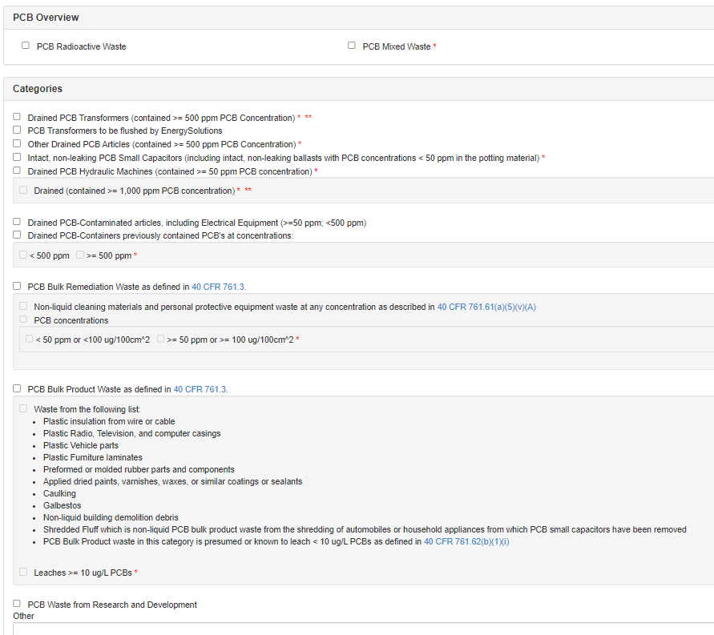
EnergySolutions’ Waste Acceptance Criteria and Customer Portal Overview
Clive Waste Acceptance Process - PCBs
40 CFR 761
Many Categories
  Bulk Remediation Waste
  Bulk Product Waste
  Transformers
  Capacitors
PCB Radioactive Waste or PCB Mixed Waste
Many Require MW Disposal and Manifest
See Asterisks on Form
Detailed information in the WAC Technical Support Document

Slide 6
EnergySolutions’ Waste Acceptance Criteria and Customer Portal Overview
Clive Waste Acceptance Process
Log into Customer Portal and Prepare/Submit Waste Profile
  Contact Technical Services for initial set-up
  Customer Portal Permissions
    Profile: View; Create/Edit
    Order: View; Create/Edit; Upload Manifests; Return Signed Manifest
    User: View; Create/Edit
EnergySolutions Review and Approval
  Formal evaluations by Technical Services, RSO, Environmental Compliance, Clive Operations and Safety
  Allow approximately one week for review. Can be expedited.
Signed Disposal Contract/Delivery Order
  Subsequently checked when shipment scheduled
Notice to Transport Issued
  CP-generated form (authenticated electronic signature) – in the profile’s Attachment tab

Slide 7
EnergySolutions’ Waste Acceptance Criteria and Customer Portal Overview
Customer Portal Waste Profiling
Specific to waste types (LLRW, MLLW, TSCA Regulated PCB’s)
Specific to composition and required management
  Debris, Oversized Debris, Soil, Hazardous Debris, Liquids, Treatment, etc.
Include detailed descriptions in the waste narrative
Chemical analytical data - Required
  Utah Certified, or NELAC/NELAP Laboratory
  Process Knowledge may be used
No “all encompassing or blanket profiles” that cover multiple waste streams
  Accurate representation of the waste that will be shipped.
Any questions, contact Technical Services

Slide 8
EnergySolutions’ Waste Acceptance Criteria and Customer Portal Overview
Customer Portal Waste Profiling – Chemical Data
Required Analytical Data
LLRW MW
pH (Liquids only) pH (Liquids only)
PFLT (Solid Waste only) PFLT (Solid Waste only)
TCLP Metals Organics (8260/8270 Total)
TCLP Volatile Organics Results showing why the waste is hazardous
TCLP Semi-Volatile Organics (e.g., TCLP Cr for D007)
TCLP Herbicides PCBs (Total, if applicable)
TCLP Pesticides
PCB’s (Total, if applicable)
NOTES:
  Certified process knowledge may be used in place of analyses
    This process knowledge should be written into the profile narrative
  PFLT may be performed through process knowledge or a visual inspection
  Total analytical results divided by 15 may be used

Slide 9
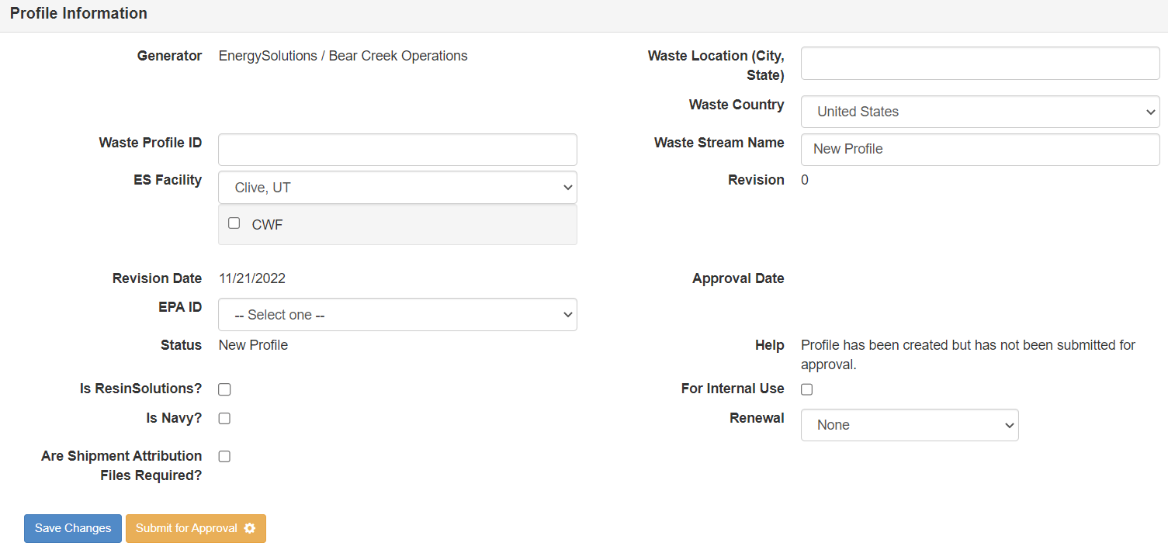
EnergySolutions’ Waste Acceptance Criteria and Customer Portal Overview
Customer Portal Waste Profiling
Customer Portal
  Electronic Forms
General Information
  Site Location
    Compact
  Waste Stream Name
  Waste Profile ID
    XXXX-YY
  EPA ID Number

Slide 10
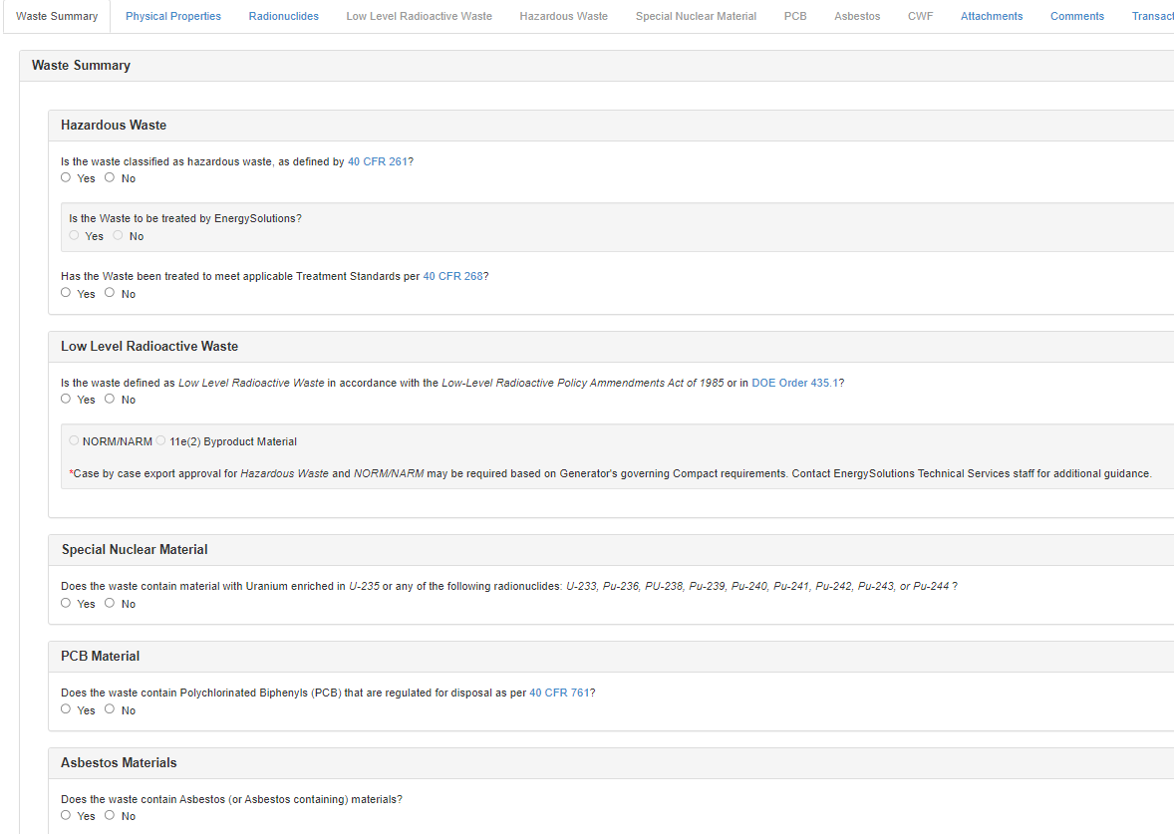
EnergySolutions’ Waste Acceptance Criteria and Customer Portal Overview
Customer Portal Waste Profiling
Waste Summary
  Hazardous Waste?
    Needing Treatment?
    Been Treated?
  LLRW / NORM / 11e.(2)?
    Compact (RM)
  SNM?
  Regulated PCBs?
  Asbestos?

Slide 11
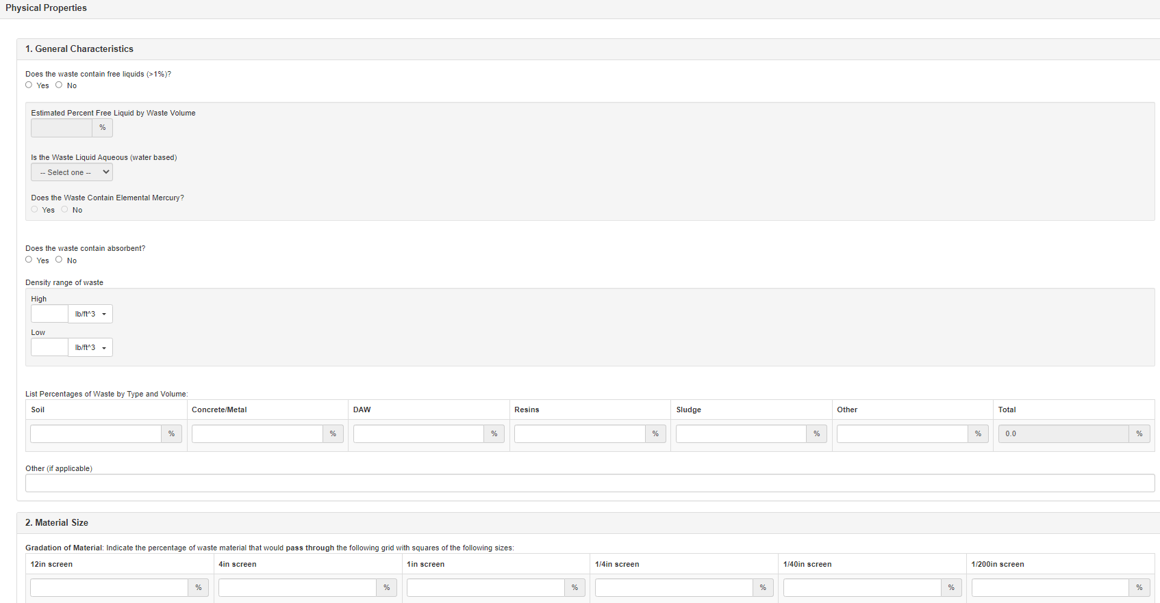
EnergySolutions’ Waste Acceptance Criteria and Customer Portal Overview
Customer Portal Waste Profiling
Physical Properties
  Free Liquids (>1%)?
    Aqueous? Mercury?
  Absorbent Present?
  Density and Volume
  Waste Type and Size
    OS Debris?
    Large Component Info
  Moisture Content
  Transport Mode and Containers

Slide 12
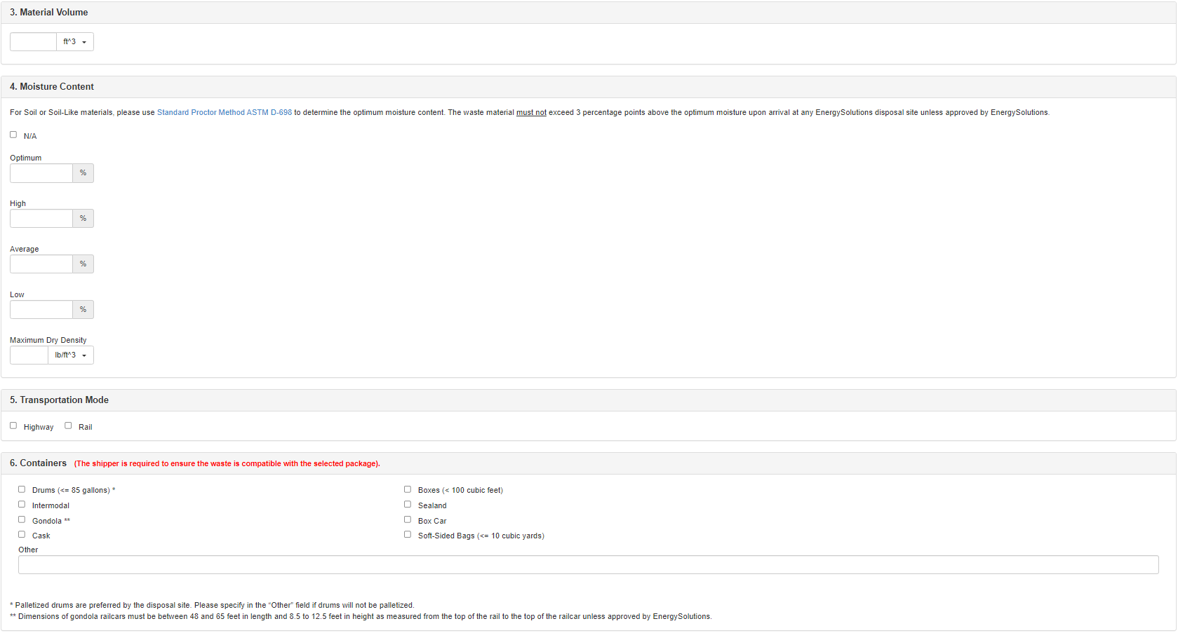
EnergySolutions’ Waste Acceptance Criteria and Customer Portal Overview
Customer Portal Waste Profiling
Physical Properties
  Moisture Content
  Transport Mode
  Containers
    Palletized?
    All bags on pallets
      Safety Issue

Slide 13
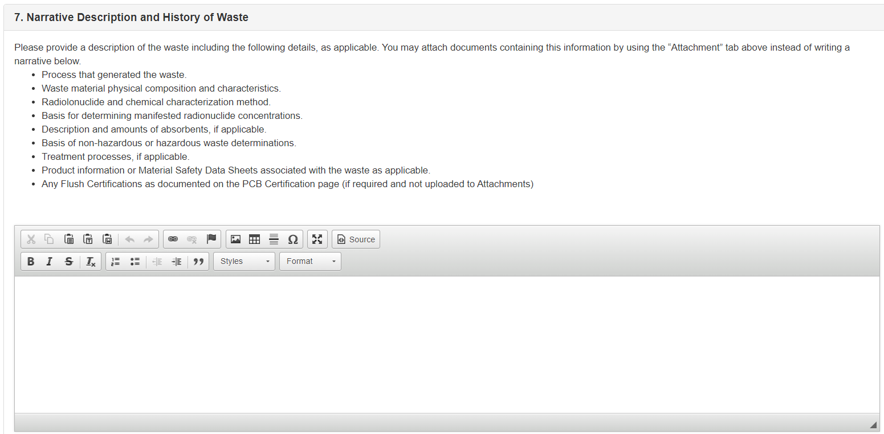
EnergySolutions’ Waste Acceptance Criteria and Customer Portal Overview
Customer Portal Waste Profiling
Physical Properties
  Narrative
    Detail on the waste
    Include all hazards
      Beryllium
      Asbestos
      Hot Particles
      High Contamination
      Chemicals
      Sharps
      Etc.

Slide 14
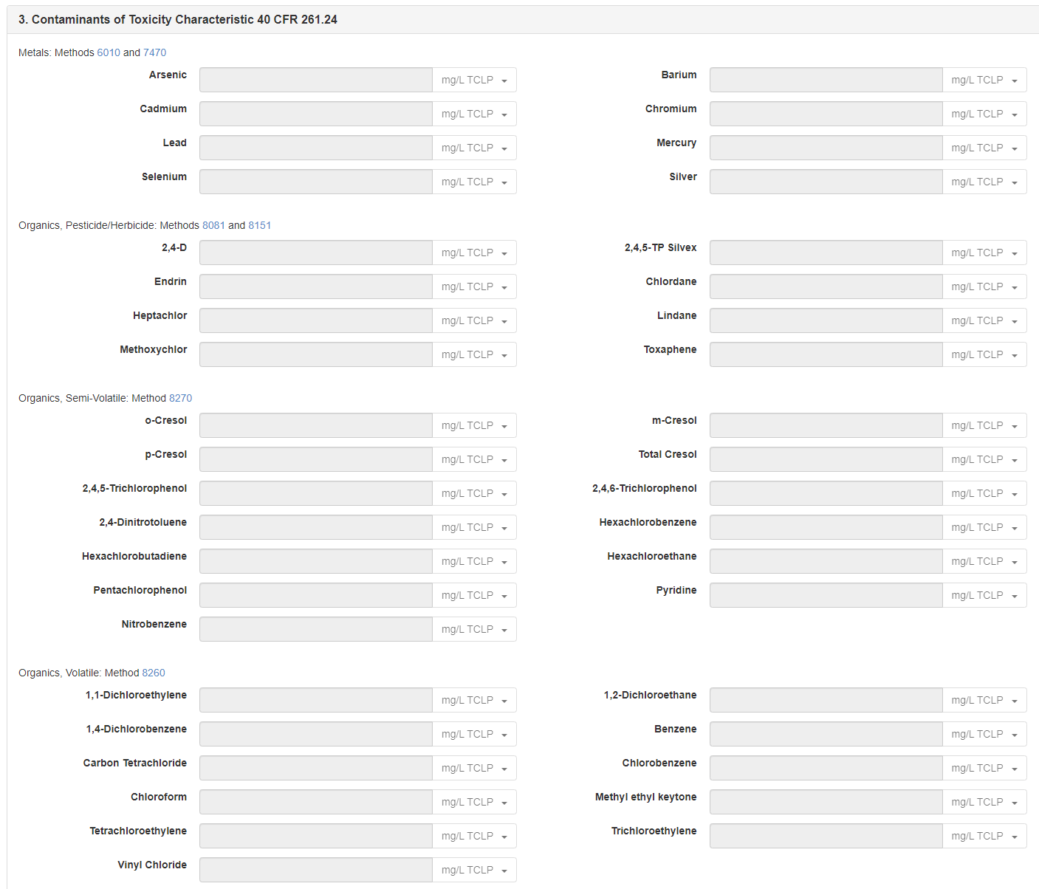
EnergySolutions’ Waste Acceptance Criteria and Customer Portal Overview
Customer Portal Waste Profiling
Radionuclides
  Upper and weighted average concentrations (pCi/g)
  Full Class A Profiles – Different than previous
    Contact Technical Services (Magic Button)
Waste Hazardous Contaminants
  LLRW or HW based on Waste Summary Selections
    Both ask for analytical data, or justification if none
    Low-Level Radioactive Waste
      Table of D-List Contaminants
      Former Codes / UHCs / Other / Lab Certification

Slide 15
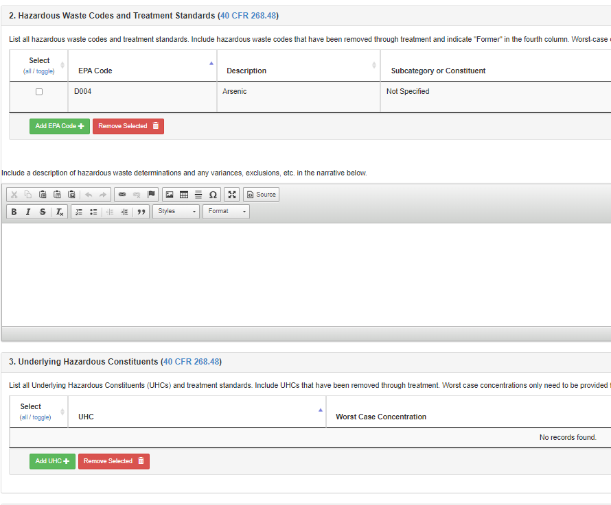
EnergySolutions’ Waste Acceptance Criteria and Customer Portal Overview
Customer Portal Waste Profiling
Waste Hazardous Contaminants
  Hazardous Waste (MW)
    Hazardous Waste
      Hazardous Waste Codes and worst-case concentrations
      PFLT / pH / Distinguishing color or odor
      UHCs / Other / Lab Certification

Slide 16
EnergySolutions’ Waste Acceptance Criteria and Customer Portal Overview
Customer Portal Waste Profiling
Other Information (Tabs)
  Special Nuclear Material (SNM)
  PCBs
  Asbestos
    Friable? 40 CFR 61 Subpart M
      Tight container – no double bag
  Attachments
    Analytical Data
    SDSs
    Pictures / Drawings
    Site-Specific Logs
    NTT (Auto)

Slide 17
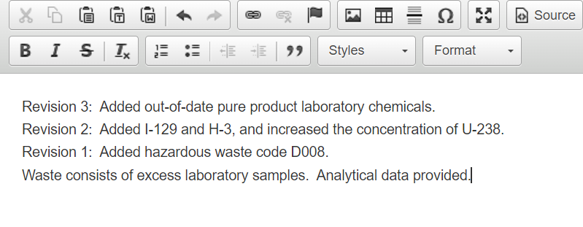
EnergySolutions’ Waste Acceptance Criteria and Customer Portal Overview
Profiling Revisions
Three Options: (Full Profile Revision, TS Edit, or Automatic Revision)
  Full Profile Revision
    Adding many isotopes, greatly increasing concentrations, adding codes, etc.
    Requires full EnergySolutions review
    New NTT
  Please provide explanation
of all revisions in the narrative →
  TS Edit
    Minor - adding an “Other Chemical Constituent” or a couple of isotopes, small concentration increases, etc.
    Contact Technical Services if you think it only requires a TS Edit (or we may contact you)

Slide 18
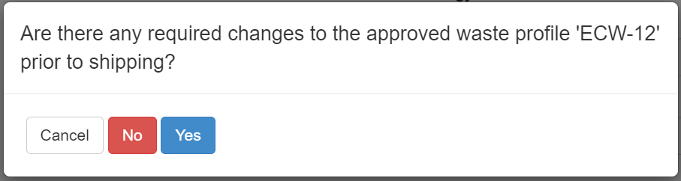
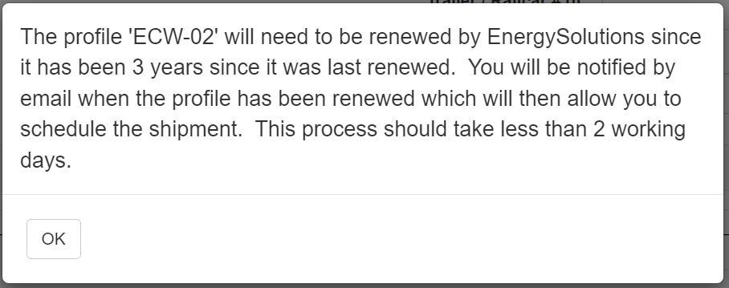
EnergySolutions’ Waste Acceptance Criteria and Customer Portal Overview
Profiling Revisions
Automatic Revision
  Full profile review required every three years
    Pop-up box when scheduling
      Need Profile Create/Edit rights
      Years one and two ask if anything changed
        If Yes, profile revision will be required
      Third-year will require a full review before shipping

Slide 19
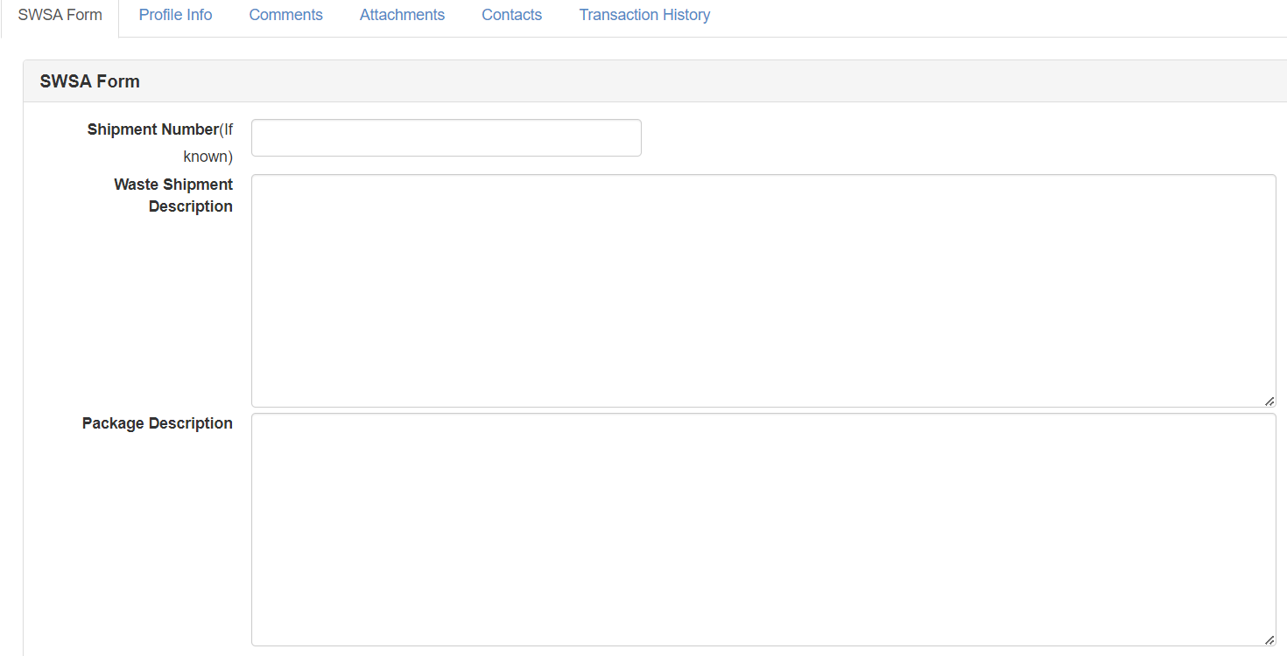
EnergySolutions’ Waste Acceptance Criteria and Customer Portal Overview
Special Waste Shipment Authorization (SWSA)
Situations that require extra attention by Clive
  Shipment Specific
  Safety
  Special Container/Items needing returned
  WAC Exceedances (e.g., ALARA Criteria)
Can be done at the Profile Level or Shipment Level
Requestor must have Profile Create/Edit authorization
Radiological Information
  Highest Removable Contamination Levels
    Alpha dpm/100 cm²
    Beta/Gamma dpm/100 cm²
  Highest Dose Rates
    Contact and 30 cm (mrem/hr)
One SWSA per shipment
SWSA will be bound to the shipment
  Need to contact Technical Services if otherwise

